Slide 1
Italian Nursery School
Conceptual Design Analysis

Slide 2
Project Requirements
The design challenge was to create a nursery school
to achieve "CasaClima A" certification.
Energy Goals: Less than 30 kWh/m²y for heating –

Slide 3
Design Concept
The team’s concept was a series “little houses”
The design has sloped roofs and small windows, and the building materials are primarily local stone and wood.
Based on the analyses, the team was able to determine a site placement and building layout that took advantage solar insolation and protected the site from harsh winter winds.

Slide 4
Design Process & Tools
Autodesk Revit Architecture was used as the main modeling tool
Autodesk Ecotect Analysis was utilized to do preliminary site analysis and natural lighting analysis.
Autodesk Vasari was used to compare different mass forms based on architectural and energy requirements

Slide 5
Building Orientation
Using the Ecotect Optimum Orientation tool, the team found that the best orientation was 160°. Based on this value, a NE-SW orientation was chosen.
Ecotect Optimum Orientation based on solar radiation values
Solar Solstice (left) and Winter Solstice (right)

Slide 6
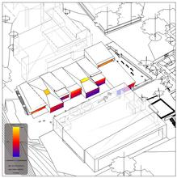
Solar Insolation Analysis
From Vasari, the cumulative solar radiation during the winter showed available insolation as 120 kWh/m².
From this analysis, it was determined that the solar radiation on the exterior walls could be used to warm the interior spaces

Slide 7
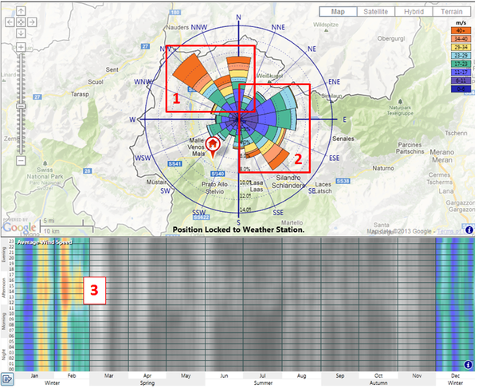
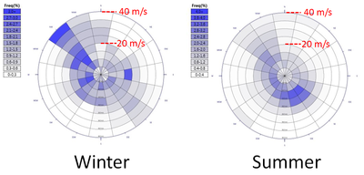
Wind Analysis
The winds in Sluderno can be very strong, especially in the winter. The building and courtyard needed to be protected from these winds.
Using the wind-rose tool within Vasari, an analysis of the winter months yielded some additional insights.
The single highest frequency winds are very fast at over 40 m/s (90mph), and come from the northwest (and north).
2) There’s also a significant southwest wind during the winter but they are slower (in the range of 5-17 m/s, 11-38 mph).
3) The coldest winds occur in January and February, and occur in the afternoon (between noon and 5pm).

Slide 8
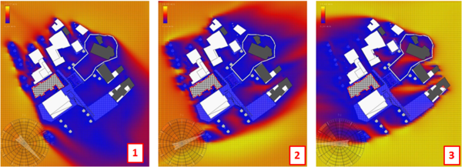
Using the wind tunnel tool in Vasari, the team visualized the effect of the surrounding buildings and environment on the winter wind patterns.
Vasari wind tunnel was used to design a shielded courtyard.
The nursery school is protected from NW and N winds by the adjacent municipal buildings and trees.
No protection is provided for WSW winds, so trees were placed on the western end of the courtyard.
There is limited protection from E winds, so the longest and highest part of the building was placed to the east.

Slide 9
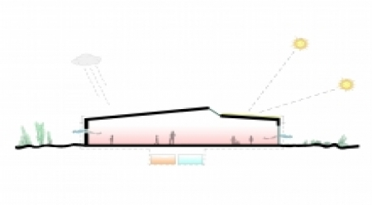
Thermal Envelope Performance
The requirements by CasaClima are that wall assemblies have a total thermal transmittance of less than 0.8 W/m2K, with windows required to have a U-value between 1.4 and 2.0 W/m2K.
The team met and exceeded the prescriptive envelope requirements of CasaClima.
Because of the cold climate, the glass specified uses the low-E coating on the third face (the inside surface of the interior pane) to prevent heat loss from to the outside while still allowing solar gain.

