Slide 1
FLOW DESIGN
Korišćenje softvera na primeru
pešačke zone u Torontu, Ontario, Canada

Slide 2
Wind tunnel settings _wind speed – 4.6 m/s _size of wind tunnel – preporučljivo da bude dva puta veći od modela u svim pravcima
Import the .sat file
simulation settings _simulation resolution -100% _model dimension - meters _display – odgovarajući za model
Model orientation
_z orientation – 45 degrees – za pravac vetra severozapad

Slide 3
Flow around buildings
As wind strikes the surface of a building, the flow typically splits as it flows over and around the building. This results in jetting off of the windward corners and strong vortex formation downstream of the leeward face as the flow streams reattach. Depending on the wind velocity, these flow phenomena can cause pedestrian discomfort, and in extreme cases, be dangerous. The following describes the behavior of the wind flow at several positions relative to the building:
At the windward surface, where the wind first impacts the building, the wind stream splits above and around the sides of the building.
Kako vetar udara o površinu zgrade, tok se obično deli tako što prolazi kroz i oko zgrade. Ovo dovodi do stvaranja vijugavih uglova i jake formacije vretena nizvodno od podloge, dok se ostatak toka sjedinjuje. U zavisnosti od brzine vetra, ovi tokovi mogu uzrokovati nelagodnost pešaka, a u ekstremnim slučajevima mogu biti opasni. Sledeće opisuje ponašanje vetra na nekoliko pozicija u odnosu na zgradu. Na vetrenoj površini, gde vetar prvо udara o zgradu, struja vetra se razdvaja iznad i oko strana zgrade.

Slide 4
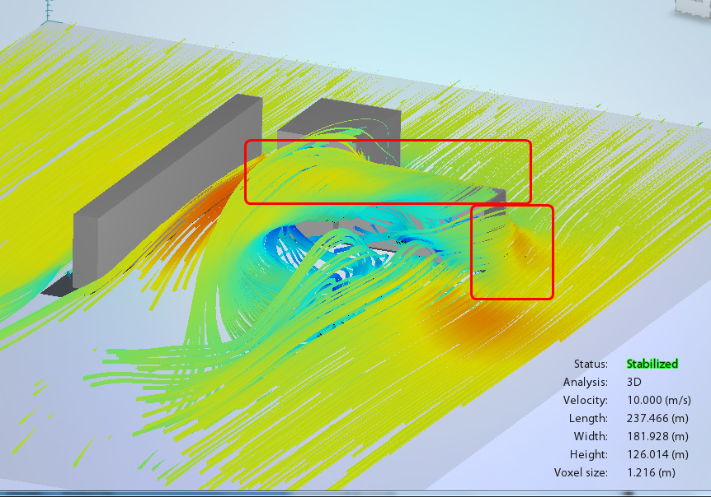

Slide 5
Flow around buildings
The air flow accelerates around the corners of the building. This causes a high speed separated region off the corner and a calmer stagnation region on the sides of the structure:
Protok vazduha ubrzava oko uglova zgrade. Ovo uzrokuje područje sa velikom brzinom odvojenom od ugla i mirniji region stagnacije sa strane strukture:

Slide 6
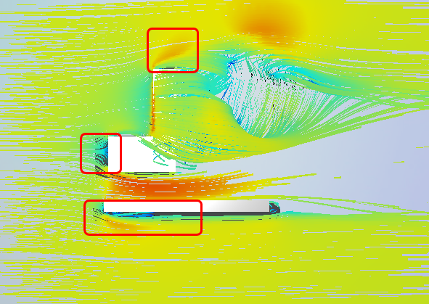

Slide 7
Flow around buildings
The wind flowing over the top of the building descends rapidly on the leeward side:
Vetar koji prolazi iznad vrha zgrade se brzo spušta na bočnoj strani podnožja:

Slide 8
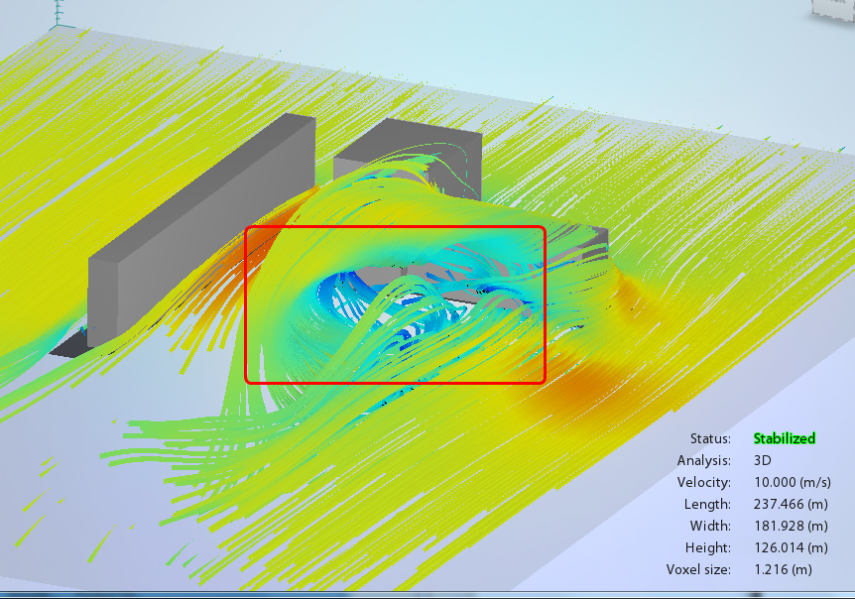

Slide 9
Flow around buildings
As the flow streams over the top and sides of the structure reconnect on the leeward side, vorticies form in the wake region. A stagnation region can occur against the leeward surface, followed by a highly energetic region of vortex flow just downstream of the structure:
Kako se strujni tokovi iznad vrha i strane konstrukcije ponovo spajaju na obodu, vrtlozi se formiraju u dnu . Stagnaciono područje se može pojaviti na površini podloge, nakon čega sledi visoko energetska oblast vrtloga tek nizvodno od strukture:

Slide 10
