Slide 1
Wind Analysis in BIM

Slide 2
Building Performance Analysis (BPA)

Slide 3
Insight Energy Optimization
Insight is an analysis tool that provides information about your building’s projected energy use and the energy costs associated with meeting that demand.
Insight’s Generate tool
Insight’s Optimize tool

Slide 4
What are the inputs you need?
The building geometry
The thermal performance
The occupancy of the building
The properties of the climate
The energy sources available at the building's location

Slide 5
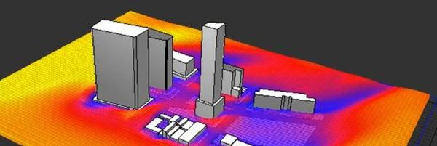
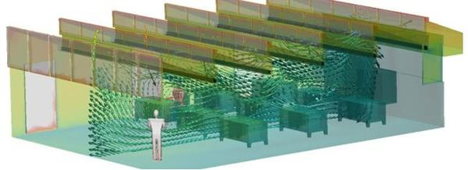
Wind Analysis in BIM
External airflow analysis
How to mass and orient a new building
How to design courtyards
What site elements like walls, trees, and landscaping can help improve the wind flow patterns
where to place openings
estimate the impact of wind
Internal airflow analysis
What is the expected airflow rate and temperature at a given location of your model
active HVAC systems

Slide 6
Flow Design in Revit
computational fluid dynamics (CFD) tool that integrates with Autodesk Revit
simulate air speeds and pressures around a building site
set up the wind tunnel.

