Slide 1
Views

Slide 2
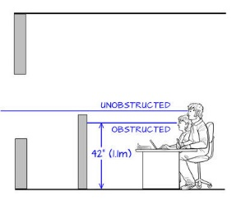
Views should not be obstructed by furniture or walls in the room.
While some people may be tall enough to see over obstructions, an average height should be assumed.

Slide 3
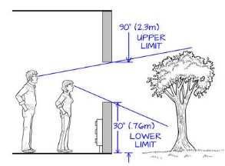
View glazing must be within certain heights to see out of it.

Slide 4
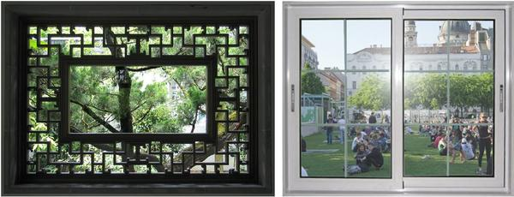
Views of nature and social space

Slide 5
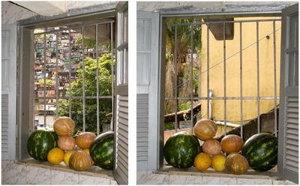
Two angles on the same view, with more and less complexity; also showing vertical bars breaking up the view

Slide 6
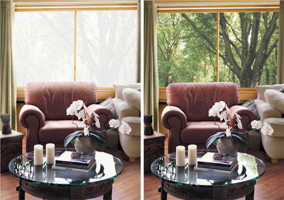
Glare mitigated by tinted windows

Slide 7
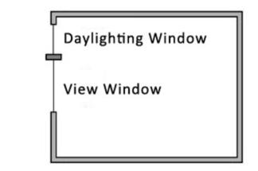
Daylighting window vs. view window

