Slide 1
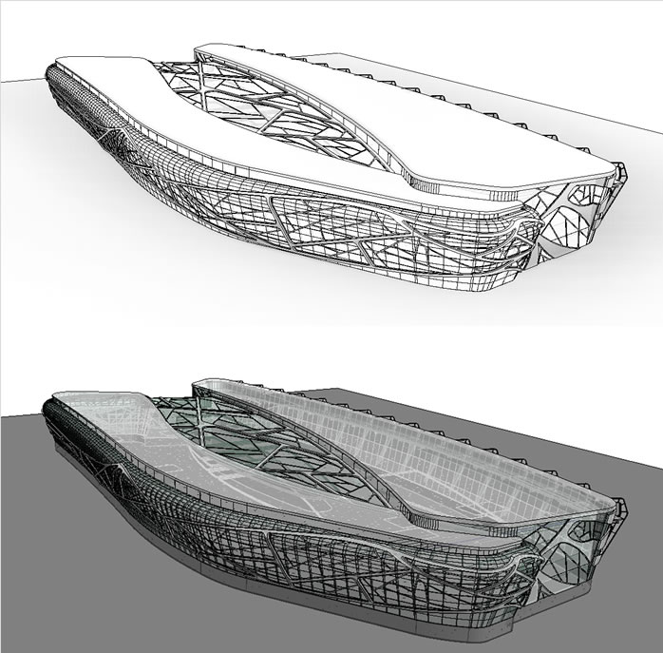
REVIT Architecture 2012
Kurs: Principi CAAD-a, Predavanje 7
Univerzitet u Beogradu, Arhitektonski fakultet
Uvod
Sistem templejta
Familije elemenata
Multikorisničko radno okruženje
Rad sa konsultantima
Razmena informacija sa drugim softverima
Dr Mirjana Devetakovic, dipl. Inž. Arh.
Beograd, 2012

Slide 2
> Principi
Princip 01: Dinamičan razvoj CAAD-a
Princip 08: Objektno orijentisani CAAD
Princip 02: Približavanje korisniku
Princip 09: BIM
Princip 03: Slika kao sredstvo saopštavanja arhitektonske ideje
Princip 10: Integrisano projektovanje
Princip 04: Preciznost i brzina
Princip 11: Interoperabilnost
Princip 05: Crtež kao document i sredstvo saopštavanja arhitektonske ideje
Princip 12: NURBS modeliranje
Princip 13: Matematičko definisanje kompleksne forme
Princip 06: Efikasnost u izmenama tokom procesa projektovanja
Princip 14: Parametarsko modeliranje
Princip 07: Model kao sistem informacija i sredstvo saopštavanja arhitektonske ideje
Princip 15: Fabrikacija

Slide 3
> Uvod

Slide 4
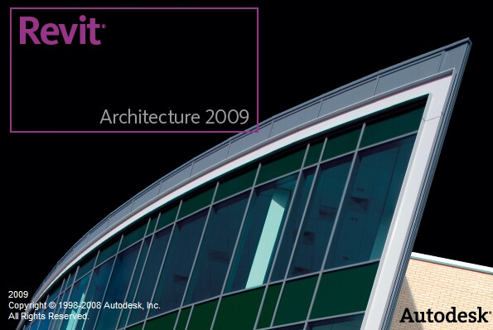
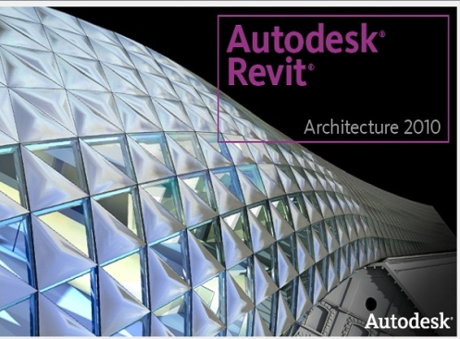
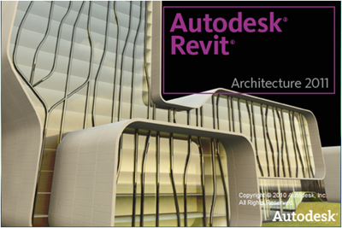
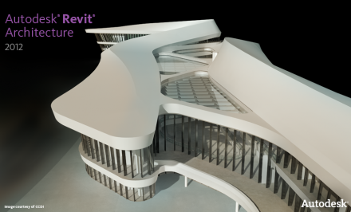
> Razvoj Revita
1989 – Parametric Technology Corporation (AEC indistry, CAD/CAM)
2000 – Revit Technology Corporation (prva verzija Revit 1.0)
2002 – Autodesk kupuje softversku kuću RTC
2002 – 2008 R&D: AutoCAD-Revit
2008 – Revit Architecture 2009 – BIM (building information modelling)
2009 – Revit 2010
1010 – Revit 2011
2011 – Revit 2012

Slide 5
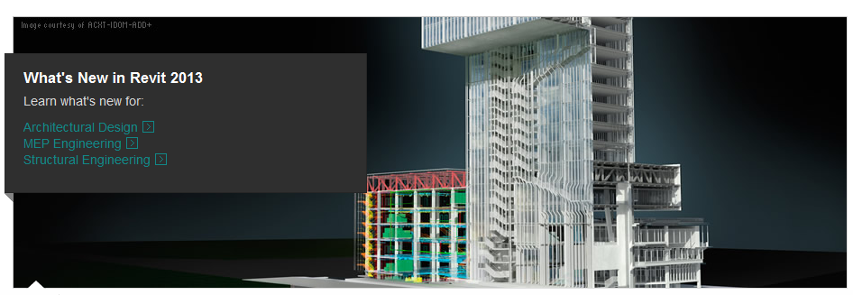
http://usa.autodesk.com/revit/#

Slide 6
BIM DEFINITIONS:
Building Information Modeling is truly about Information. Information put into the model and information extracted from the model. (SmartBIM)

Slide 7
BIM DEFINITIONS:
A building information model (BIM) is a digital representation of physical and functional characteristics of a facility. As such, it serves as a shared knowledge resource for information about a facility, forming a reliable basis for decisions during its lifecycle from inception onward.
A basic premise of BIM is collaboration by different stakeholders at different phases of the lifecycle of a facility to insert, extract, update or modify information in the BIM process to support and reflect the roles of that stakeholder.
The BIM is a shared digital representation founded on open standards for interoperability.
(USA National BIM Standard)

Slide 8
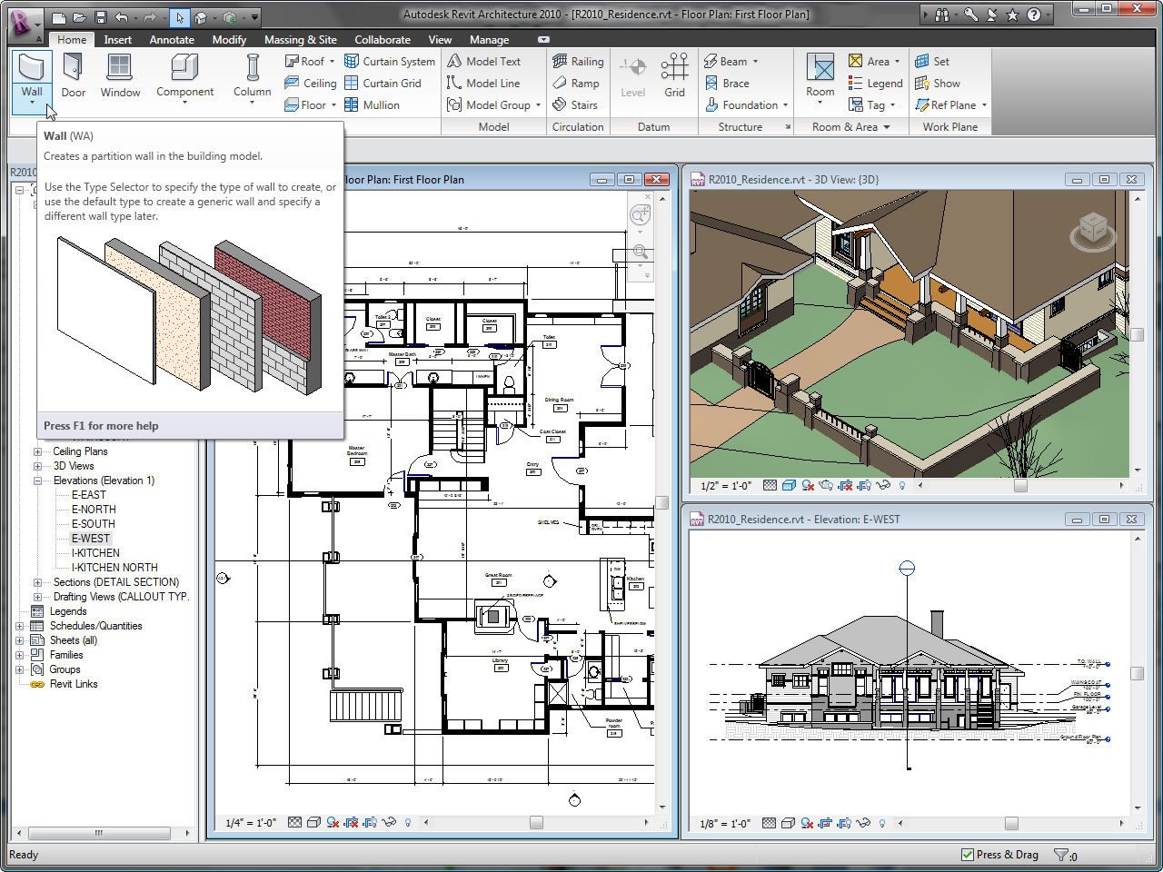

Slide 9
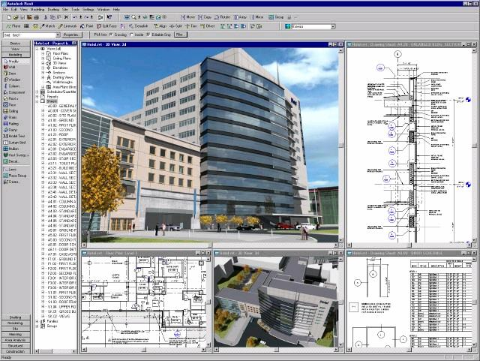

Slide 10
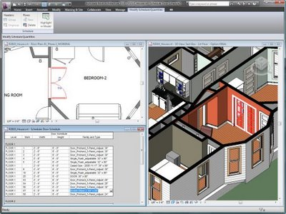

Slide 11
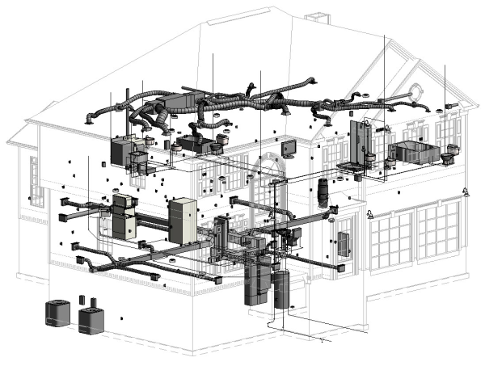
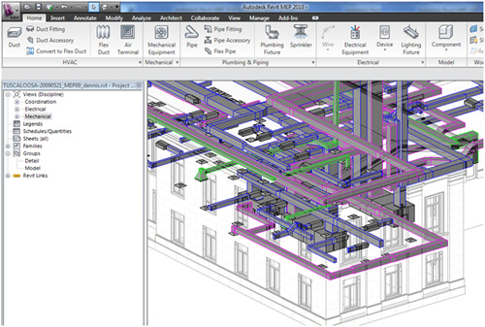
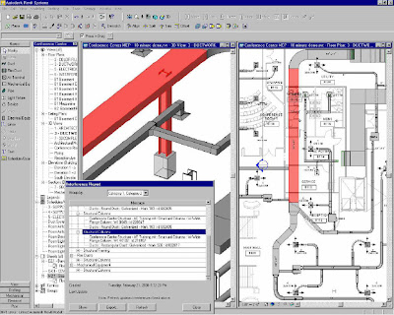
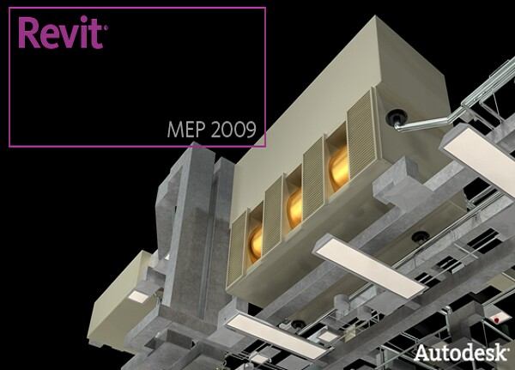
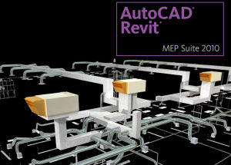
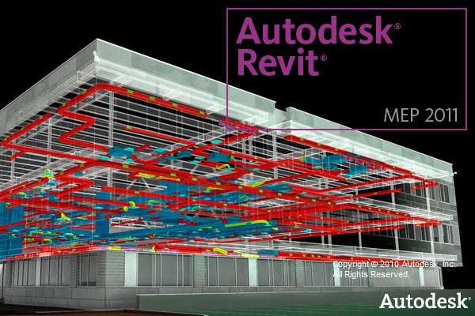
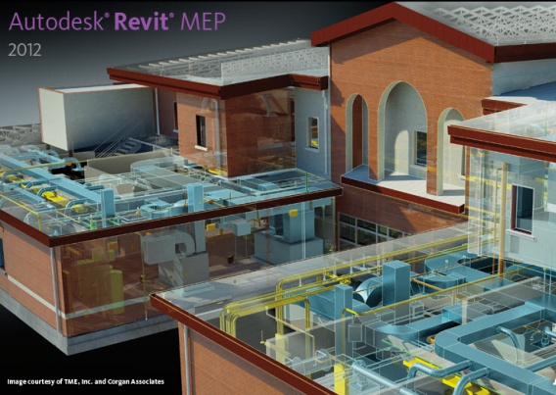
> Revit MEP
Mašinske instalacije
Električne instalacije
Vdovod i kanalizacija

Slide 12
http://www.avanoservices.com/services/mep-design/

Slide 13
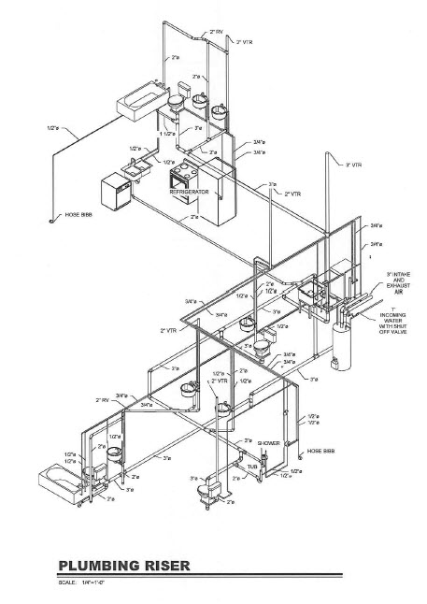
http://www.avanoservices.com/services/mep-design/

Slide 14
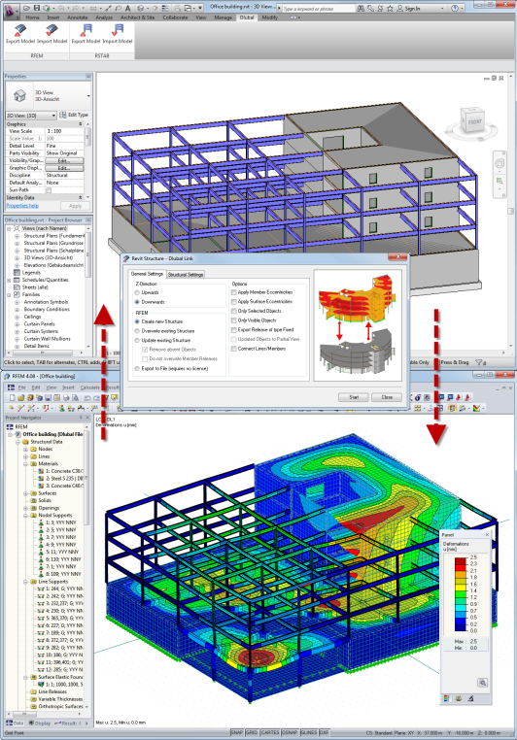
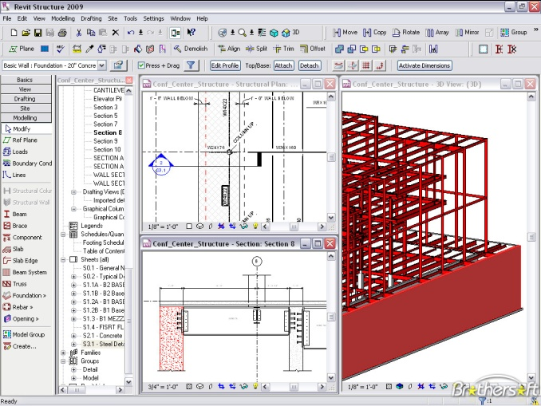
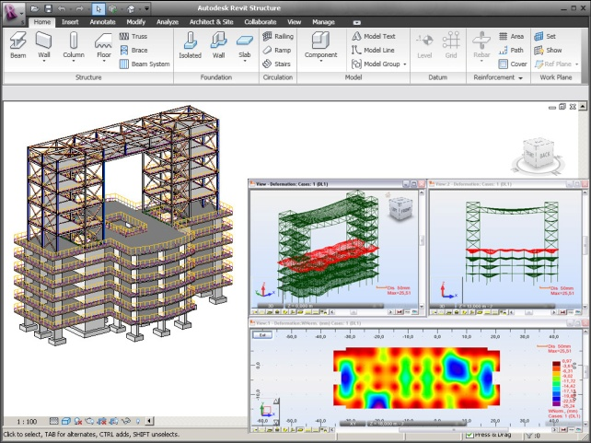
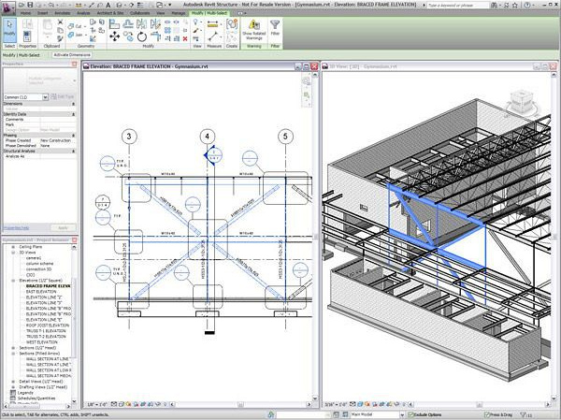
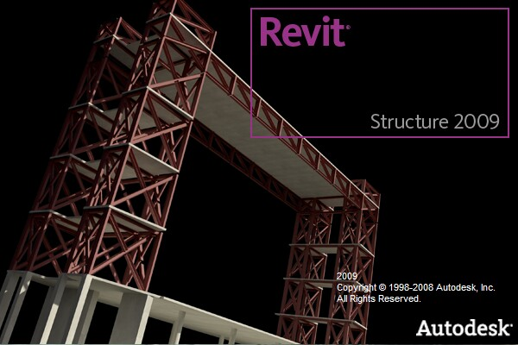
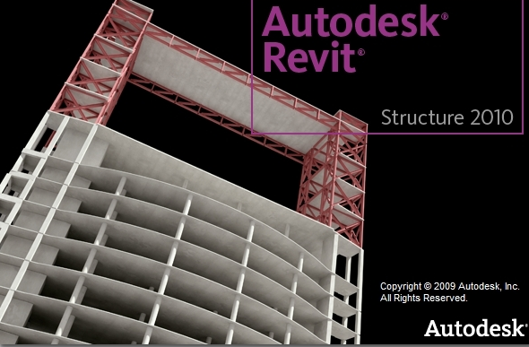
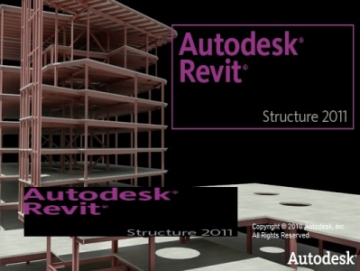
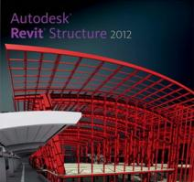
> Revit Structure

Slide 15
> “Top Tips for Implementing Revit Architecture”
http://www.adskmedia.com/revit_2009/

Slide 16
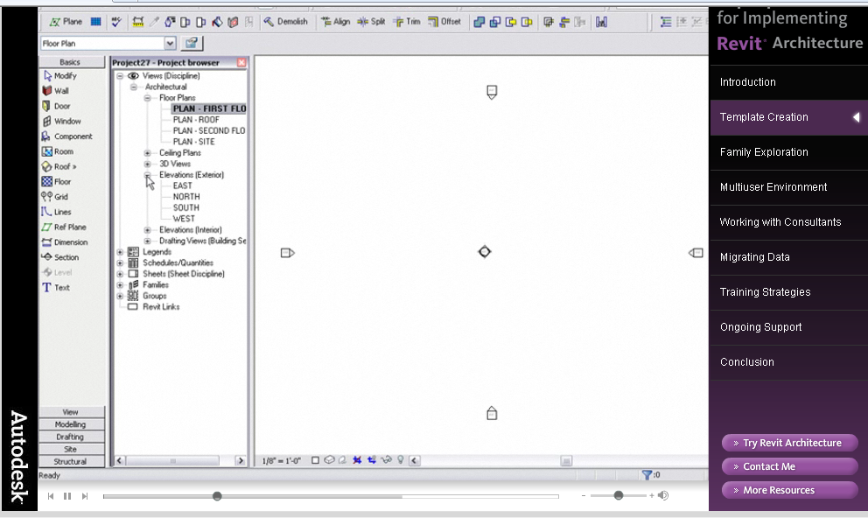
> Predefinisani crteži (Templates)

Slide 17
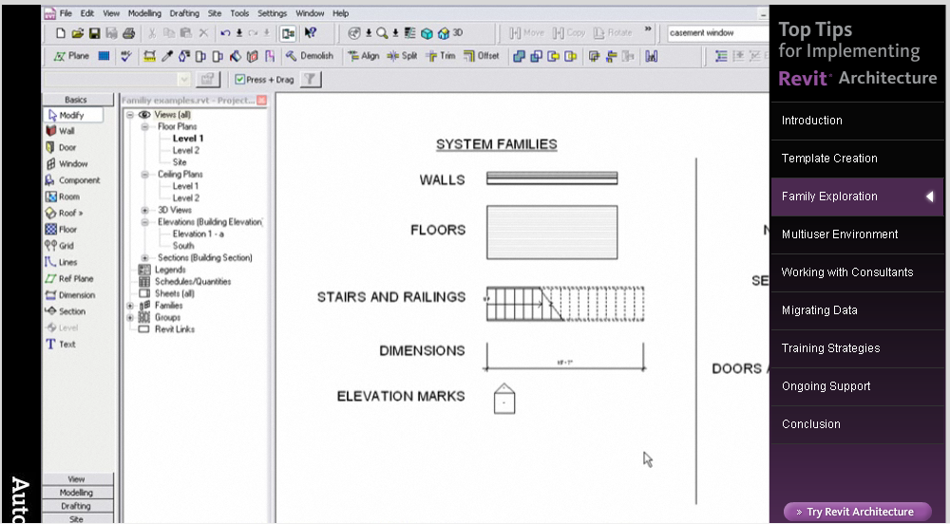
> Familije objekata(Families)
Tri tipa familija

Slide 18
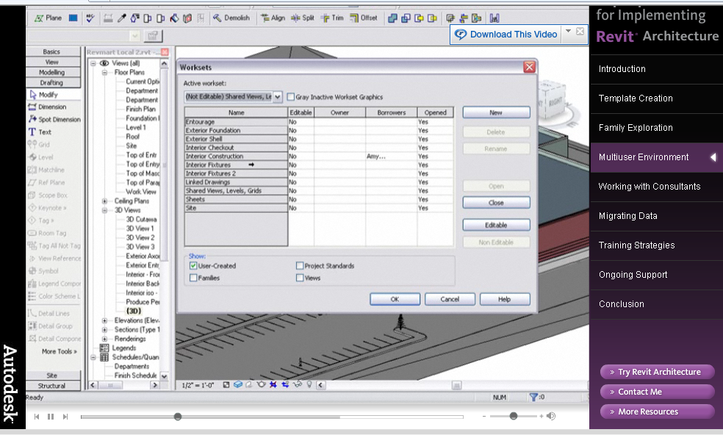
> Multikorisničko okruženje
pristup informacijama

Slide 19
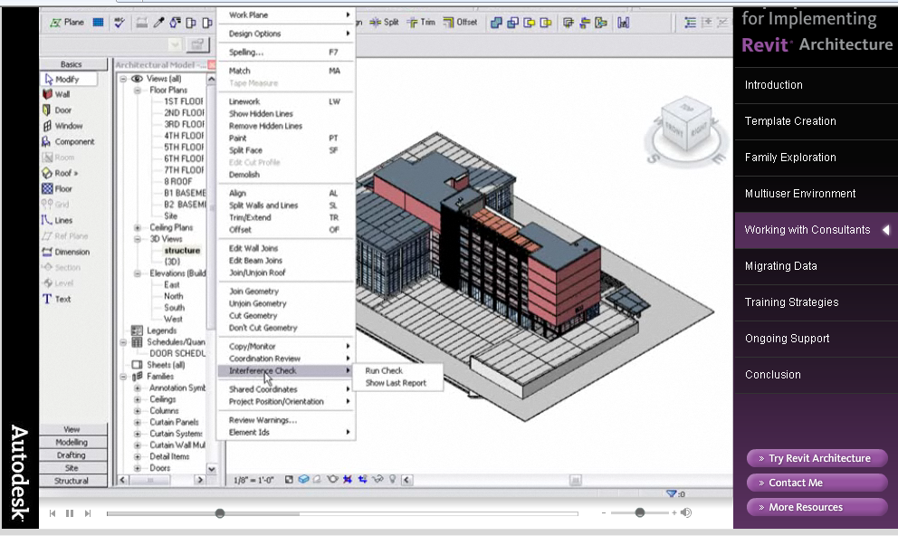
> Saradnja sa konsultantima
Problem usklađivanja informacija

Slide 20
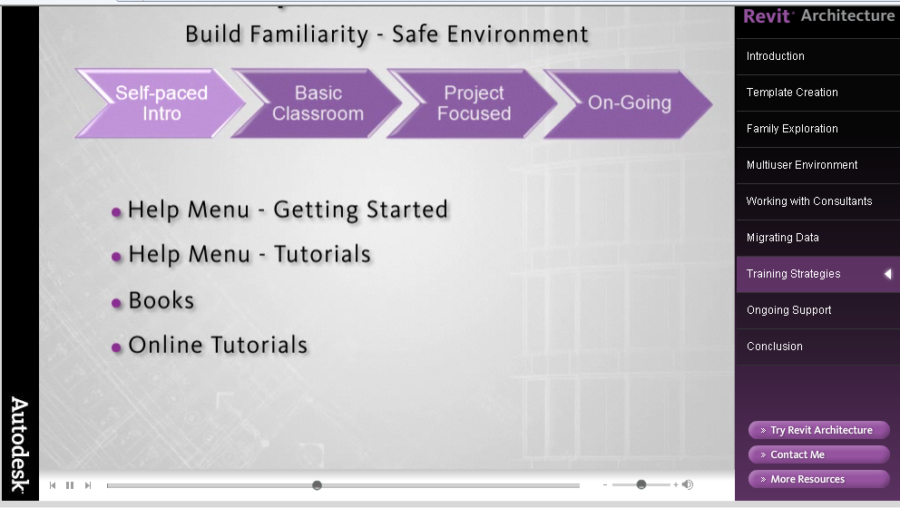
> Obuka (“Revit is not a plug and play software”)
samostalno učenje

Slide 21
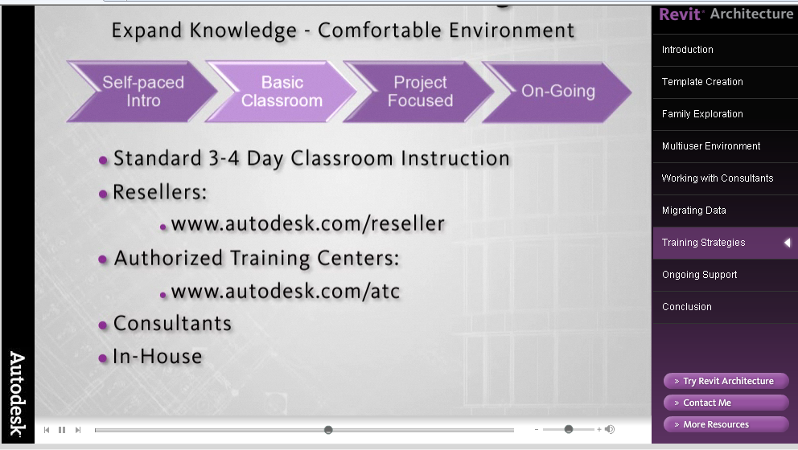
> Obuka (“Revit is not a plug and play software”)
Osnovna obuka

Slide 22
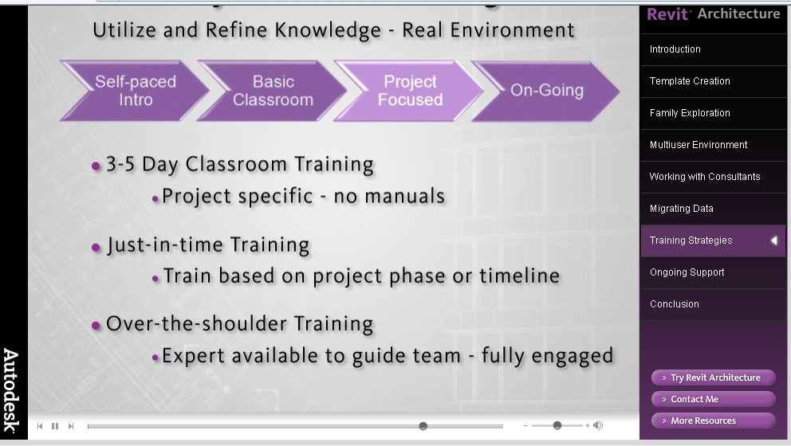
> Obuka (“Revit is not a plug and play software”)
rad na konkretnom projektu

Slide 23
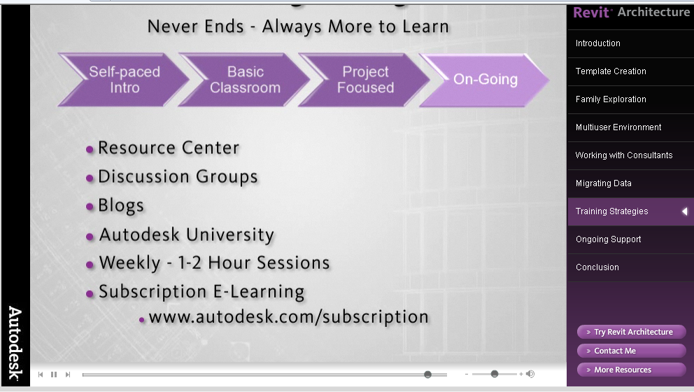
> Obuka (“Revit is not a plug and play software”)
Kontinuirano učenje tokom korišćenja u praksi

Slide 24
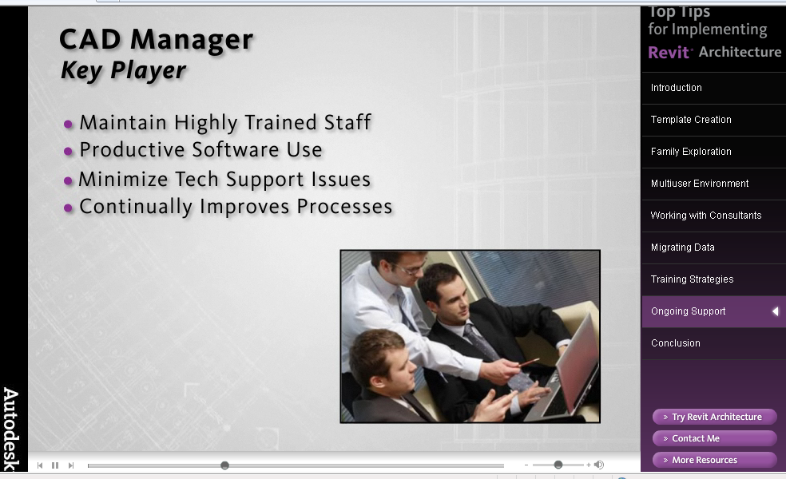
> Podrška
Uloga CAAD menadžera

Slide 25
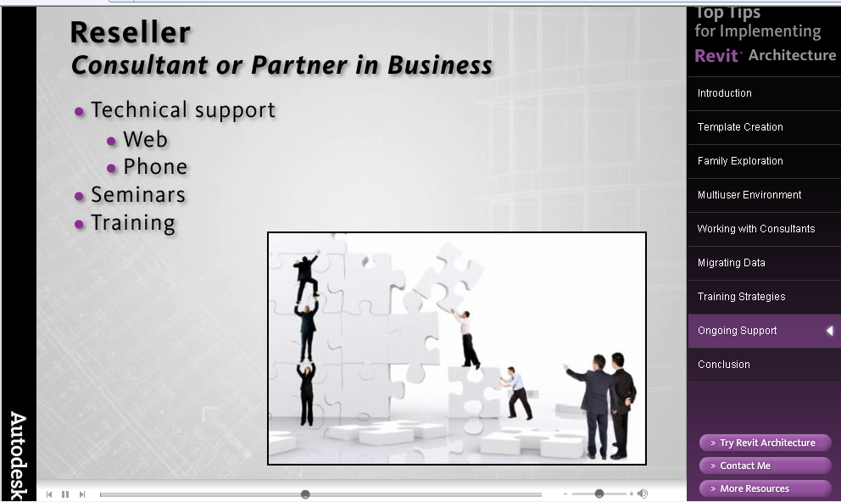
> Podrška
Uloga distributera softvera

Slide 26
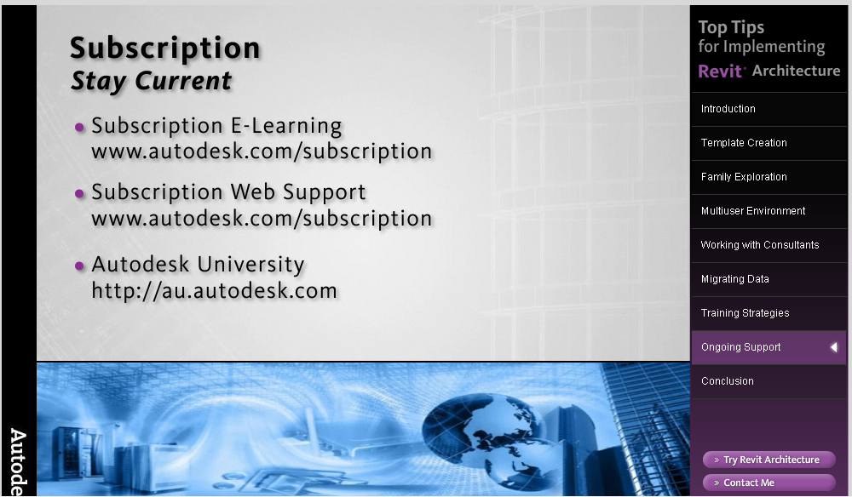
> Podrška
Kontinuirana edukacija

Slide 27
> Reference

Slide 28
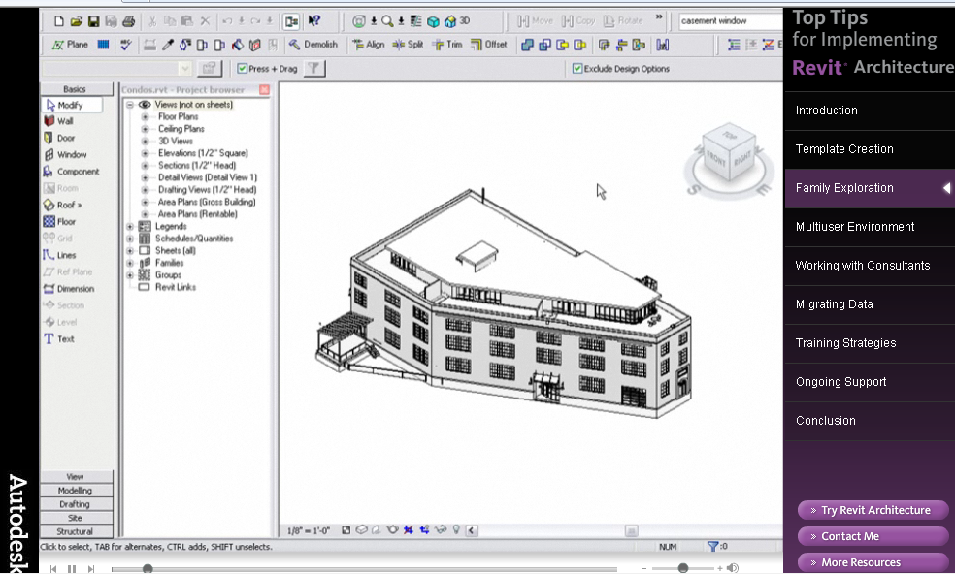
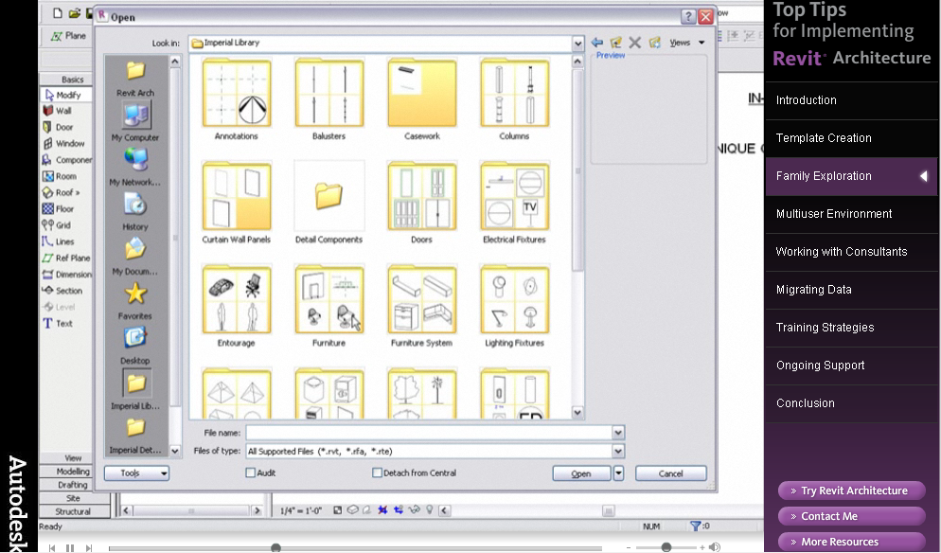
> Reference
Top Ten Tips for Implementing Revit Architecture
http://www.adskmedia.com/revit_2009/

Slide 29
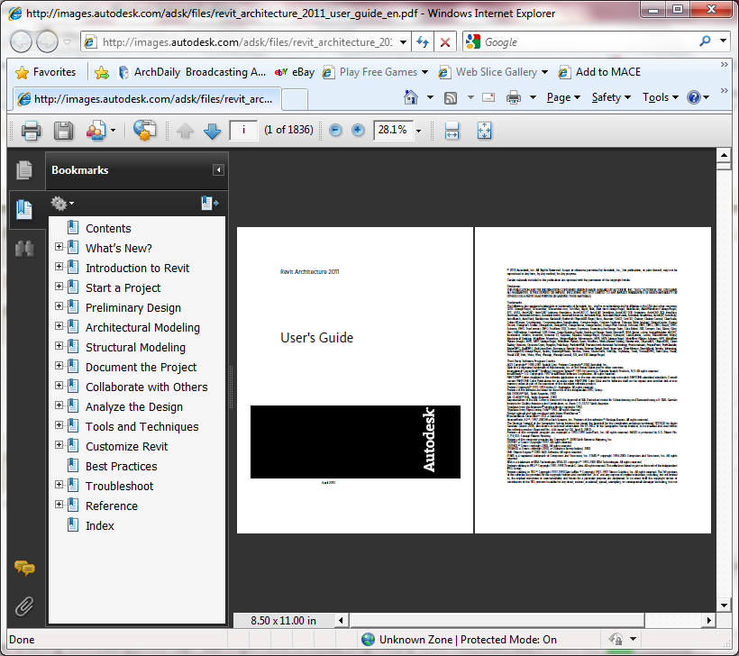
> Reference
Revit Architecture User Guide http://images.autodesk.com/adsk/files/revit_architecture_2011_user_guide_en.pdf

Slide 30
> Zadatak

Slide 31
> Zadatak
Zadatak 06 – Revit Case Study
Izabrati jedan karakterističan primer iz prakse u kome je korišćen Revit i dati sasvim kratak opis osnovnih karakteristika primene ovog softvera. Prilog ilustrovati sa tri ilustracije veličine 200/200 piksela.
Svaki zadatak nosi do 10 poena. Procenat koji će neki zadatak imati u ukupnom broju poena predviđenom za kvalitet redovnog rada, biće određen naknadno.

Slide 32
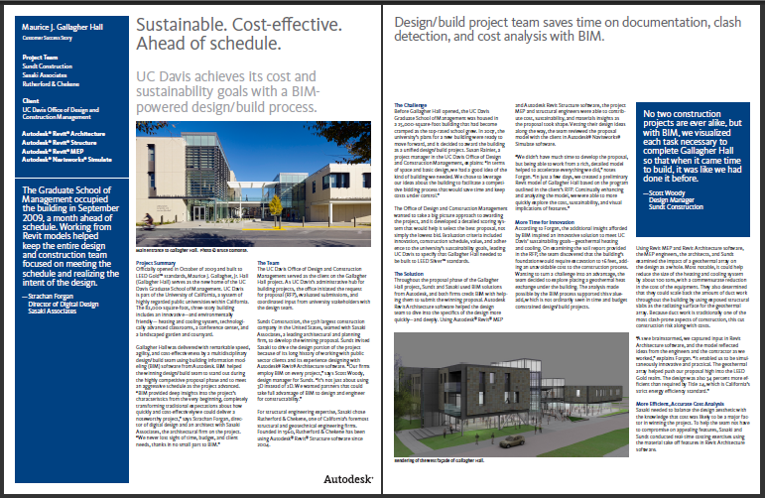
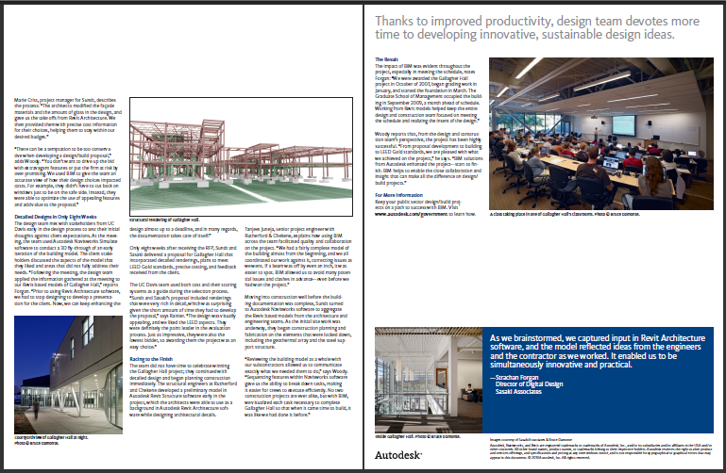
> Primer

Slide 33
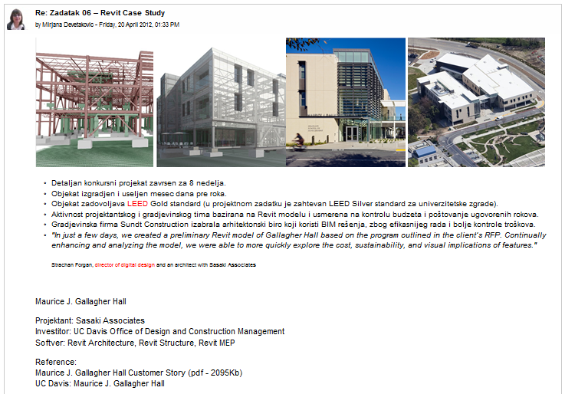
> Primer

Slide 34
Beograd 2012.

Slide 35
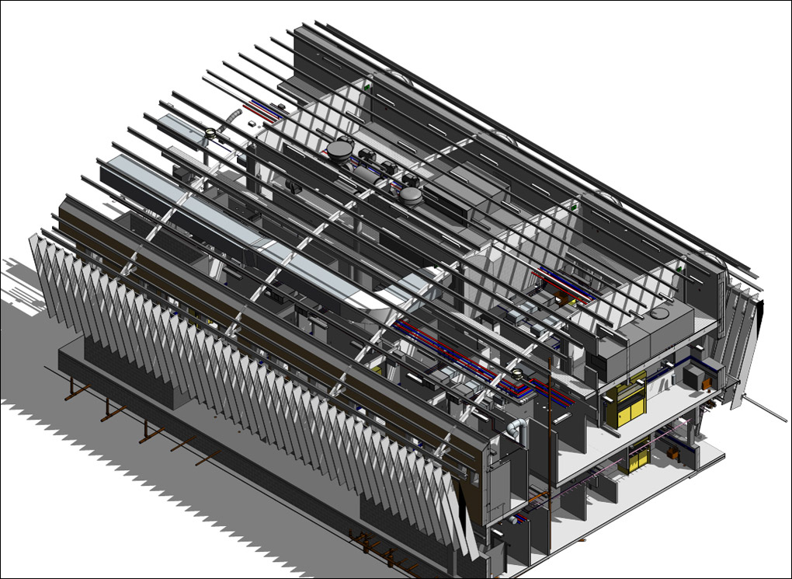
The multidisciplinary Revit model by Ceilidh Higgins of GHD Sydney that was the winner in the Integration category. Source: http://www.aecbytes.com/feature/2010/RevitTechnologyConference2010.html, Revit Technology Conference

Slide 36
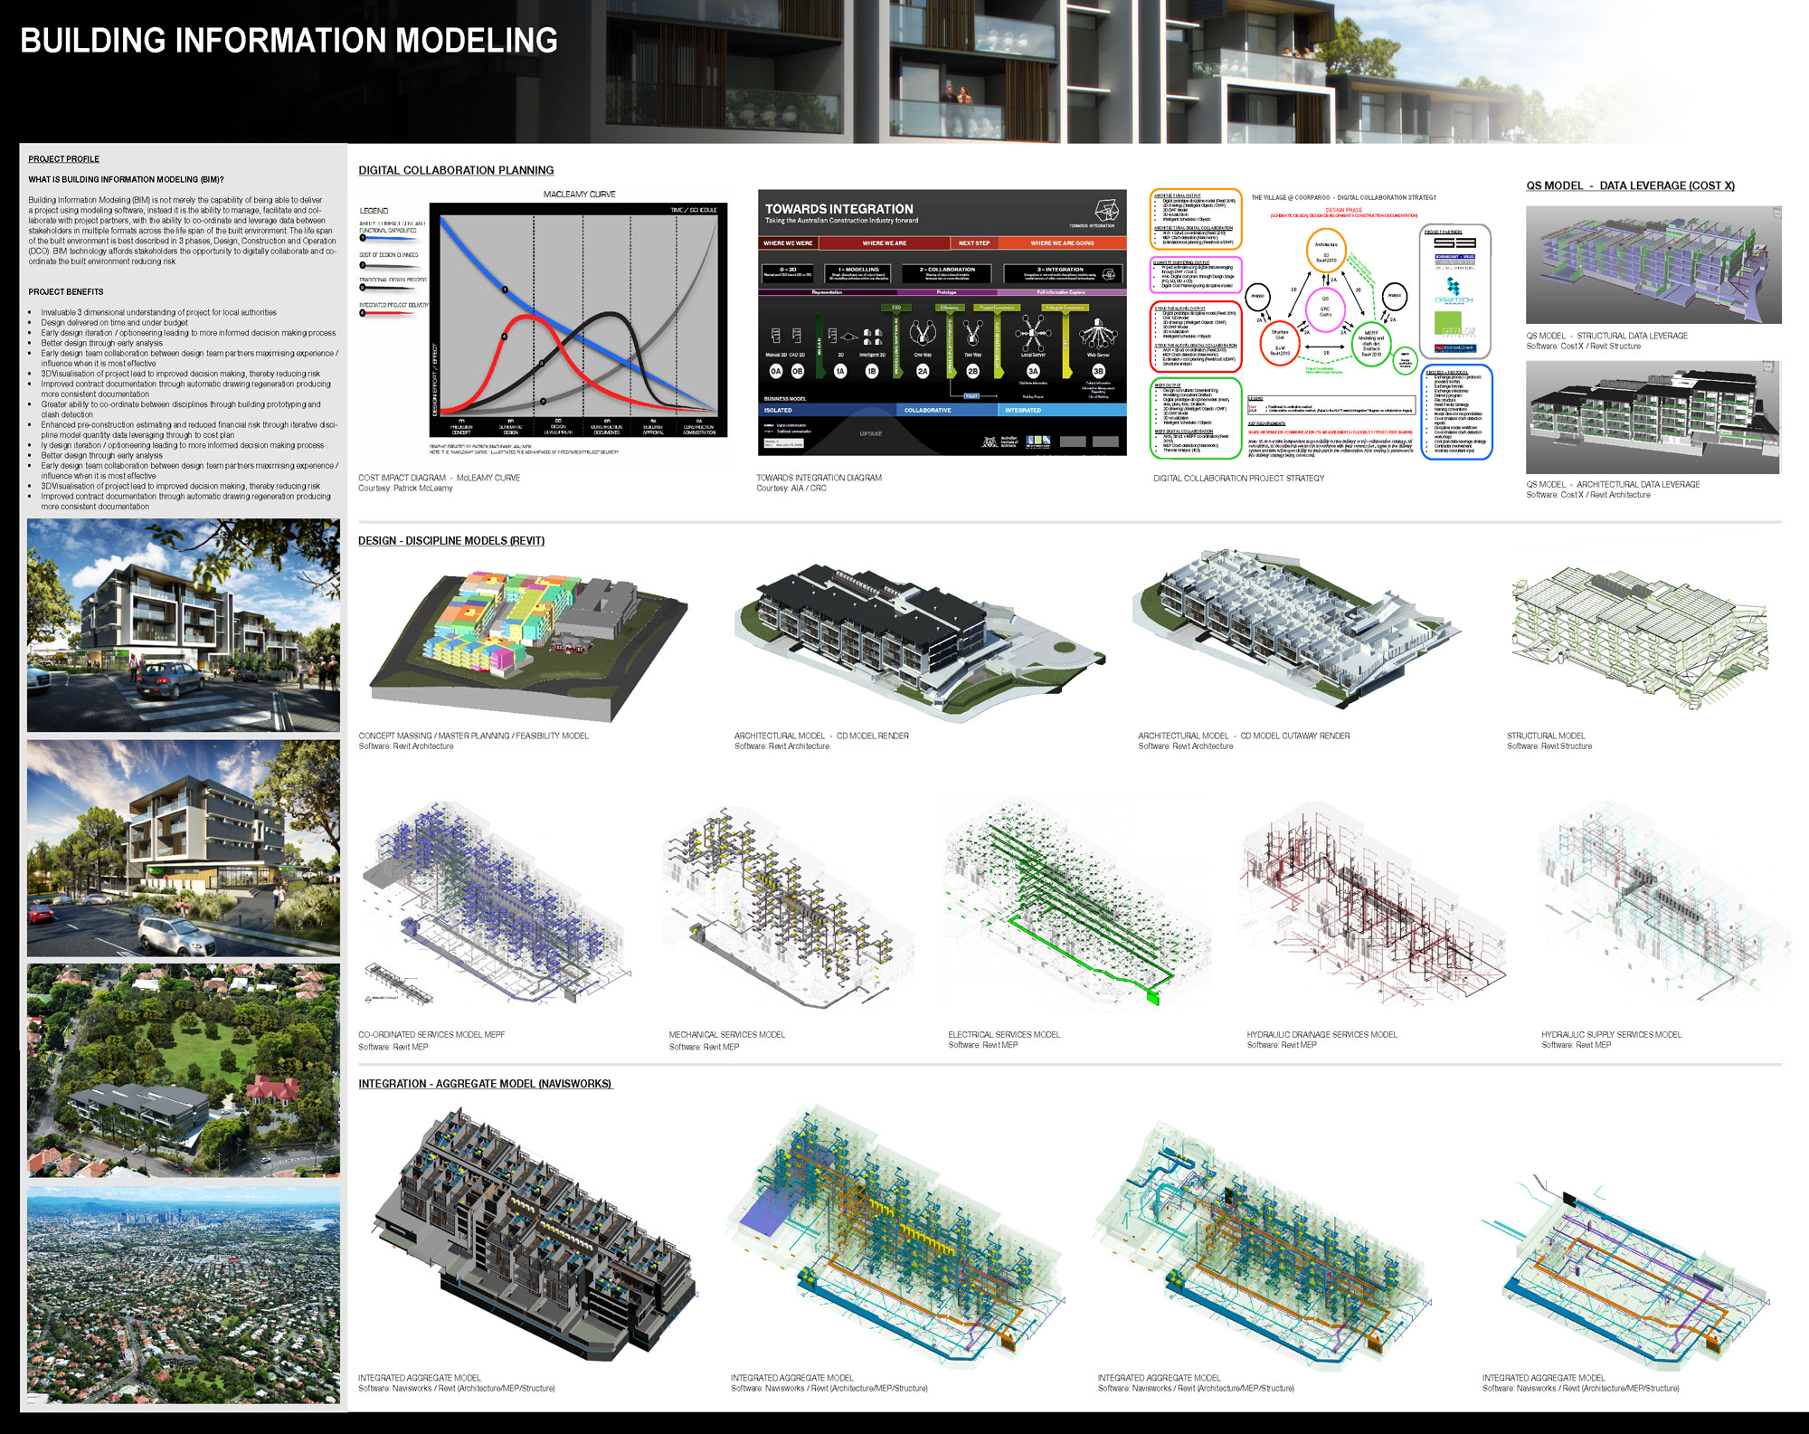

Slide 37
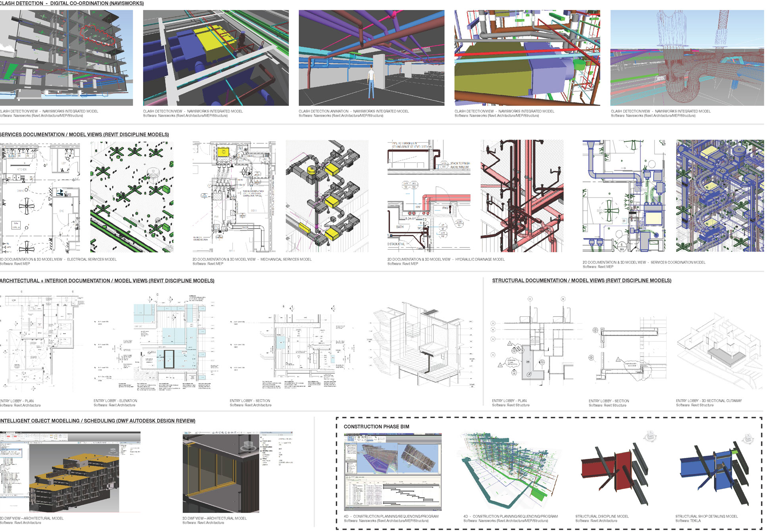

Slide 38
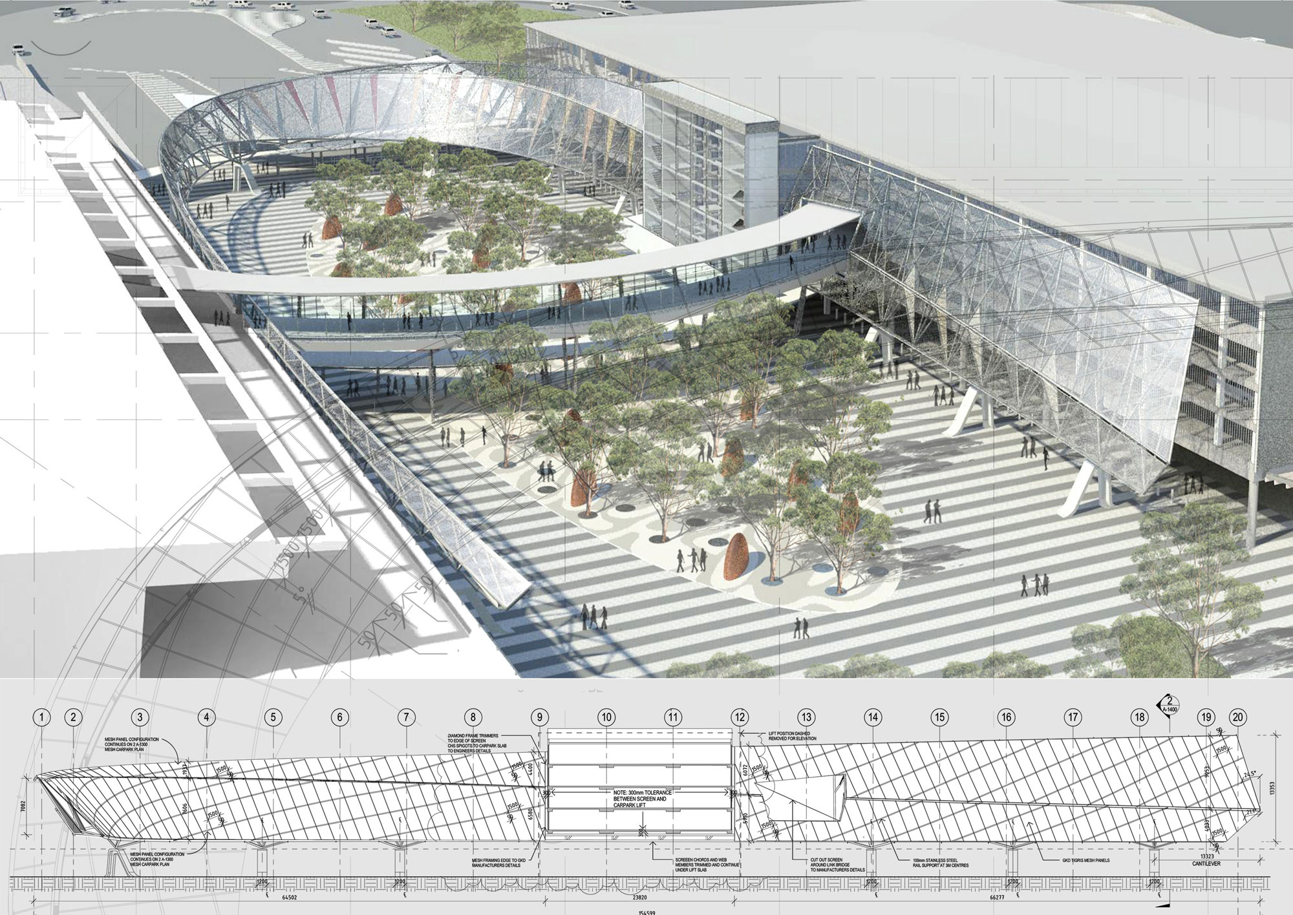
Gianni Zandel, Woodhead Pty Ltd
Source: http://www.revitconference.com/rtc2011au/index.htm,

Slide 39
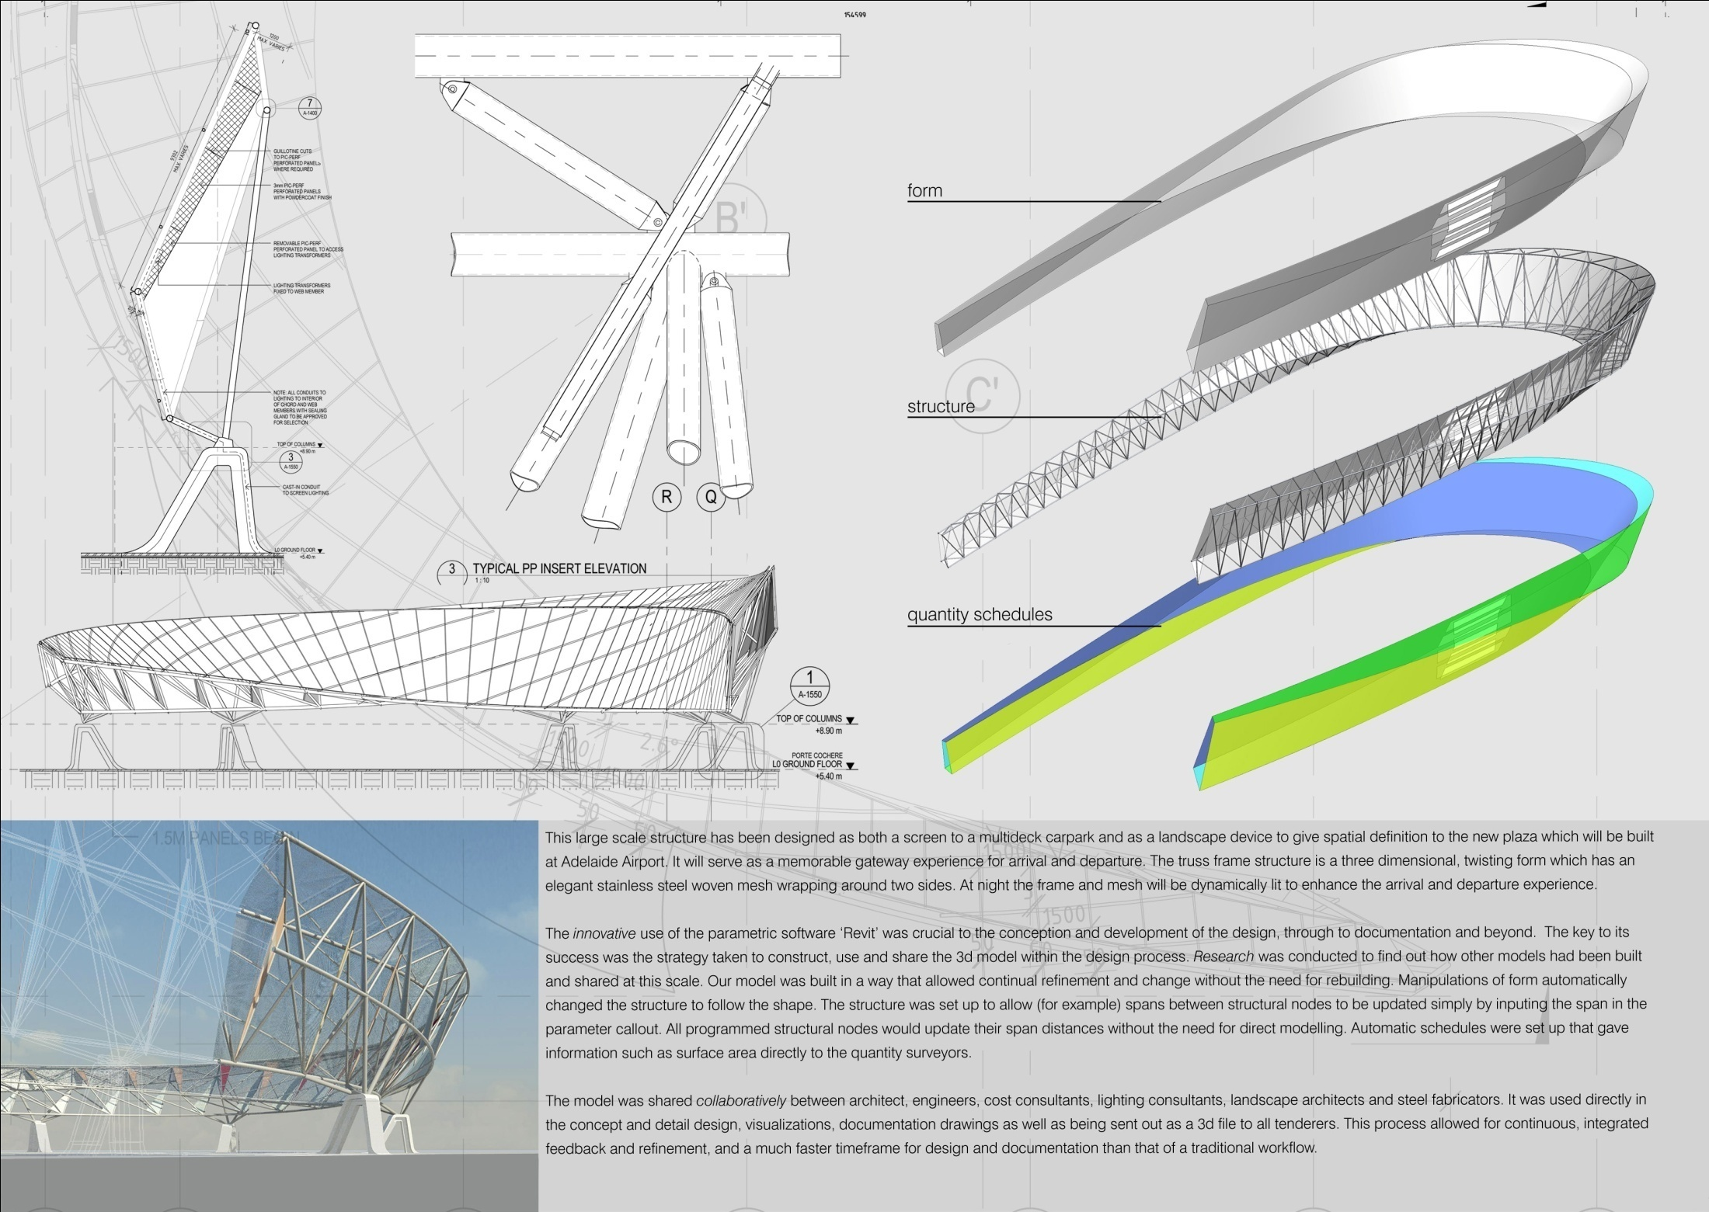
Gianni Zandel, Woodhead Pty Ltd
Source: http://www.revitconference.com/rtc2011au/index.htm,

Slide 40
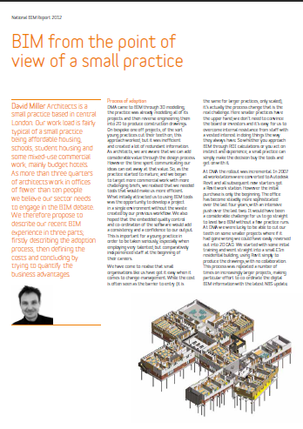
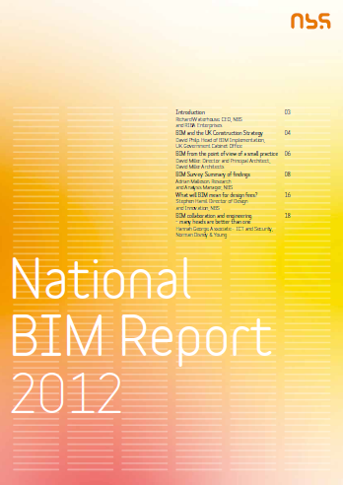
> UK 2012

Slide 41
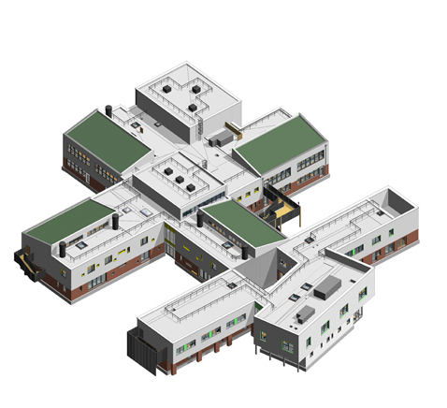


George Eliot School
David Miller Architects
http://www.david-miller.co.uk/george-eliot-school#

Slide 42
> Nova zanimanja
BIM development coordinator
BIM manager

Slide 44

AEC (UK) BIM Protocols v2.0
http://aecuk.wordpress.com/2012/09/07/aec-uk-bim-protocols-v2-0-now-available/?goback=%2Egmp_98421

Slide 45

> Revit Interface

