Slide 1
Rhinoceros 3D - NURBS modeliranje Kurs: Principi CAAD-a, Predavanje 12 Univerzitet u Beogradu, Arhitektonski fakultet
Definicija
Arhitektura slobodne forme
NURBS Osnovni pojmovi
Softver sa NURBS funkcionalnostima
Rhino – rad sa krivim linijama i površima
Dr Mirjana Devetakovic, dipl. inž. arh.
Beograd, 2012

Slide 2
> Principi
Princip 01: Dinamičan razvoj CAAD-a
Princip 08: Objektno orijentisani CAAD
Princip 02: Približavanje korisniku
Princip 09: BIM
Princip 03: Slika kao sredstvo saopštavanja arhitektonske ideje
Princip 10: Integrisano projektovanje
Princip 04: Preciznost i brzina
Princip 11: Interoperabilnost
Princip 05: Crtež kao document i sredstvo saopštavanja arhitektonske ideje
Princip 12: NURBS modeliranje
Princip 13: Matematičko definisanje kompleksne forme
Princip 06: Efikasnost u izmenama tokom procesa projektovanja
Princip 14: Parametarsko modeliranje
Princip 07: Model kao sistem informacija i sredstvo saopštavanja arhitektonske ideje
Princip 15: Fabrikacija

Slide 3
> Definicija

Slide 4
> NURBS
NURBS, Non-Uniform Rational B-Splines (Non-Uniform Rational Basis Spline), are mathematical representations of 3-D geometry that can accurately describe any shape from a simple 2-D line, circle, arc, or curve to the most complex 3-D organic free-form surface or solid. Because of their flexibility and accuracy, NURBS models can be used in any process from illustration and animation to manufacturing.
Freeform surfaces
“how to store a surface design digitally?”
“how to communicate a design freeform geometry to a numerically controlled milling machine?”
Source: Potmann, Asperl, Hofer, Kilian: Architectural Geometry, Bentley Institute Press, 2007

Slide 5
> Freeform Architecture

Slide 6
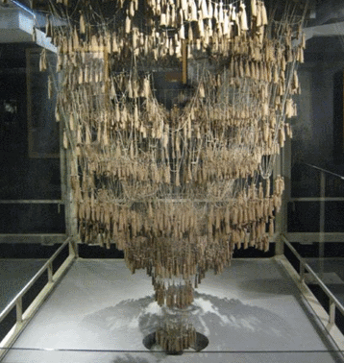
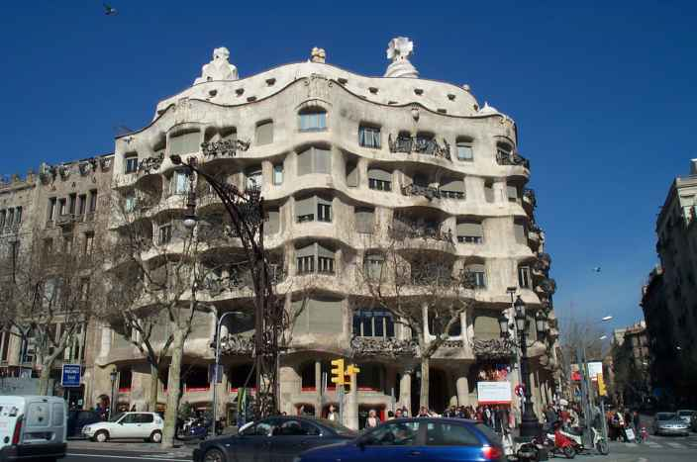
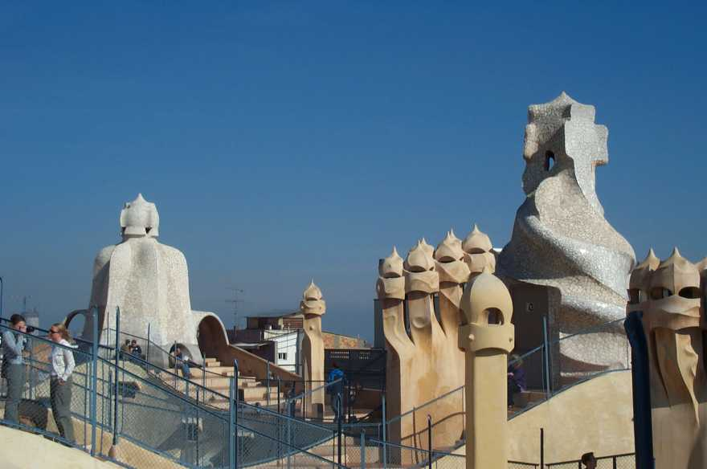
> Freeform architecture
Gaudi: weights attached to chains and the resulting form, source: http://labs.blogs.com/its_alive_in_the_lab/2010/10/index.html
Gaudi: Casa Mila (1905-07)

Slide 8
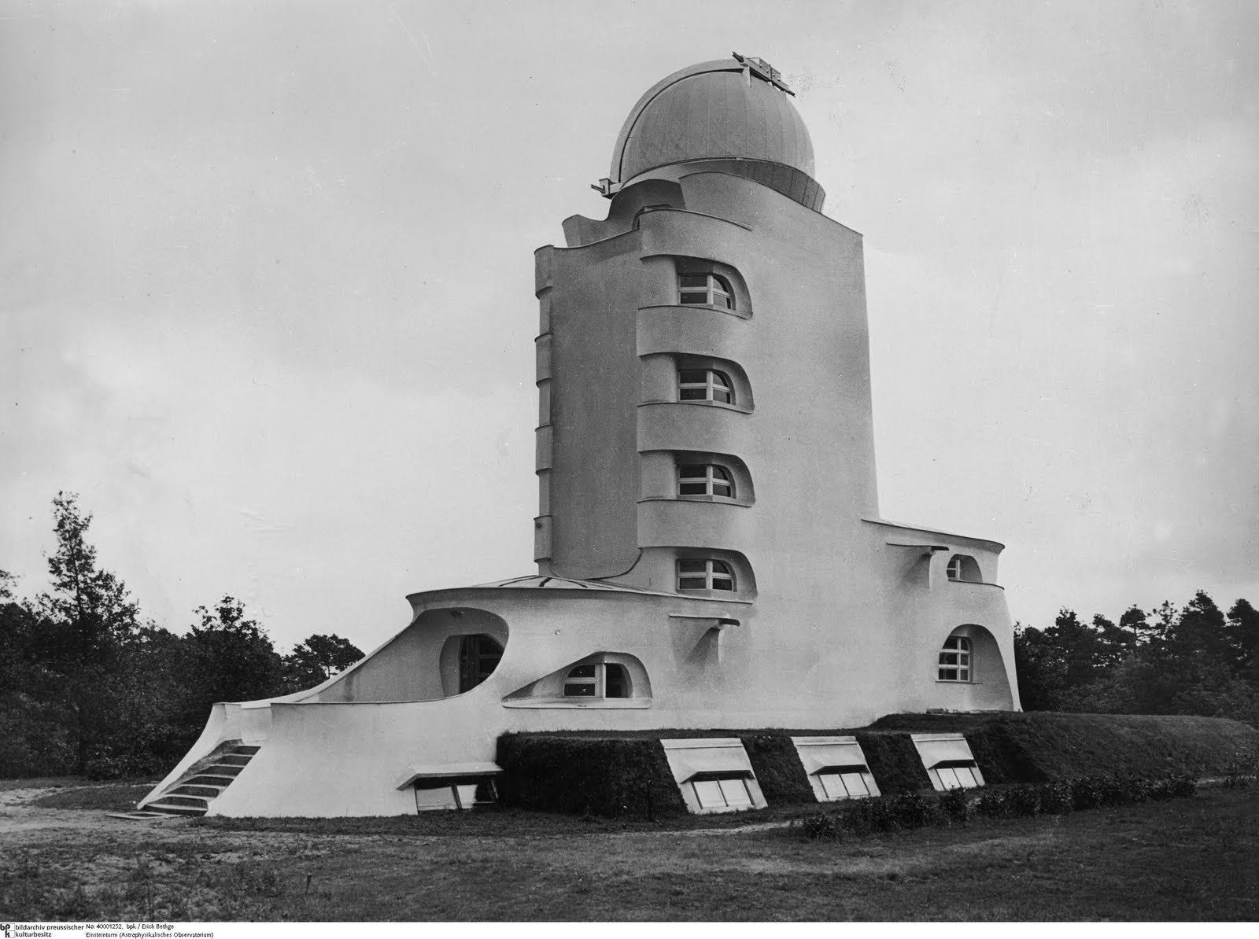
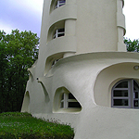
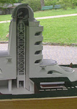
> Freeform architecture
Erich Mendelson: Einstein Tower, 1919-21, Potsdam, Germany

Slide 10
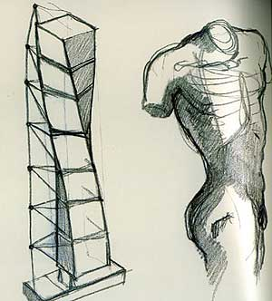
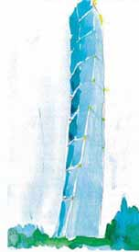
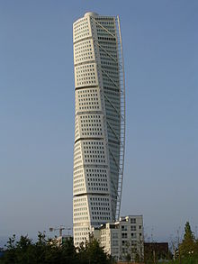
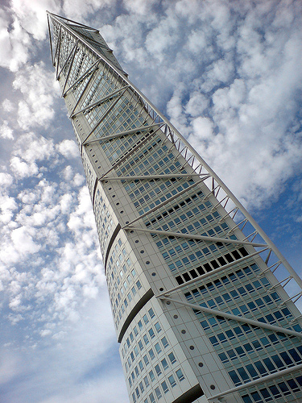
> Freeform architecture
Santiago Calatrava: Turning Torso, Malmø, Sweden, 2001-06

Slide 11
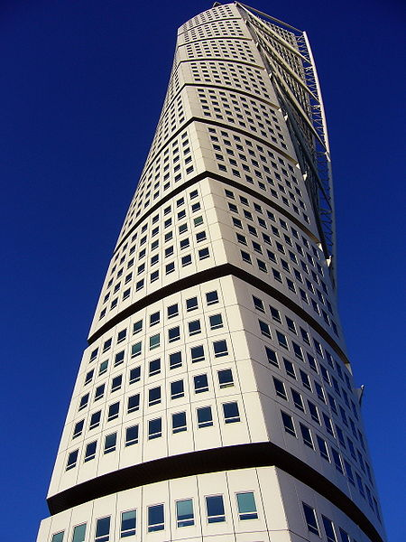

Slide 12
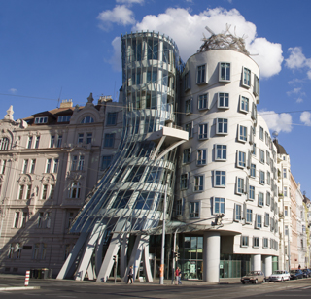
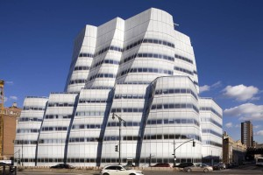
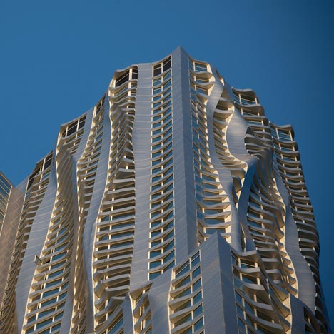
> Freeform architecture
Frank O’Gehry, Dancing house, Prague, 1996; IAC Building, New York, 2007; 8 Spruce Str., NY, 2011

Slide 13
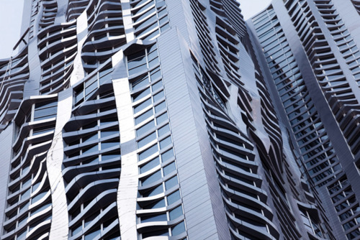
Frank O’Gehry: 8 Spruce street, NY, 2011

Slide 14
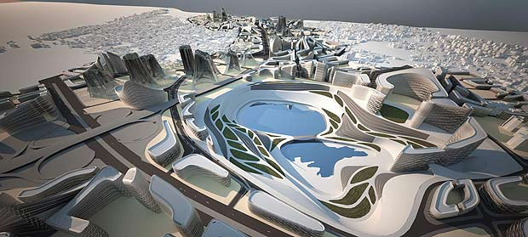
> Freeform urbanism
Zaha Hadid: Kartal Pendik Masterplan, Istambul, Turkey, 2006

Slide 15
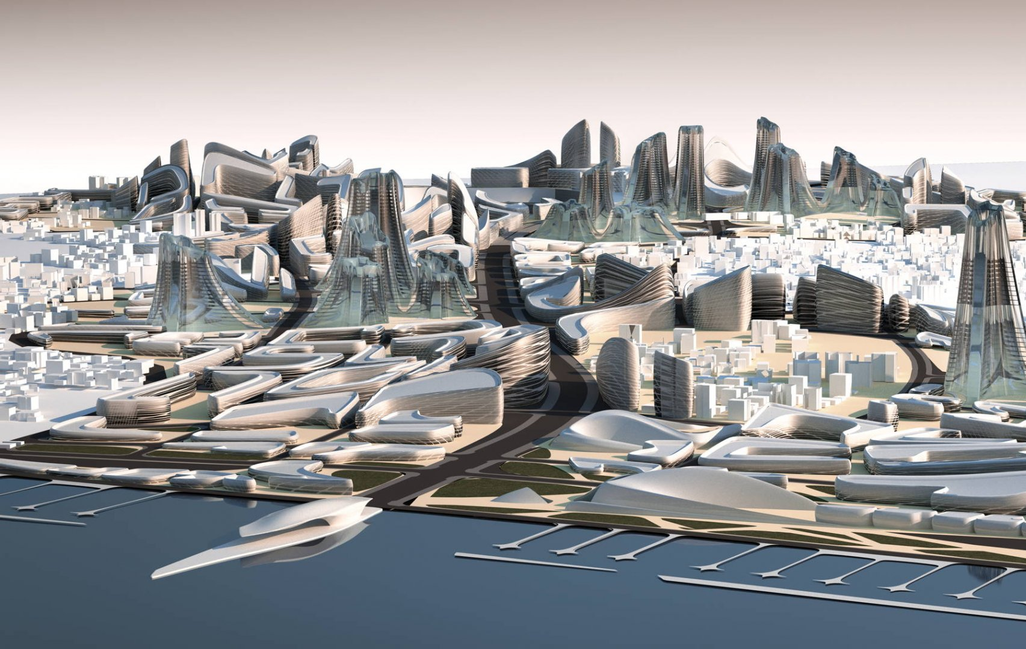
Zaha Hadid: Kartal Pendik Masterplan, Istambul, Turkey, 2006

Slide 16
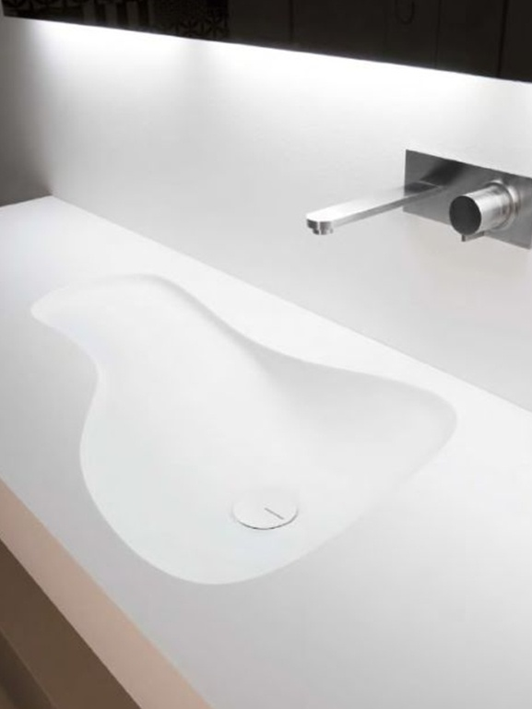
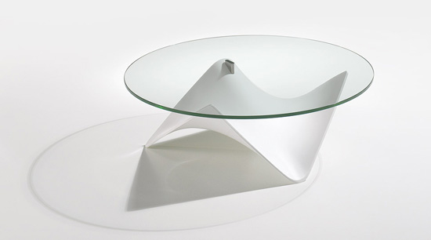
> Freeform design
CORIAN, Stingray coffee table, Draenert, designed by Stephan Veit.

Slide 17
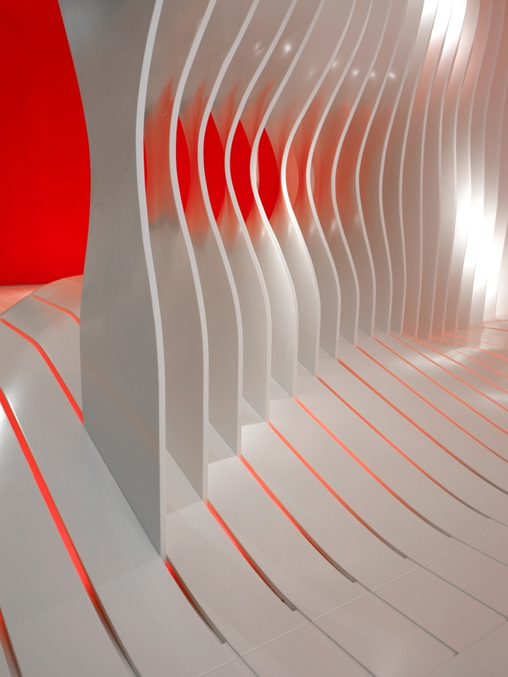
Designer : Amanda Levete Architects, Fabricator : DuPont : Corian Super Surfaces, Milan Design Week April 2009

Slide 18
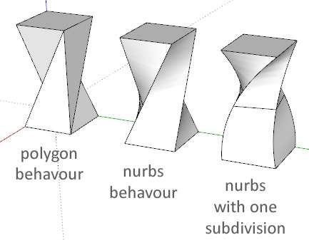
> NURBS modeliranje
Jacob Winer, http://forums.sketchucation.com/viewtopic.php?f=10&t=12967

Slide 19
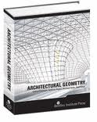
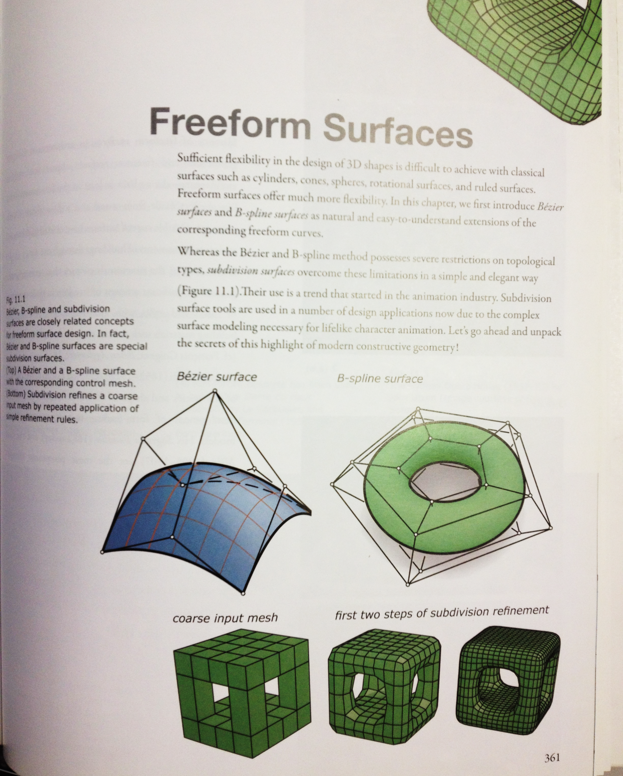
Source: Potmann, Asperl, Hofer, Kilian: Architectural Geometry, Bentley Institute Press, 2007

Slide 20
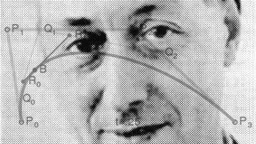
> Pierre Bésier (1910 – 1999), Renault
Bésier curve

Slide 21
> Mathematics behind NURBS

Slide 22
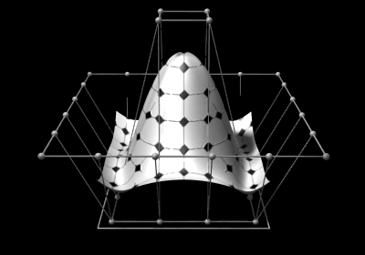
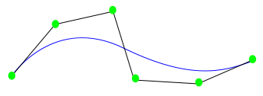
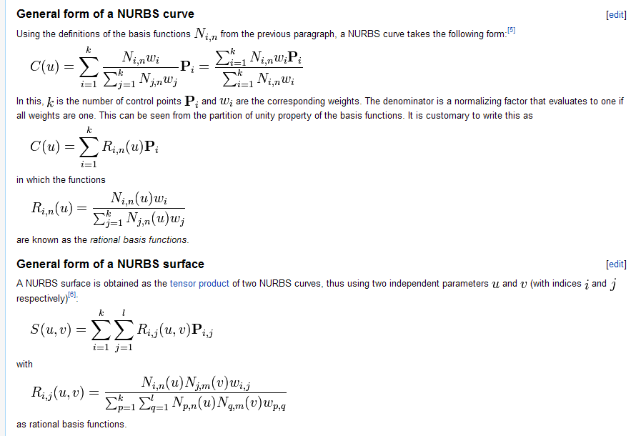

Slide 23
> Software

Slide 24
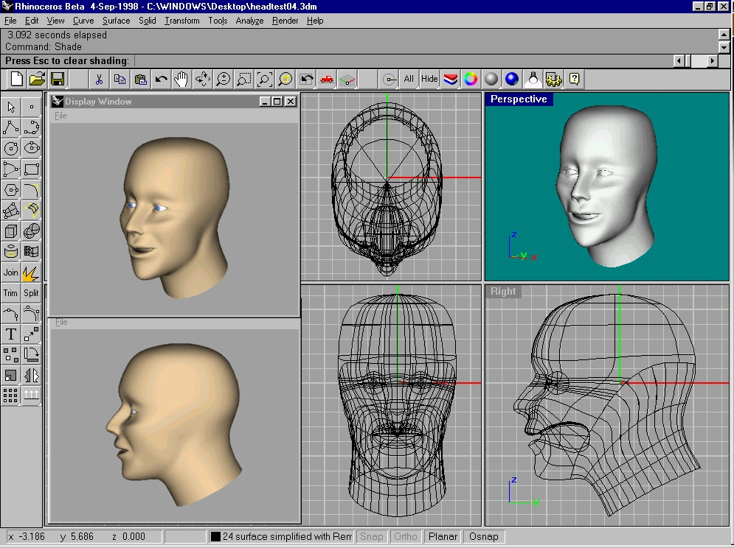

Slide 25
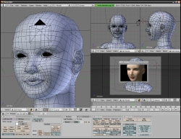

Slide 26
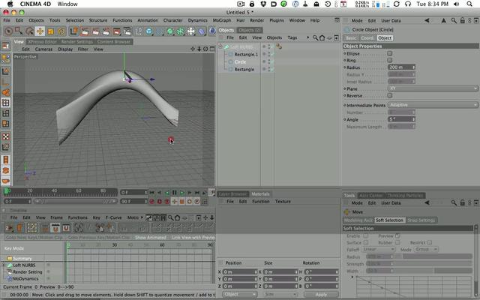

Slide 27
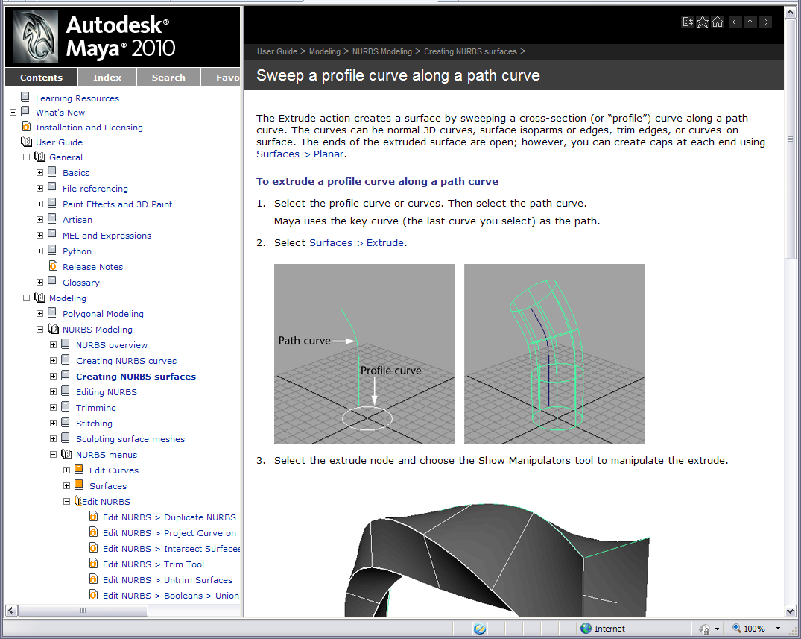

Slide 28
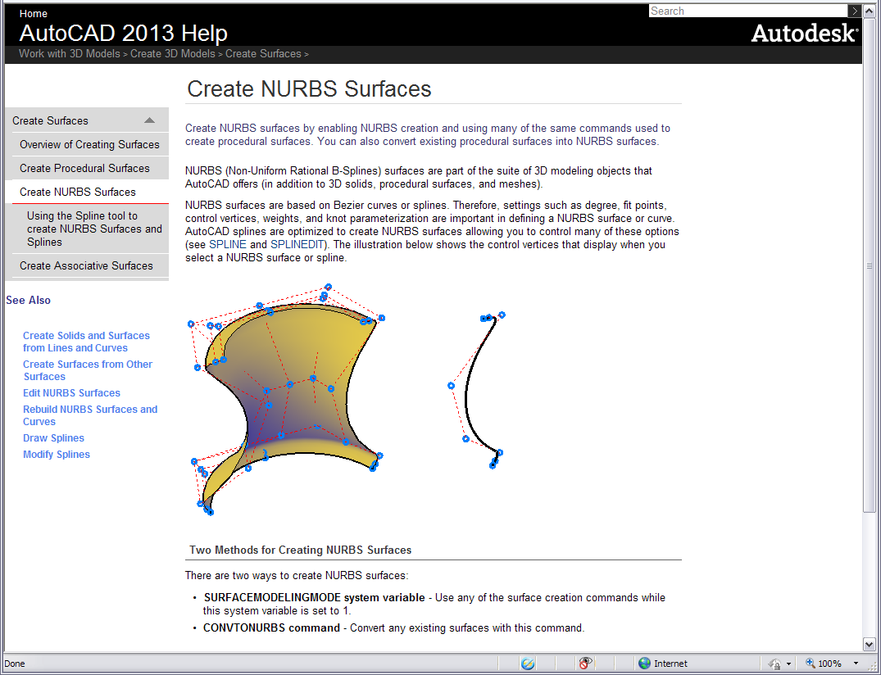

Slide 29
> NURBS Basics

Slide 30
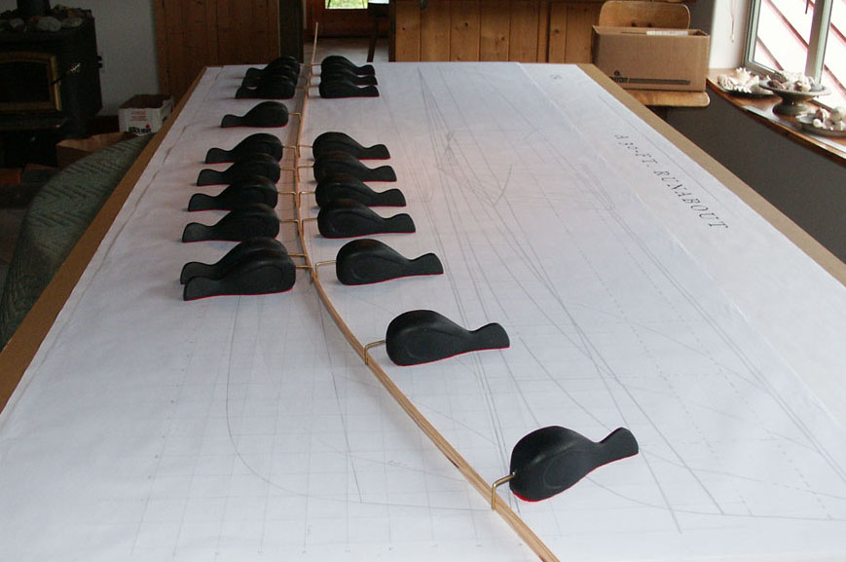
> Spline weight

Slide 31
> Point weight

Slide 32
> Degree
The degree is a positive whole number.
This number is usually 1, 2, 3 or 5, but can be any positive whole number. NURBS lines and polylines are usually degree 1, NURBS circles are degree 2, and most free-form curves are degree 3 or 5. Sometimes the terms linear, quadratic, cubic, and quintic are used. Linear means degree 1, quadratic means degree 2, cubic means degree 3, and quintic means degree 5.
You may see references to the order of a NURBS curve. The order of a NURBS curve is positive whole number equal to (degree+1). Consequently, the degree is equal to order-1.
It is possible to increase the degree of a NURBS curve and not change its shape. Generally, it is not possible to reduce a NURBS curve’s degree without changing its shape.

Slide 33
> Degree
3
1
5

Slide 34
> Degree
u degree 2 v degree 2
u degree 1 v degree 2
u degree 1 v degree 1

Slide 35
> Knot
The knots are a list of degree+N-1 numbers, where N is the number of control points. Sometimes this list of numbers is called the knot vector. In this term, the word vector does not mean 3‑D direction.
This list of knot numbers must satisfy several technical conditions. The standard way to ensure that the technical conditions are satisfied is to require the numbers to stay the same or get larger as you go down the list and to limit the number of duplicate values to no more than the degree. For example, for a degree 3 NURBS curve with 11 control points, the list of numbers 0,0,0,1,2,2,2,3,7,7,9,9,9 is a satisfactory list of knots. The list 0,0,0,1,2,2,2,2,7,7,9,9,9 is unacceptable because there are four 2s and four is larger than the degree.

Slide 36
> Knot

Slide 37
> Kink
A kink is a point where a curve dramatically changes direction. The corners of a rectangle are kinks. Kinks can also happen at a point where a curve dramatically changes its the amount it curves. For example a rounded rectangle has kinks where the line segments turn into arcs.

Slide 38
> Kink

Slide 39
> Handlebar
Edit a curve or surface with Bézier curve style handlebars.

Slide 40
> Rhino 3D

Slide 41
> Rhino Geometry Types

Slide 42
> Loft

Slide 43
> Loft

Slide 44
> Extract Isocurve

Slide 45
> Trim Surface

Slide 46
> Blend

Slide 47
> Offset Surface

Slide 48
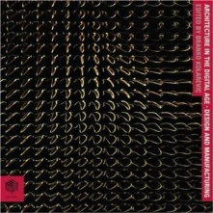
> Reference
What is NURBS?, Rhinoceros, NURBS modeling for windows, http://www.rhino3d.com/nurbs.htm
Potmann, Asperl, Hofer, Kilian: Architectural Geometry, Bentley Institute Press, 2007
Rhino 4.0 User's Guide, http://elearning.amres.ac.rs/moodle/pluginfile.php/12814/block_html/content/Rhino%204.0%20Users%20Guide.pdf
NURBS, Wikipedia, http://en.wikipedia.org/wiki/Non-uniform_rational_B-spline

Slide 49
Beograd 2012

