Slide 1
Lesson Overview
Summary
In this lesson, students explore the tools available in the Autodesk® Revit® software to create several types of common project views and specify the information that appears in them
They will learn how to:
Create 2D views of their building model, such as plans, elevations, and sections—creating new views from scratch and duplicating existing views
Create 3D views by duplicating and editing the default 3D orthographic view
Customize the information presented in those views

Slide 2
Learning Objectives
After completing this lesson, students will be able to:
Use 2D and 3D views to accurately convey information about their design to different audiences
Adjust the properties of model views to emphasize key elements of their design and hide unnecessary or unwanted detail

Slide 3
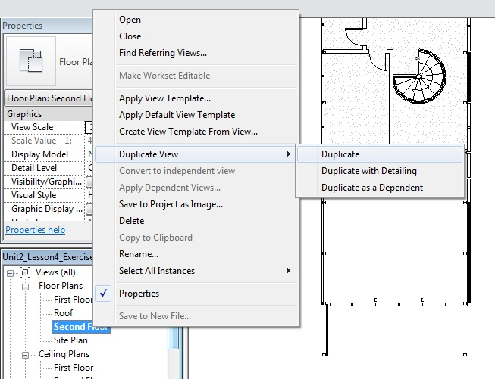
Exercise 1.6.1: Creating Plan Views
In this exercise, students will learn how to:
Create new plan views
Select which types of elements appear by setting visibility graphics overrides
Turn on cropping and resize the crop region
Adjust the view range (the height of the cutting plane and the view depth)
Select another level to underlay

Slide 4
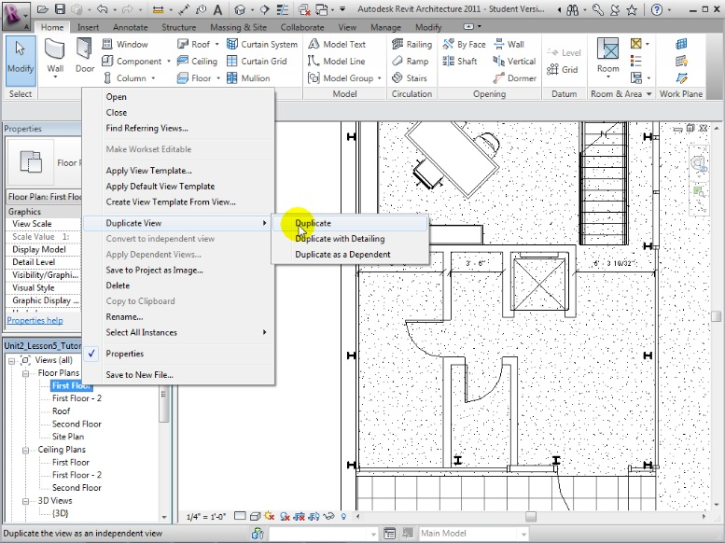
Creating New Plan Views
Duplicating plan views with and without detailing (annotations)
Select plan view
Right-click view name in Project Browser
Duplicate with or without detailing
Duplicate as a dependent
Rename new view

Slide 5
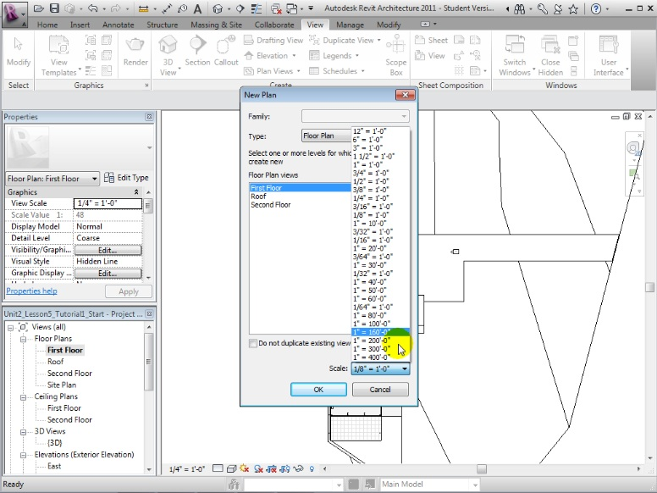
Creating New Plan Views
Using the Plan View tool to create additional plan views for a level
Open the Plan View tool
Uncheck Do not duplicate existing views checkbox
Choose view scale
Select levels of new views to create
Repeat for ceiling plans, plan regions, and area plans

Slide 6
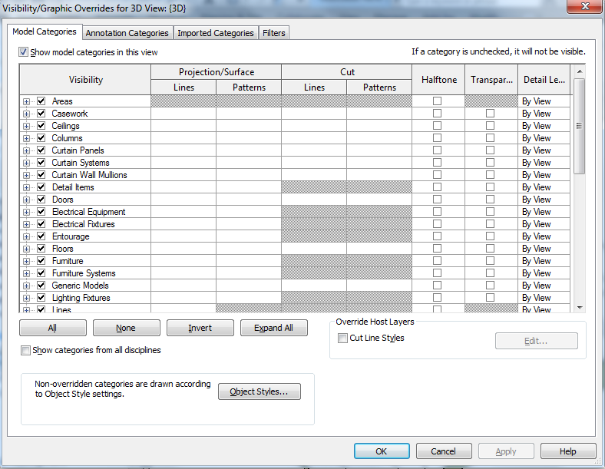
Customizing and Presenting Views
Filtering the elements to show in a view
Set Visibility/Graphics overrides
Model objects
Walls / Doors / Windows
Floors / Roofs
Components
Annotation objects
Object Tags
Dimensions / Text
Imported objects

Slide 7
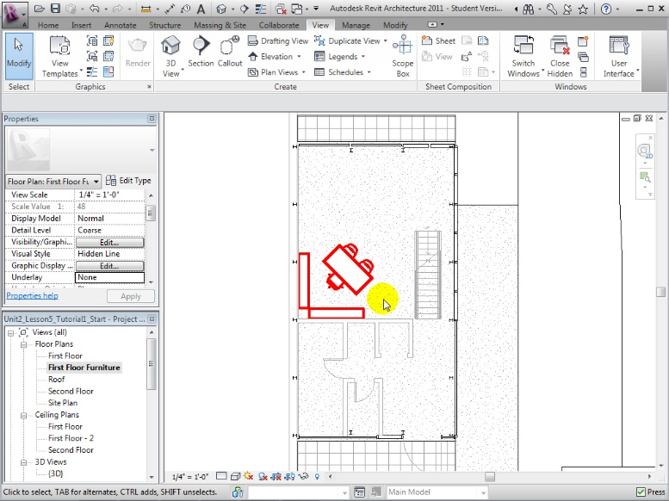
Filtering Elements Displayed
Filtering and highlighting elements using visibility graphics overrides
Open visibility graphics overrides
Adjust appearance of element categories
Turn on or off visibility
Override line weight or color
Choose halftone or transparent display effect

Slide 8
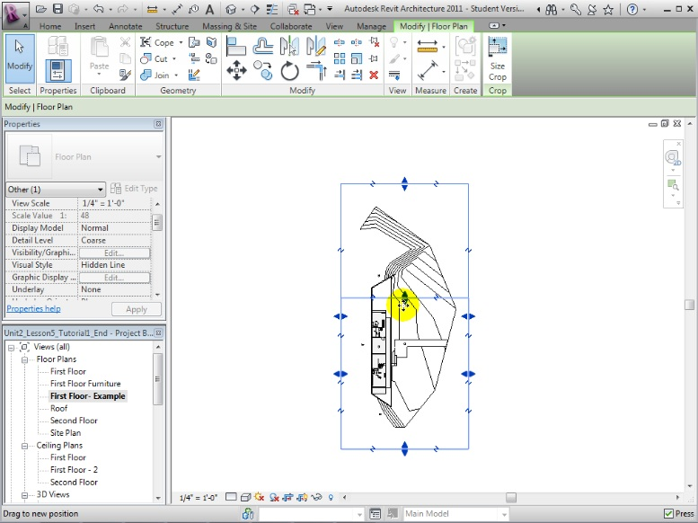
Setting View Properties and Display Options
Turning on cropping and resizing the crop region for a plan view
Use controls in View Control bar to quickly set whether to:
Crop the view
Display crop region
Select boundary of crop region, then:
Drag boundary to move it
Drag blue arrows to resize it

Slide 9
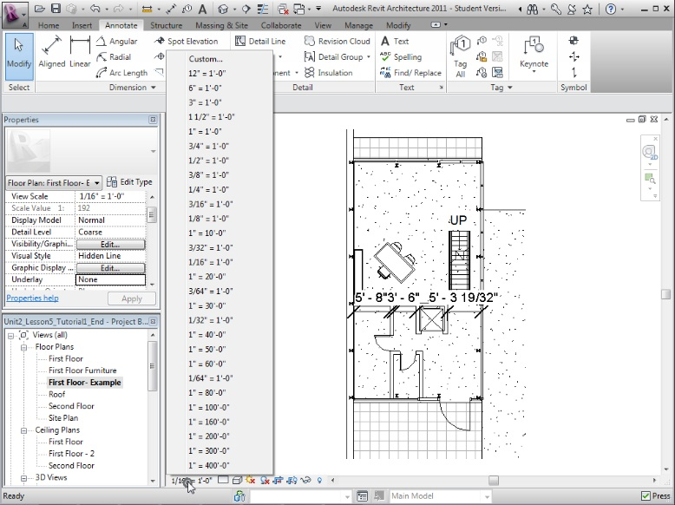
Setting View Properties and Display Options
Changing the scale and adjusting the level of detail
Use controls in View Control bar to quickly set
View scale
Level of detail
Elements in view may change to show more or less detail
Text annotations and dimensions maintain the same absolute size

Slide 10
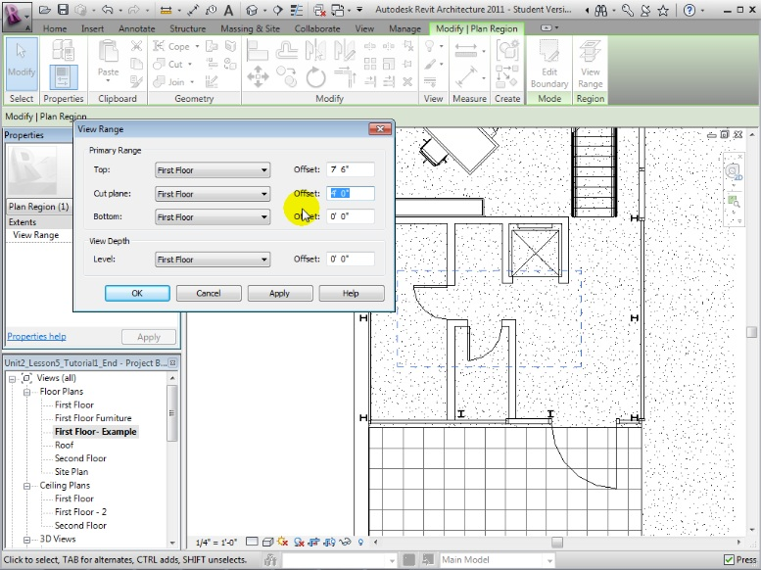
Setting View Properties and Display Options
Adjusting the view range (cut plane and view depth) for a plan or region
Edit the view range in view properties
Set elevation of:
Cut plane
Top and bottom of range
View depth
Create plan regions to use a different view range for specific areas within a plan

Slide 11
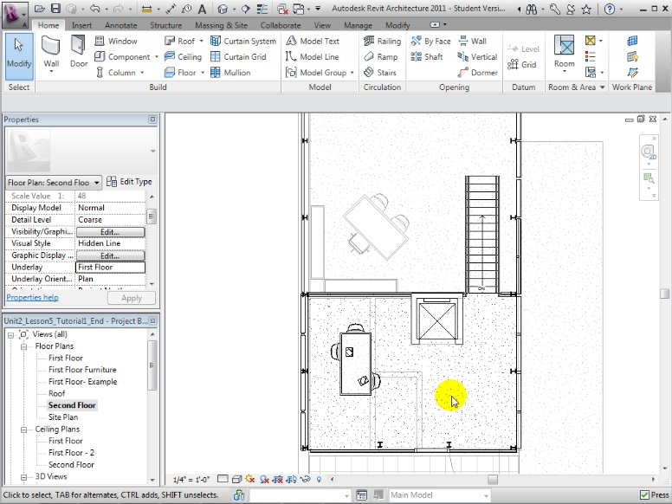
Setting View Properties and Display Options
Selecting another level to underlay
Select another level to underlay in view properties
Underlay displayed as gray lines in view
Use underlay to align elements between levels

Slide 12
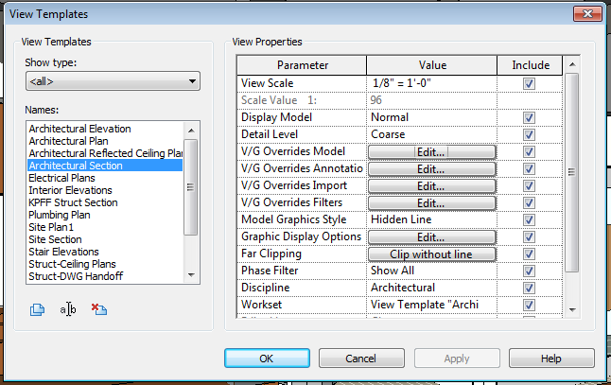
Saving and Reusing View Settings
Creating and applying view templates to ensure consistency
Create view template
Set properties of current view
Create and name new template
Choose properties to include
Apply view template
Open view
Apply new view template or default

Slide 13
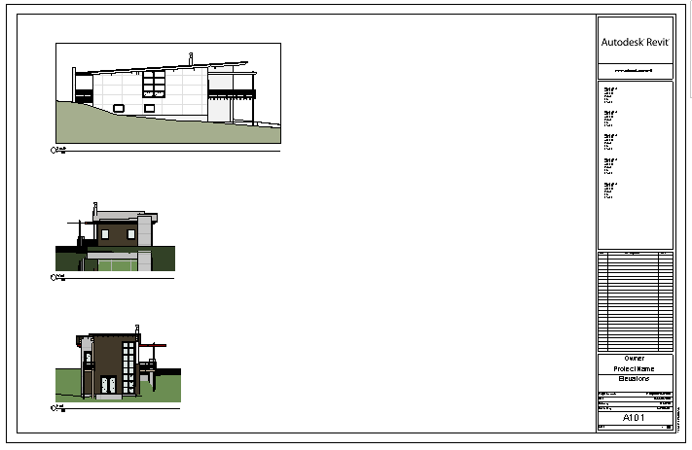
Customizing and Presenting Views
Placing views on sheets
Open a Sheet/Layout
Sheet size
Titleblock
Drag desired views sheet
Adjust view properties
Scaling
Cropping
Activate/Deactivate view to edit model in place

Slide 14
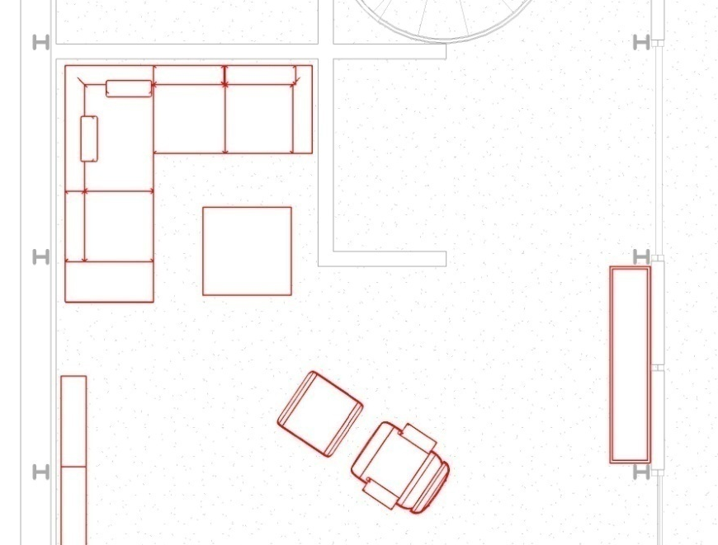
Exercise 1.6.1: Creating Plan Views
Student Exercise
Create a plan view that focuses on the structural elements of the first floor
Create a plan view that focuses on the interior design of the first floor
Create new plan views that focuses solely on the first floor and second floor of the residence

Slide 15
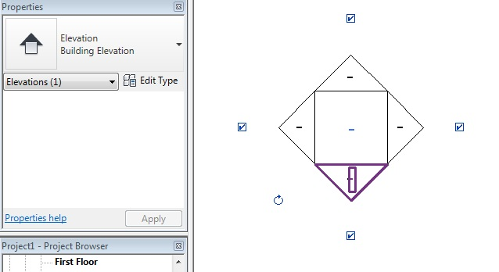
Exercise 1.6.2: Creating Elevation and Section Views
In this exercise, students will learn how to:
Place elevation tags to create new elevation views
Draw section lines to create new section views
Modify view properties to adjust the crop region, level of detail, and scale
Set visibility graphics overrides to choose which types of objects appear in the views

Slide 16
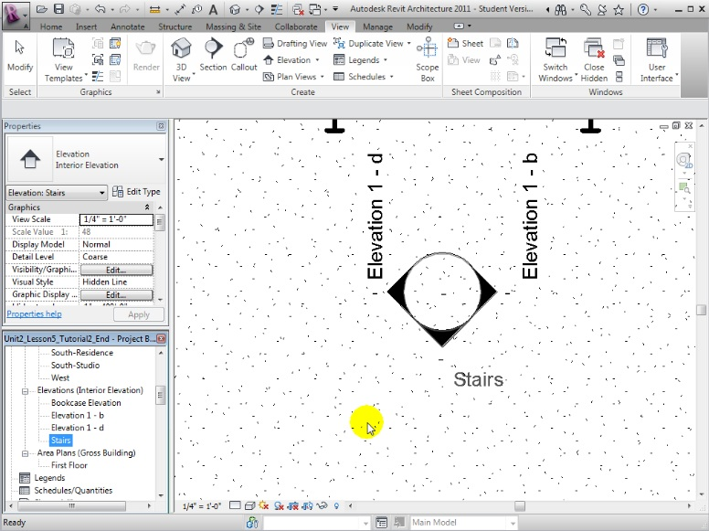
Creating Elevation and Section Views
Placing elevation tags to create new elevation views
Open the Elevation tool
Hover tag near walls to align the elevation orientation
Change elevation type to interior or exterior elevation
Select which views to create
Edit far clip offset and crop
Double click tag to quickly open elevation views

Slide 17
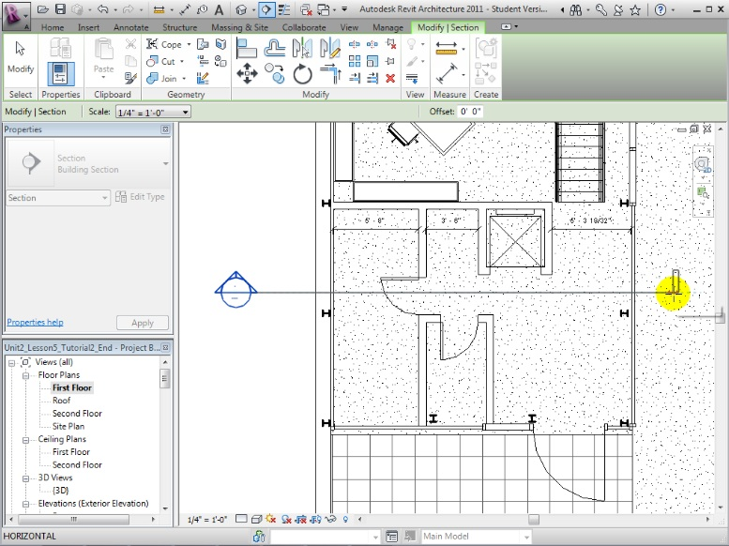
Creating Elevation and Section Views
Drawing section lines to create new section views
Open the Section tool
Draw section line in plan or elevation view
Edit far clip offset and crop
Select section line and click blue arrows to change view orientation

Slide 18
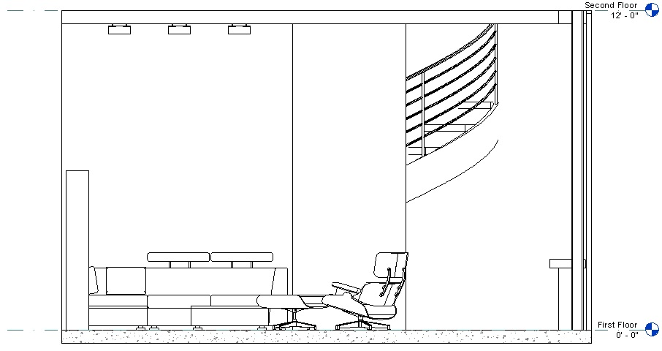
Exercise 1.6.2: Creating Elevation and Section Views
Student Exercise
Create an interior elevation view for all sides of the living room of the residence
Adjust the crop region to show only on the living room walls
Set the scale of one view to be 1/2" = 1'-0” and the level of detail to Fine
Create a view template and apply this view template to the other interior elevation views

Slide 19
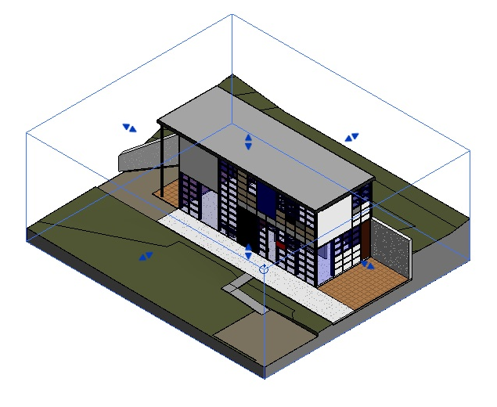
Exercise 1.6.3: Creating 3D Views
In this exercise, students will learn how to:
Duplicate the Default 3D View to create additional 3D views
Use widgets to change the view settings
Use the section box to create 3D plans and section views
Use the Camera tool to create new perspective views.
Adjust the crop region, far clip offset, camera, and target

Slide 20
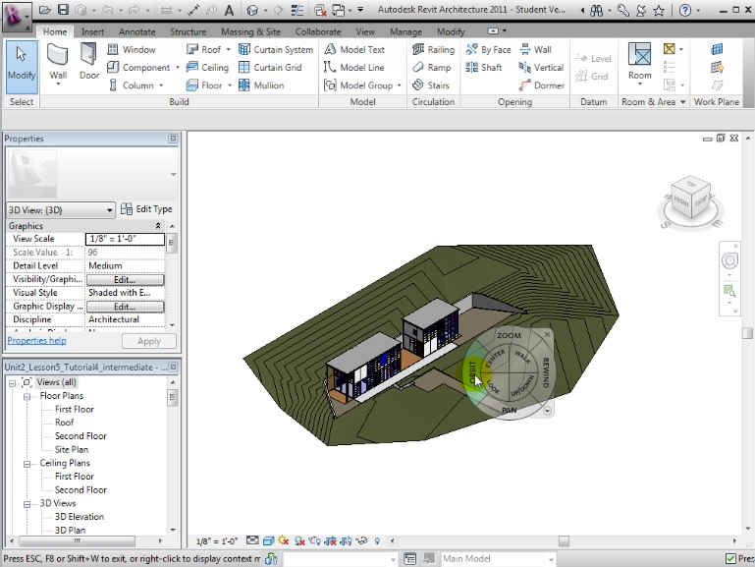
Creating 3D Default / Birdseye Views
Using the ViewCube® and SteeringWheels® to change camera position
Use ViewCube®
Click corners, edges, and faces to re-orient
Drag to rotate model
Click home icon
Use SteeringWheels®
Drag orbit control to rotate
Pan, walk, or look around
Duplicate to create new 3D view with camera settings

Slide 21
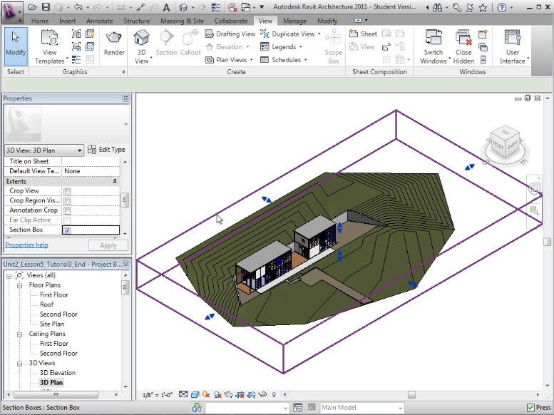
Creating 3D Views
Using the section box to create 3D plans and section views
Open 3D view
Turn on section box option in Extents section of view properties
Move the faces of section box to cut away parts of the model

Slide 22
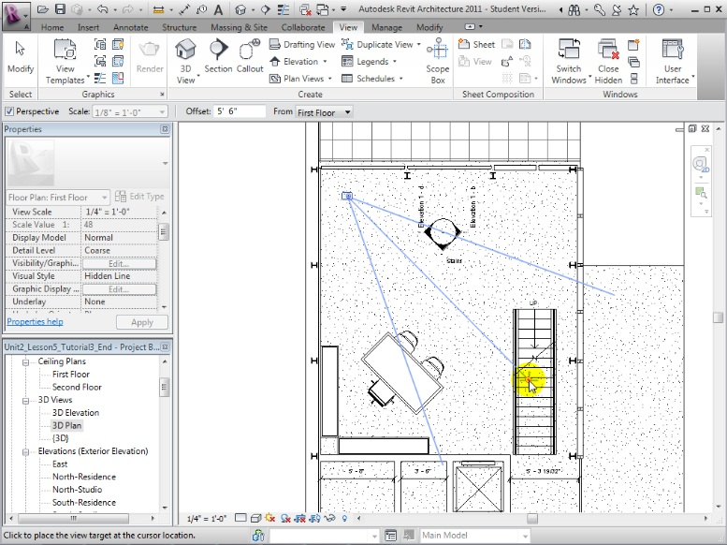
Creating 3D Views
Using the Camera tool to create new perspective views
Open the Camera tool
Click in view to place camera
Drag to set target location and far clip offset
Rename new perspective view in Project Browser

Slide 23
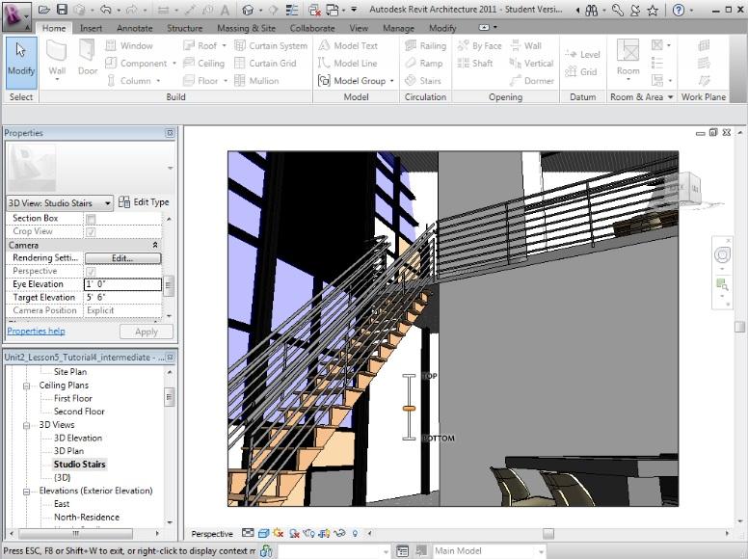
Creating 3D Views
Adjusting crop region, far clip offset, and camera and target positions
Use controls in View Control bar to show crop region
Right-click view, then choose Show Camera to display camera in floor plan view
Move camera, target, or far clip offset
Set eye and target elevations
Use widgets to dynamically change view

Slide 24
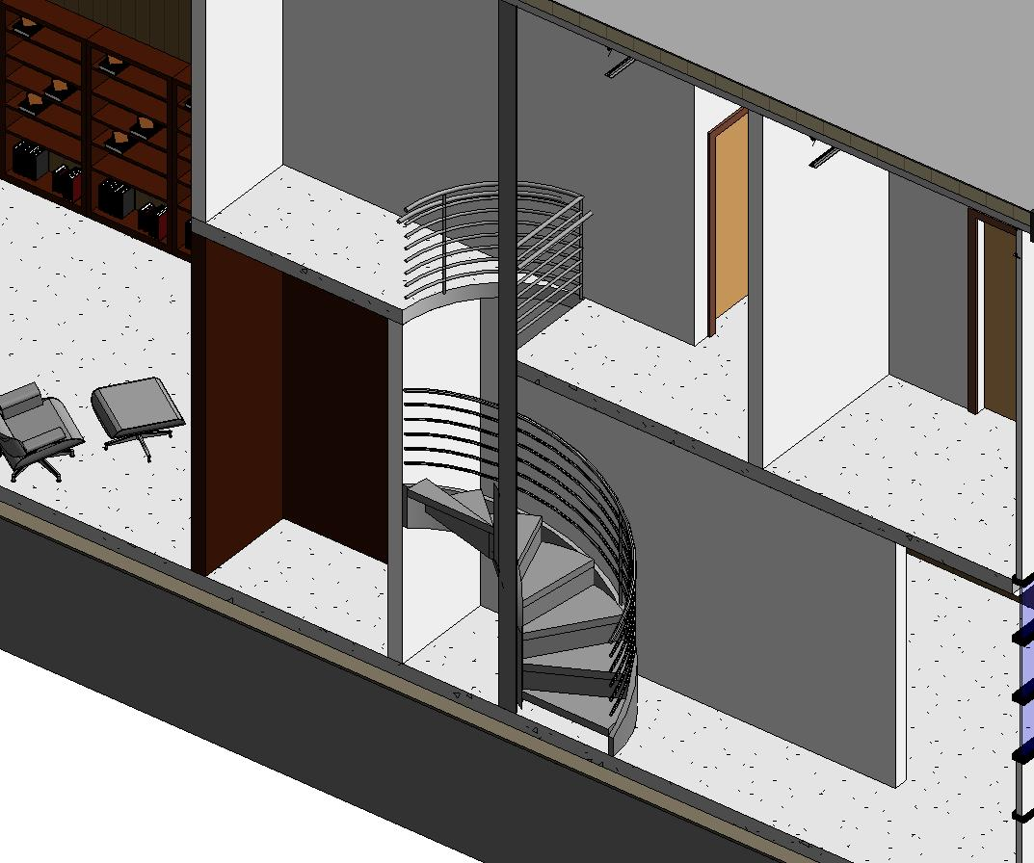
Exercise 1.6.3: Creating 3D Views
Student Exercise
Create an interior perspective view of the living room in the residence by using the camera tool
Duplicate the default 3D view and move the faces of the section box to displays the interior features of the residence residence and the studio by cutting through the spiral stairs as shown

Slide 25
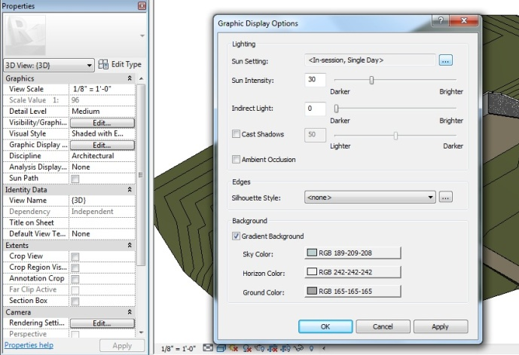
Exercise 1.6.4: Adjusting the Appearance of Elements
In this exercise, students will learn how to:
Use the View Control bar to change display properties
Display shadows and specify the location of the lighting source
Set a project’s location and orientation to cast accurate shadows in a solar study
Use Graphic Display Options to enhance the silhouettes and add gradient backgrounds

Slide 26
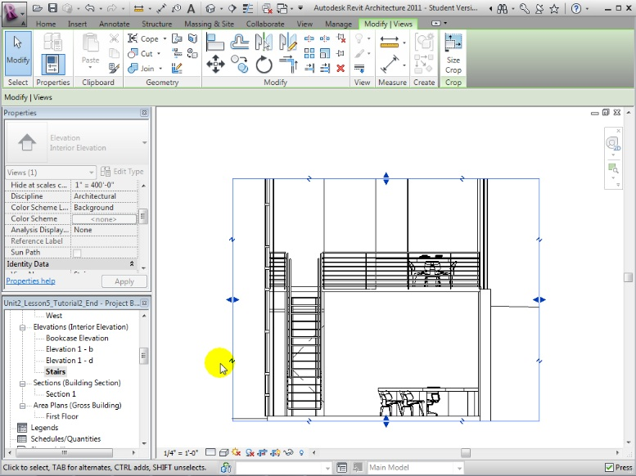
Setting View Properties and Display Options
Modifying elevation and section view properties
Use controls in View Control bar to quickly set:
View scale
Level of detail
Visual style
Cropping and visibility of crop boundary

Slide 27
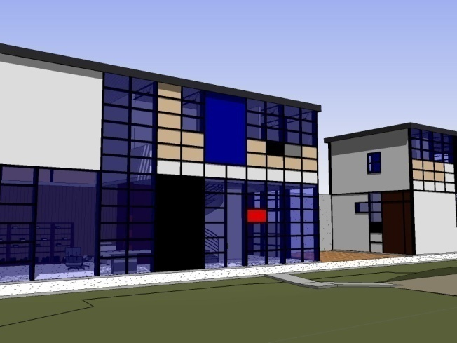
Exercise 1.6.4: Adjusting the Appearance of Elements
Student Exercise
Use the Camera tool to create an exterior perspective view, that shows the east exterior walls of the residence and studio
Duplicate this view and display it using the Shaded with Edges and Realistic visual styles
Adjust the Graphic Display Options to cast accurate shadows

Slide 28
Assessment
Creating Plan Views and Setting View Properties
Which types of objects are copied when you duplicate a view without detailing? With detailing?
What factors affect whether it is better to duplicate with or without detailing?
How would you change the view properties to show clerestory windows with sills located at 6 feet (1.8 meters) above the floor level?

Slide 29
Assessment
Creating Elevation and Section Views
What types of information are typically displayed in:
Exterior elevation views?
Interior elevation views?
Building sections?
Should you create interior elevations for every room?
What features of a room are best illustrated using interior elevations?
What are the key differences between elevation and section views?

Slide 30
Assessment
Creating 3D Views
What happens to the accuracy of objects that appear at the edges as you expand a perspective view’s crop region?
If you want to include a broader view of your model in a perspective view, how should you change the camera placement?
Can you use a section box to cut away parts of a perspective view?

Slide 31
Assessment
Adjusting the Appearance of Elements in a View
What visual styles would you recommend for views that will be:
Printed in construction documents?
Presented to clients to show materials recommendations?
Used to check for intersections or interferences between objects?
How are the shadows displayed in your view affected by:
Project location?
Time of day?
Month of the year?

Slide 32
Key Terms
The following key terms were used in this lesson:
Key Term | Definition
Plan view | A horizontal view looking directly down toward a level from a viewpoint above.
Reflected Ceiling Plan view | A horizontal view looking direct up toward a level from a viewpoint below.
Elevation view | Interior or exterior vertical views with a line of site parallel to the ground. Elevation views typically present external projections of building elements.
Section view | A vertical view that slices through a building to displays the relationships between the cut elements.

Slide 33
Notes:
Thank you.

Slide 34
Autodesk, AutoCAD, AutoCAD LT, Revit, Robot, and 3ds Max are registered trademarks or trademarks of Autodesk, Inc., and/or its subsidiaries and/or affiliates in the USA and/or other countries. All other brand names, product names, or trademarks belong to their respective holders. Autodesk reserves the right to alter product and services offerings, and specifications and pricing at any time without notice, and is not responsible for typographical or graphical errors that may appear in this document.

