Slide 1
BOX PACKING

Slide 2
Seven generative concepts: - Spiraling - Packing - Weaving - Blending - Cracking - Flocking - Tiling
Exploration of Tooling,
Benjamin Aranda and Christopher Lash

Slide 3
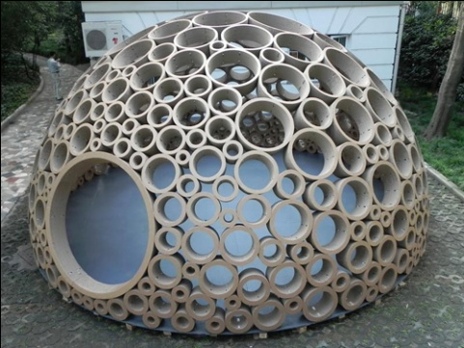
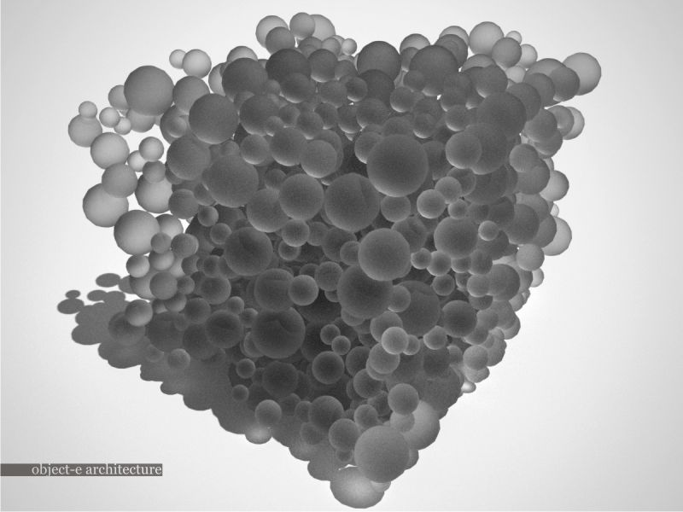
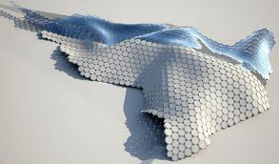
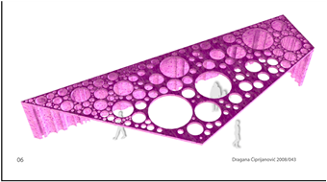
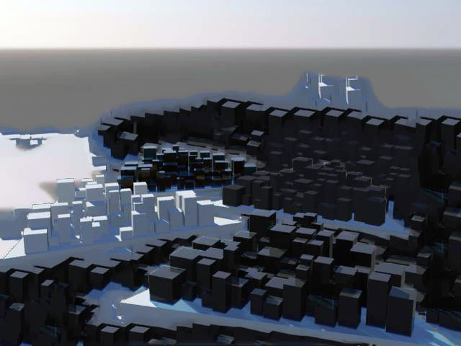
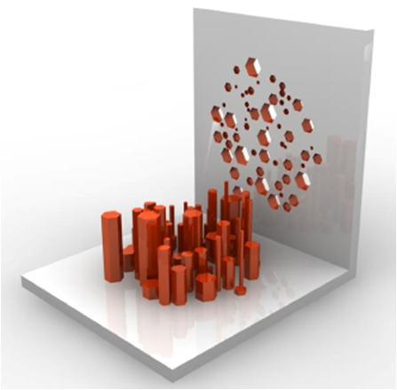
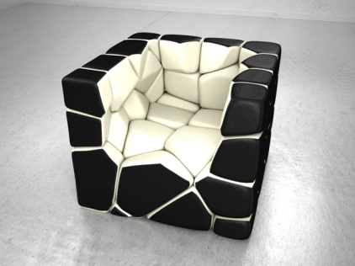
The Packing concept

Slide 4
The Box Packing
within the Wolfram Demonstration projects

Slide 5
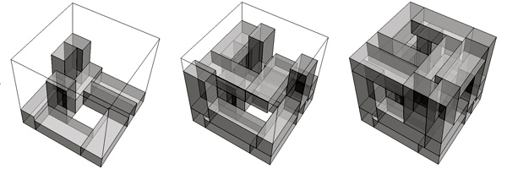
27 identical cubic elements changing proportions
a = 1
b = 2,6
C = 7
a = 1
b = 2,5
C = 6,5
a = 1,2
b = 1,7
C = 4

Slide 6
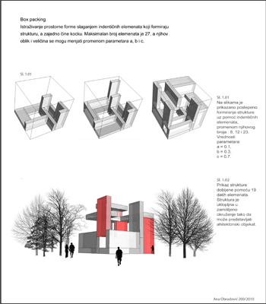
Some students’results of manually packing boxes in Rhino

Slide 7
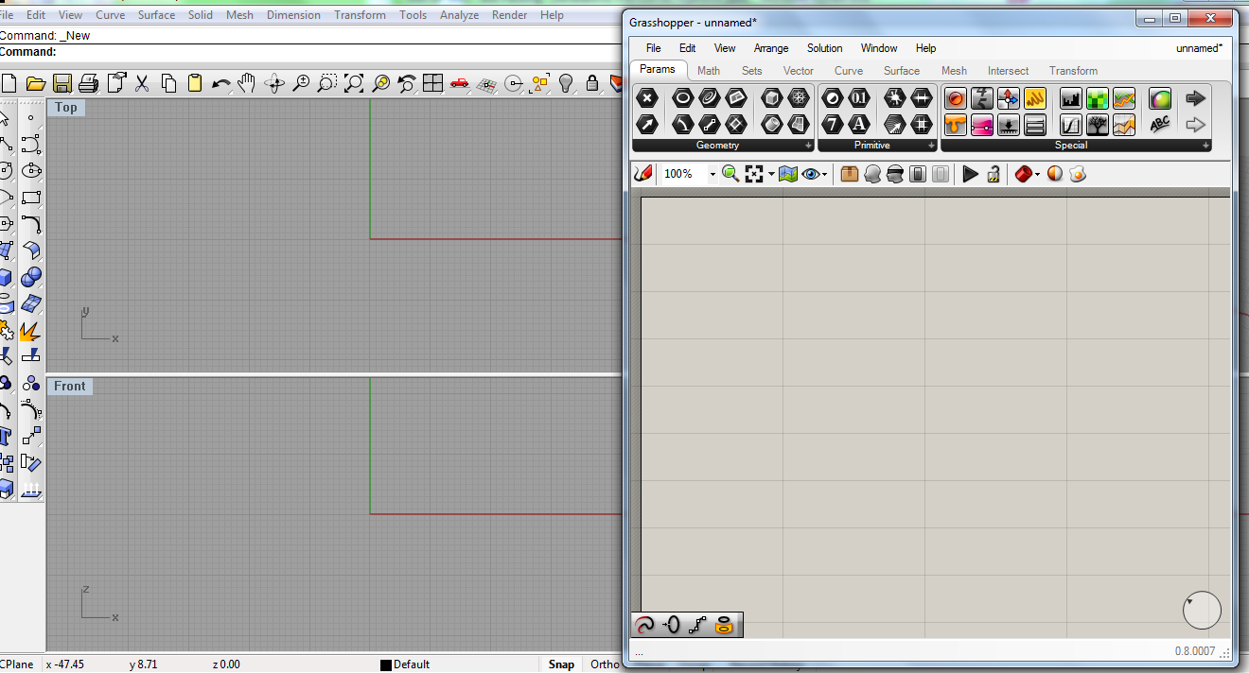
Grasshopper
Rhino plug-in
Graphical editor
Algorithm editor
Parametric modeling in creation of 3D objects
No need of scripting knowledge
Building form generators
from the simple to awe – inspiring
The most common professional architectural tool for development of generative concepts
Ability for expert users to extend the system with C# and Visual Basic

Slide 8
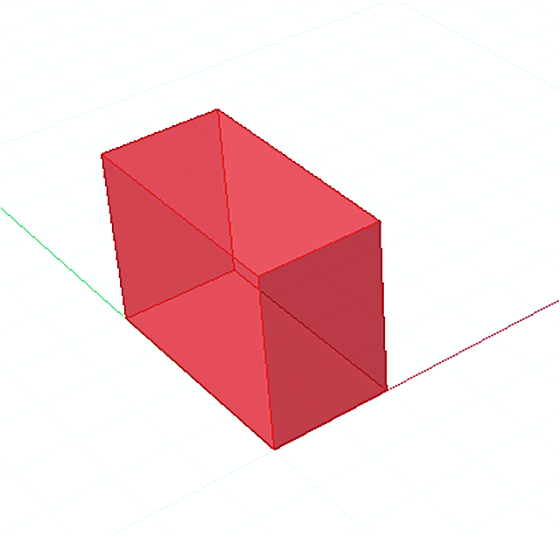
27 identical cubical elements
b
c
packing
a
a+ b + c

Slide 9
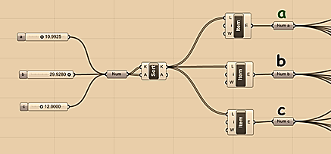
b
c
a
defining conditional relation a < b < c
Realization in Grasshopper definition

Slide 10
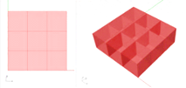
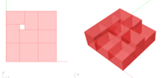
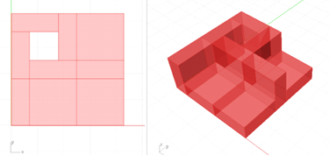
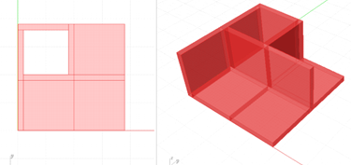
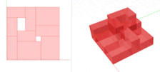
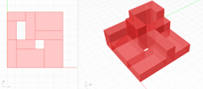
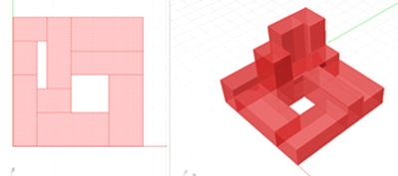
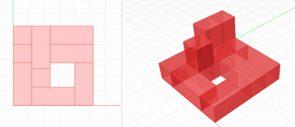
Decreasing of one of the lowest parameter a
Increasing of the highest parameter c

Slide 12
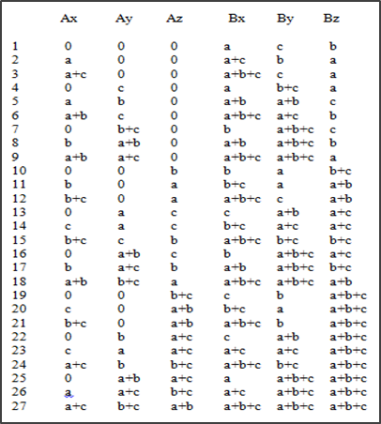
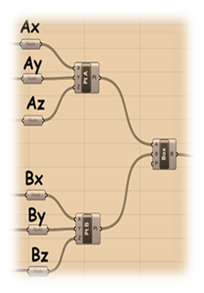
Matching six numerical lists for packing element’s corner in definition

Slide 13
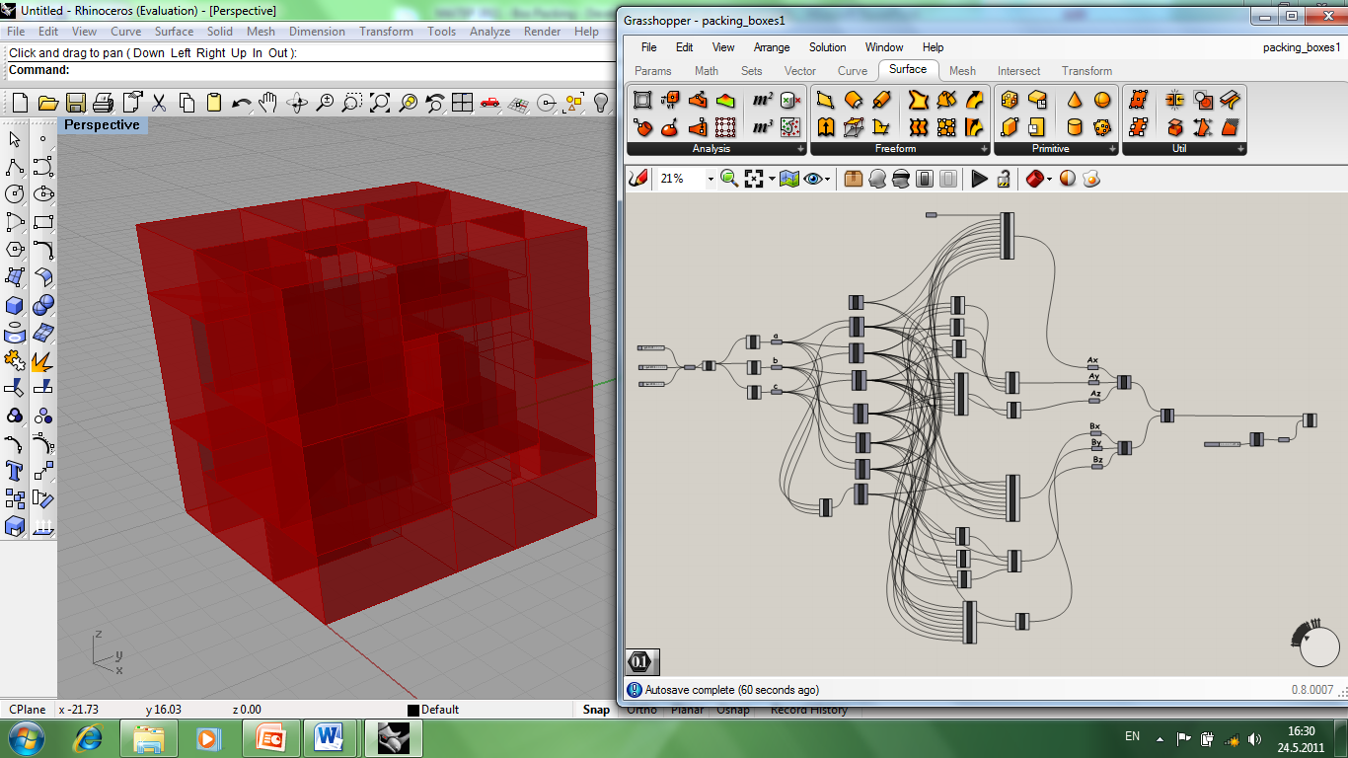
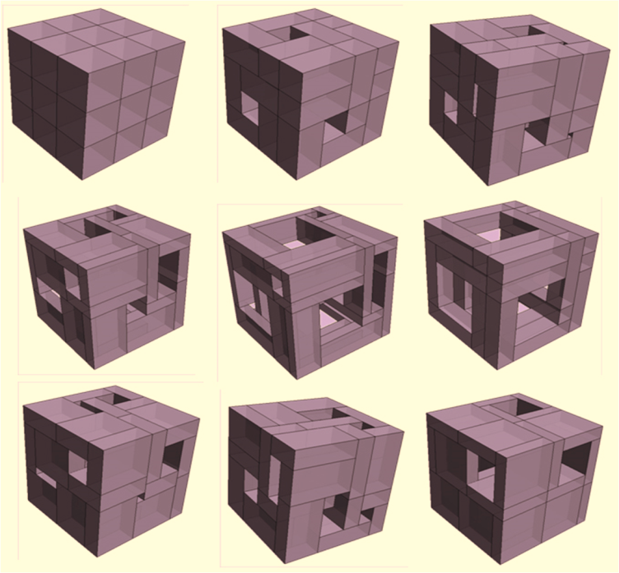
Final possible effects of initial Grasshopper definition

Slide 14
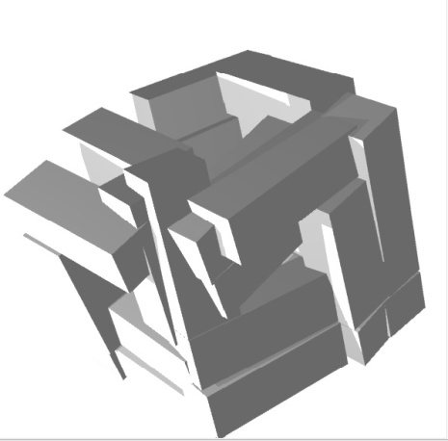
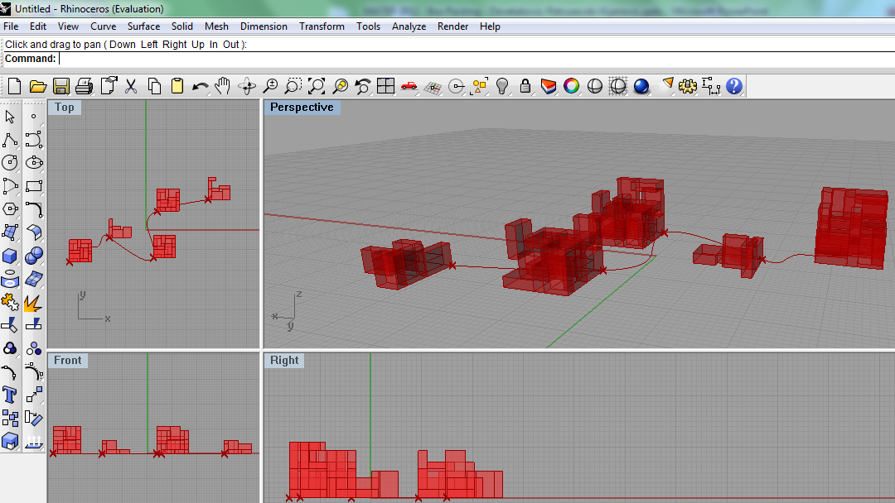
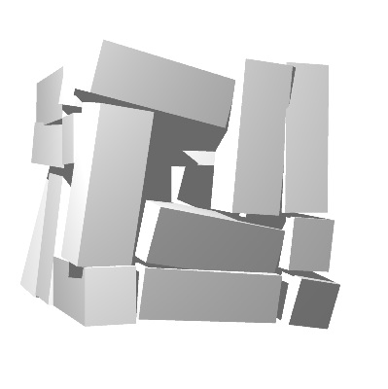
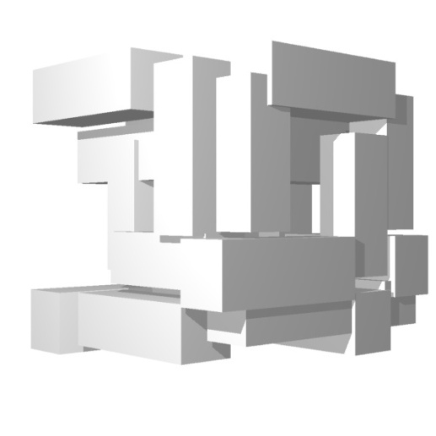
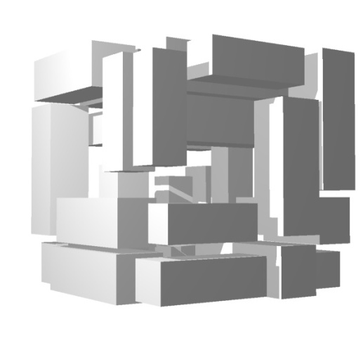
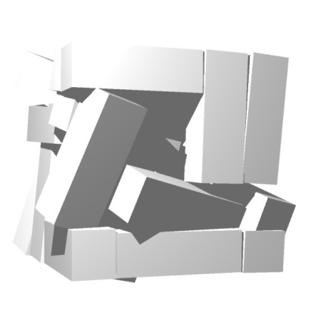
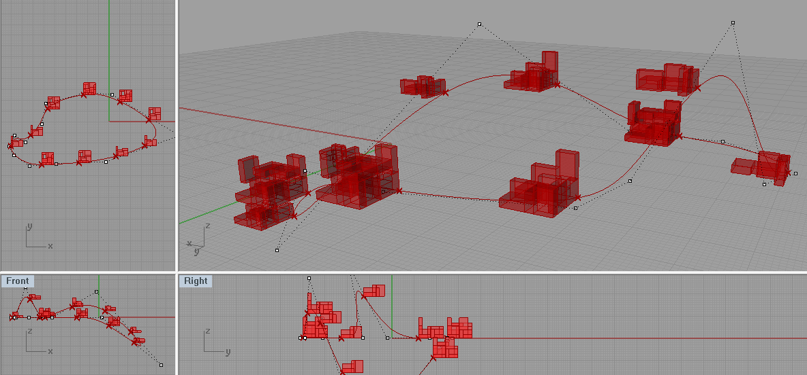
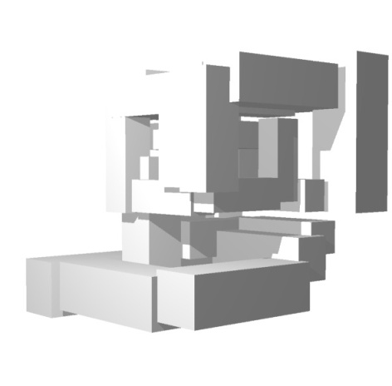
Modification and extending of initial definition
2. Multiplication, scaling and distribution along curve

Slide 15
> 3D Visual Communications: Box Packing – Exercises

Slide 16
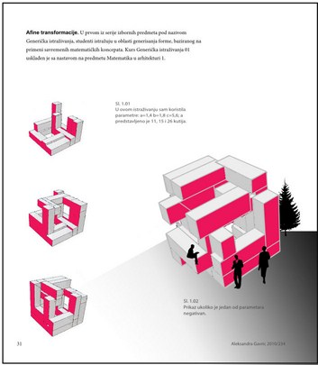
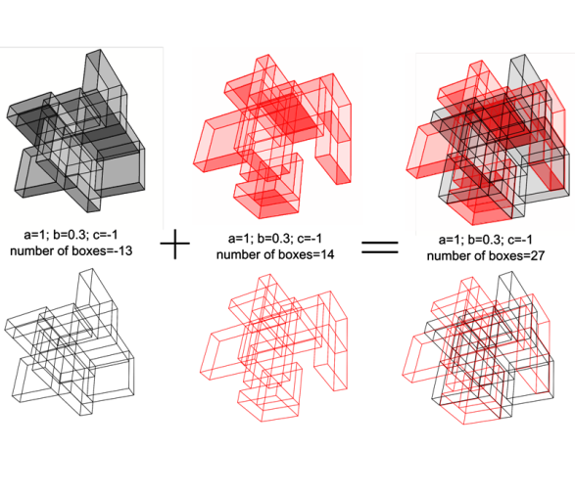
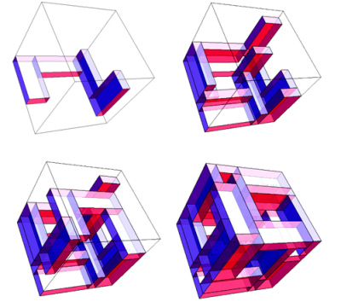
> Box Packing: The Wolfram Demonstration

Slide 17
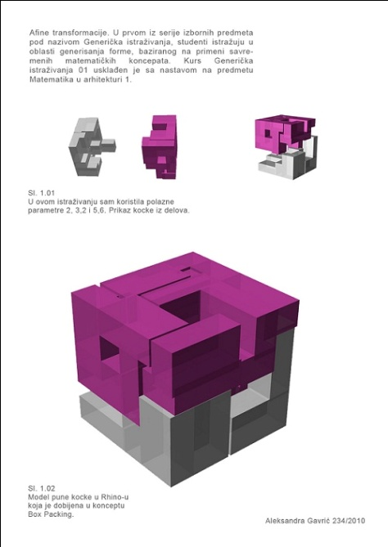
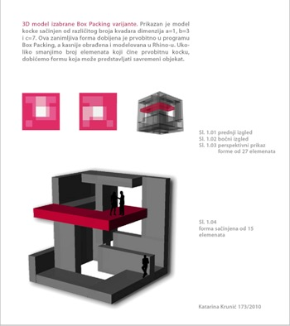
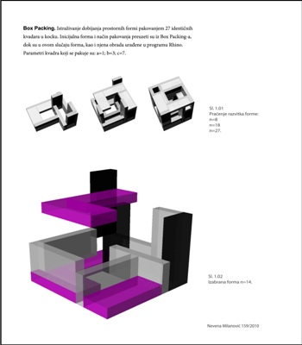
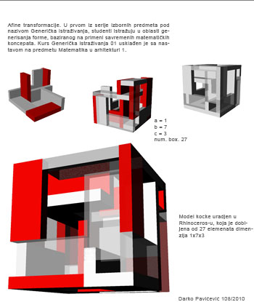
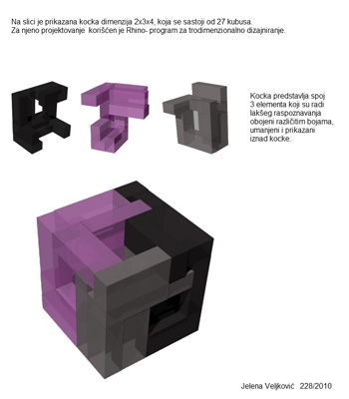
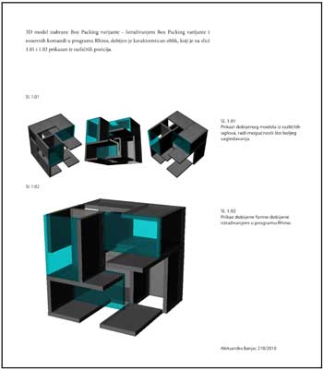
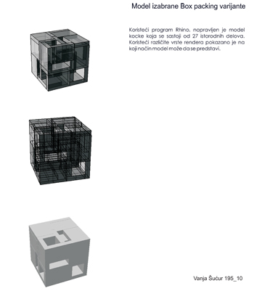
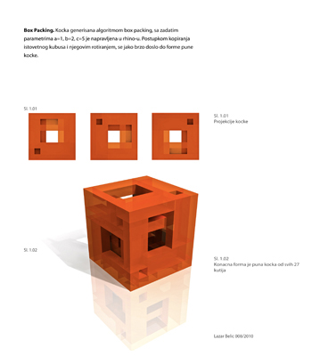
> Box Packing: Rhino Modeling exercise

Slide 18
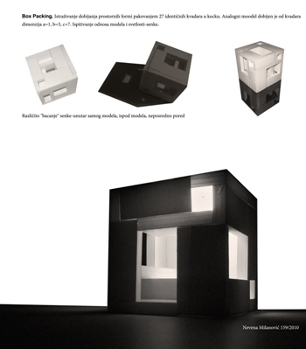
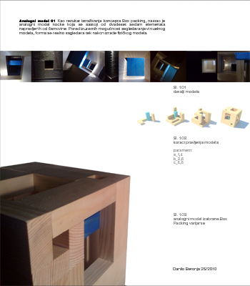
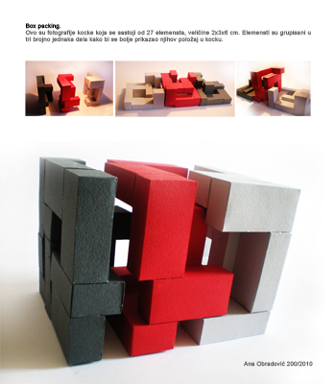
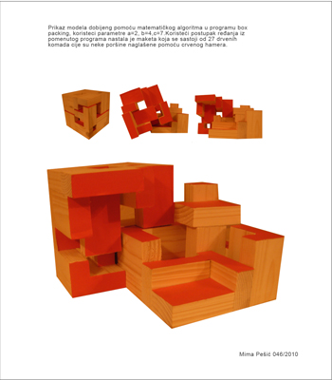
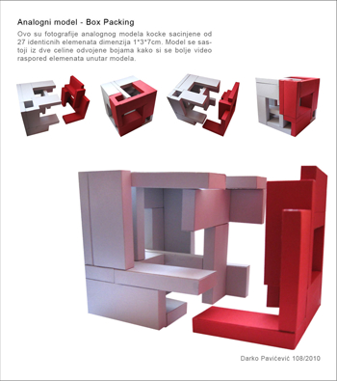
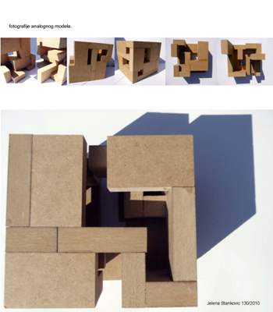
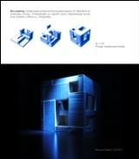
> Box Packing: Analogue model 01

Slide 19
> Box Packing: Materialization

Slide 20
> Box Packing: Lighting

Slide 21
> Box Packing: Variations (using the Grasshopper definition)

Slide 22
> Box Packing: Architectural object

Slide 23
> Box Packing: Analogue model 2

Slide 24
> Box Packing: Urban complex

Slide 25
> 3D Visual Communications: Box Packing - Students’ collections

Slide 26
> collection: student Danilo Beronja

Slide 27
> collection: student Lazar Belic

Slide 28
> collection: Predrag Agatonovic, M.Arch.

Slide 29
2012

