Slide 1
Container Architecture Course: 3D Visual Communications University of Belgrade, Faculty of Architecture
Shipping Containers
Container Architecture Examples
Container Housing
Resources
Dr Mirjana Devetaković
Belgrade, 2014

Slide 2
Shipping Containers

Slide 3
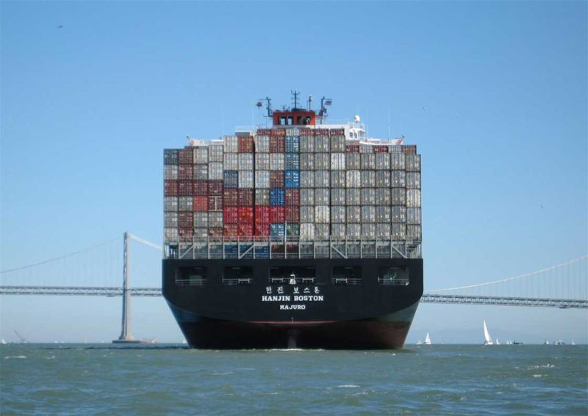
Shipping Containers

Slide 4
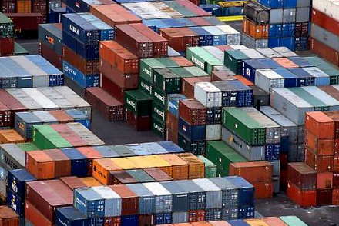
Typical Shipyard
http://bitchinarch.wordpress.com/category/shipping-containers/

Slide 6
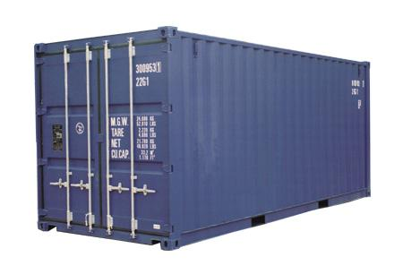
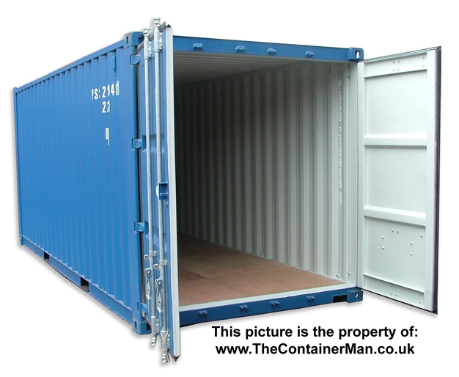

Slide 7
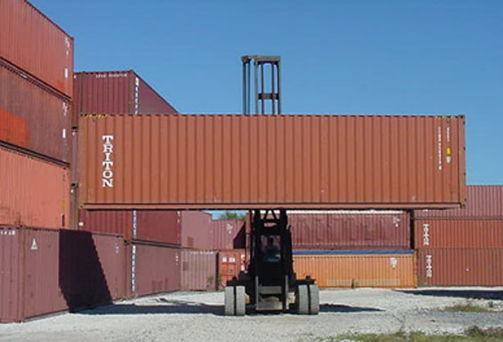

Slide 8
Alternative Container Use

Slide 9
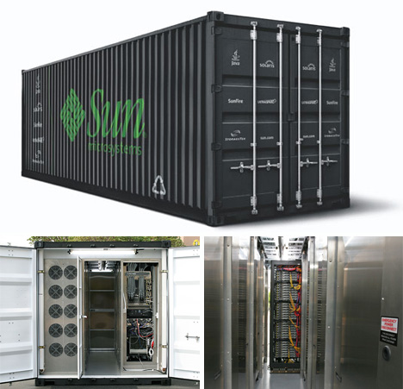

Slide 10
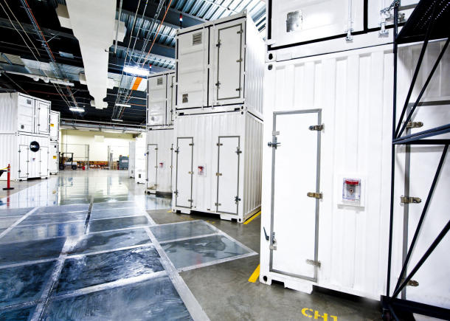
Microsoft Windy City data center, Chicago
http://news.cnet.com/8301-13860_3-10364746-56.html

Slide 11
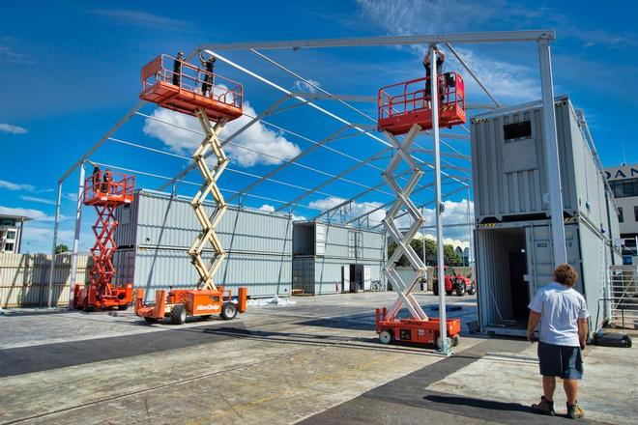
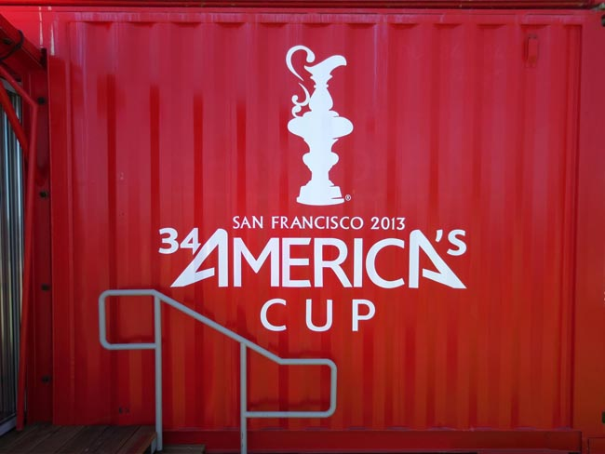
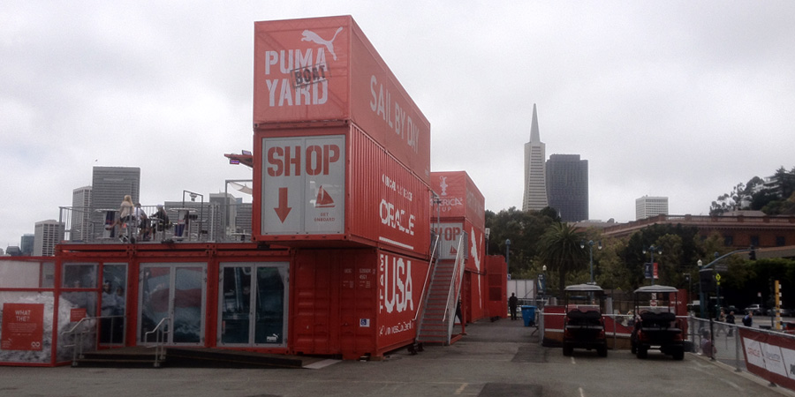

Slide 12
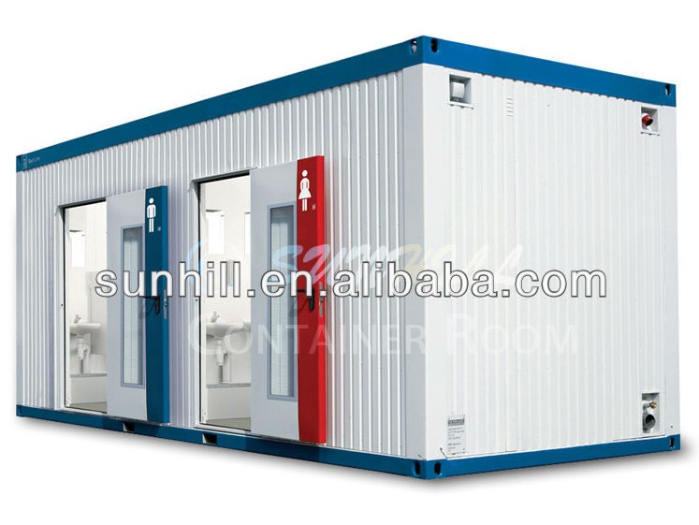
Public facilities

Slide 13
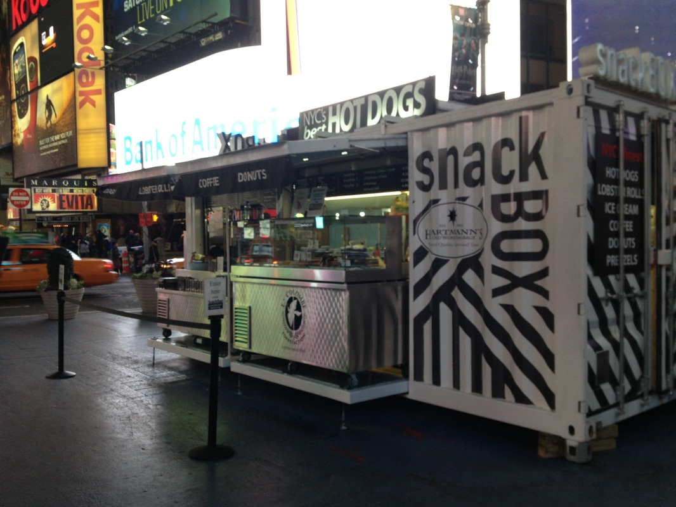
Snack Box, NYC
http://www.snackboxnyc.com/index.html

Slide 14
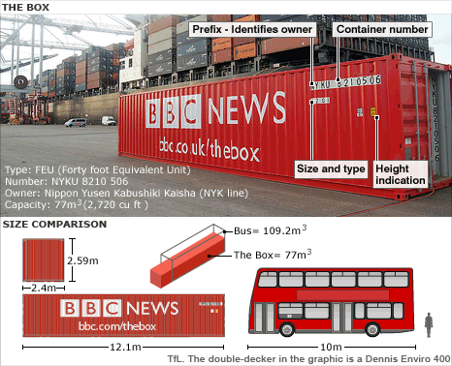

Slide 15
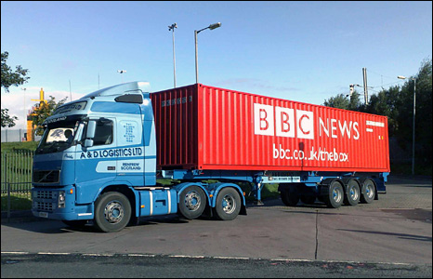

Slide 16
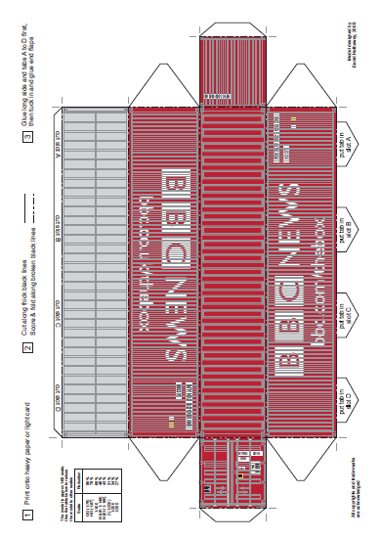
http://news.bbc.co.uk/2/shared/bsp/hi/pdfs/16_09_08_bbc_box_d_hathaway.pdf

Slide 17
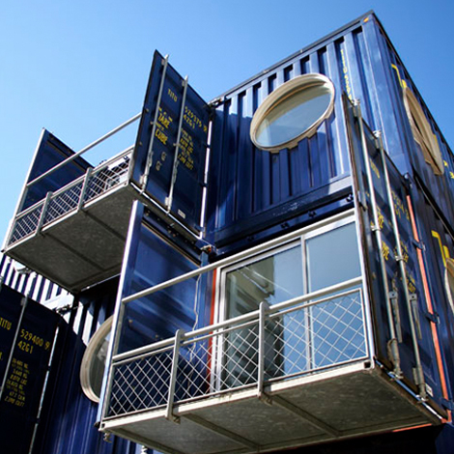
Container Architecture
(Cargotecture)

Slide 18
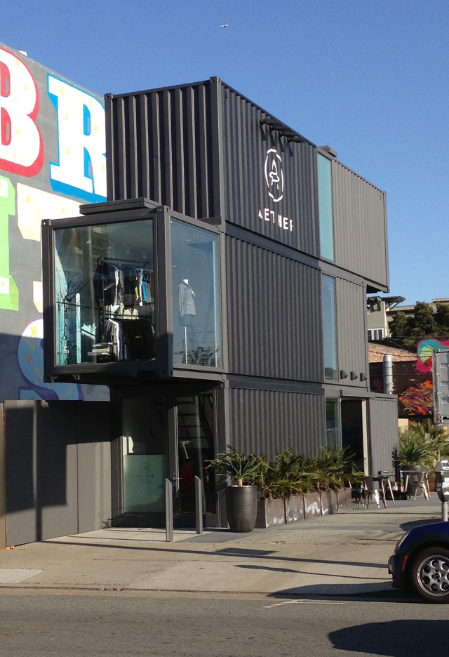
AETHER APPAREL Store, San Francisco
http://inmaterialdesign.wordpress.com/2013/07/23/shipping-container-shops/

Slide 19
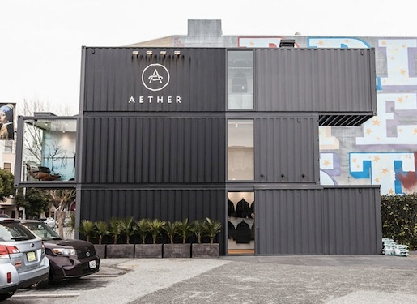
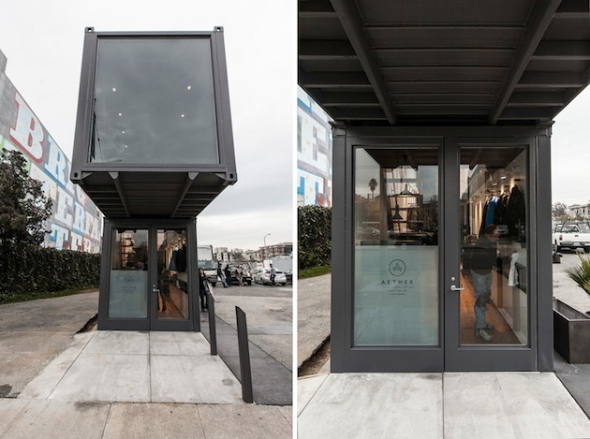

Slide 20
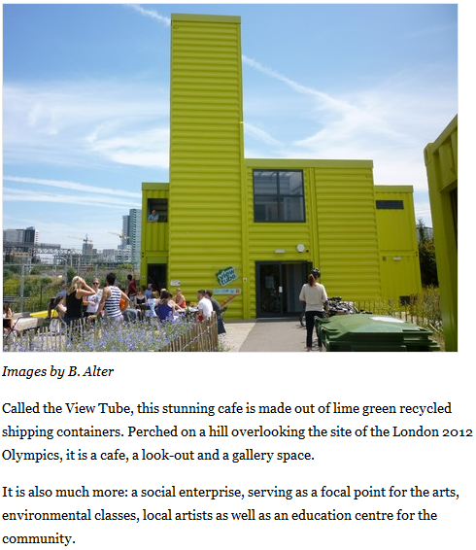
View Tube Café, London, 2012
Container Cafe is a View Tube on the Olympic Site http://www.treehugger.com/sustainable-product-design/container-cafe-is-a-view-tube-on-the-olympic-site.html

Slide 21
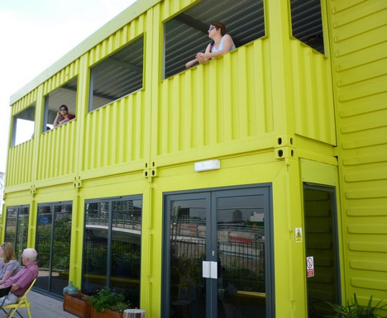
View Tube Café, London

Slide 22
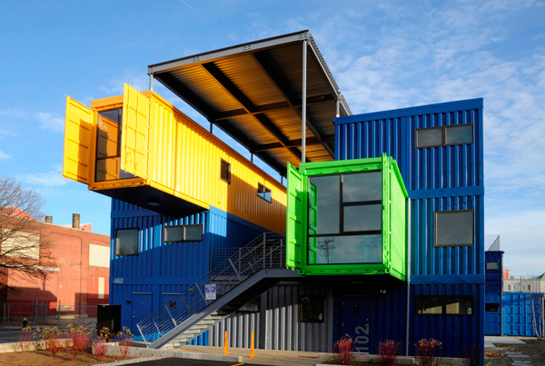
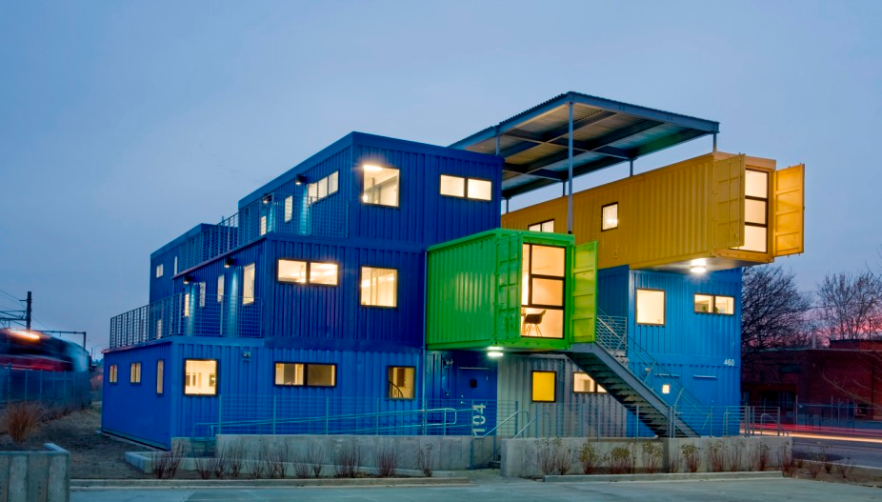
Box Office Shipping Container,

Slide 23
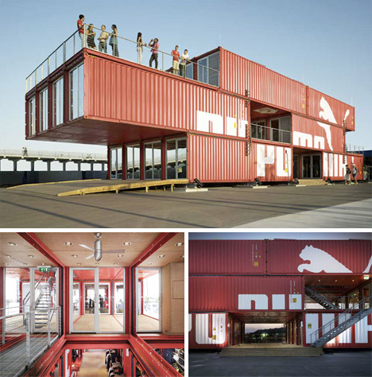

Slide 25
Yoav Messer Architects ltd: ECOntainer bridge, Israel
Source of illustration: DesignBoom, http://www.designboom.com/architecture/yoav-messer-architects-econtainer-bridge-israel/

Slide 26
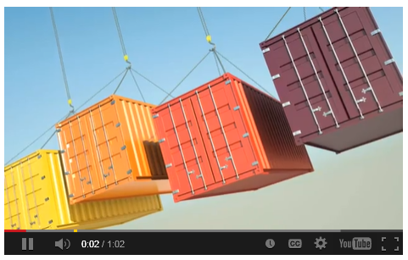
New Shipping Container Bridge Concept
http://www.messer-architects.co.il/econtainer-bridge.html
http://youtu.be/XbF-MBr0Vlk

Slide 27
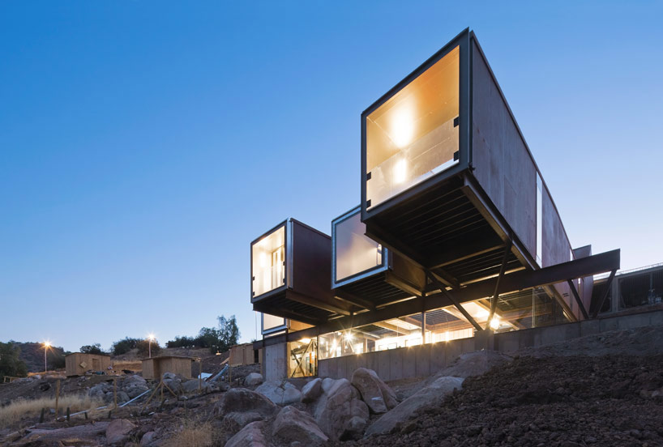
Casa Oruga: shipping container home snakes across the Andes
Source of illustration:
DesignBoom, Casa Oruga: shipping container home snakes across the Andes http://www.designboom.com/architecture/casa-oruga-shipping-container-home-snakes-across-the-andes/ (Jan. 2014)

Slide 28
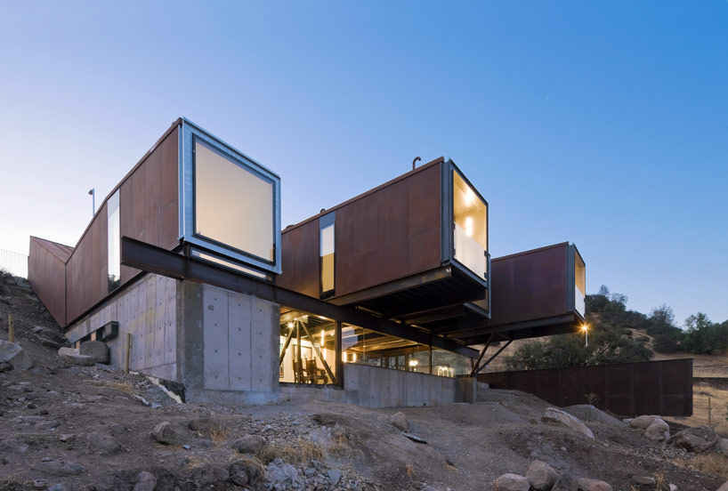
Source of illustration:
DesignBoom, Casa Oruga: shipping container home snakes across the Andes http://www.designboom.com/architecture/casa-oruga-shipping-container-home-snakes-across-the-andes/ (Jan. 2014)

Slide 29
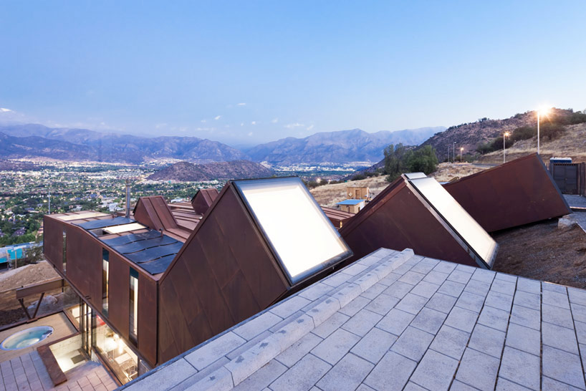
Source of illustration:
DesignBoom, Casa Oruga: shipping container home snakes across the Andes http://www.designboom.com/architecture/casa-oruga-shipping-container-home-snakes-across-the-andes/ (Jan. 2014)

Slide 30
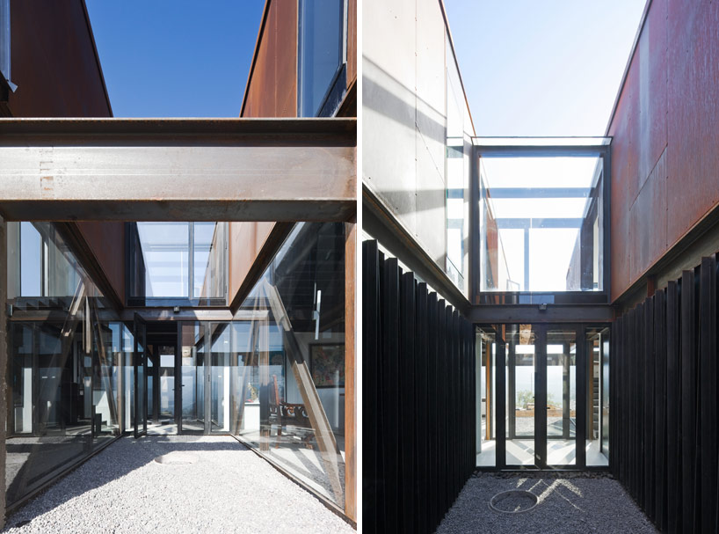
Source of illustration:
DesignBoom, Casa Oruga: shipping container home snakes across the Andes http://www.designboom.com/architecture/casa-oruga-shipping-container-home-snakes-across-the-andes/ (Jan. 2014)

Slide 31
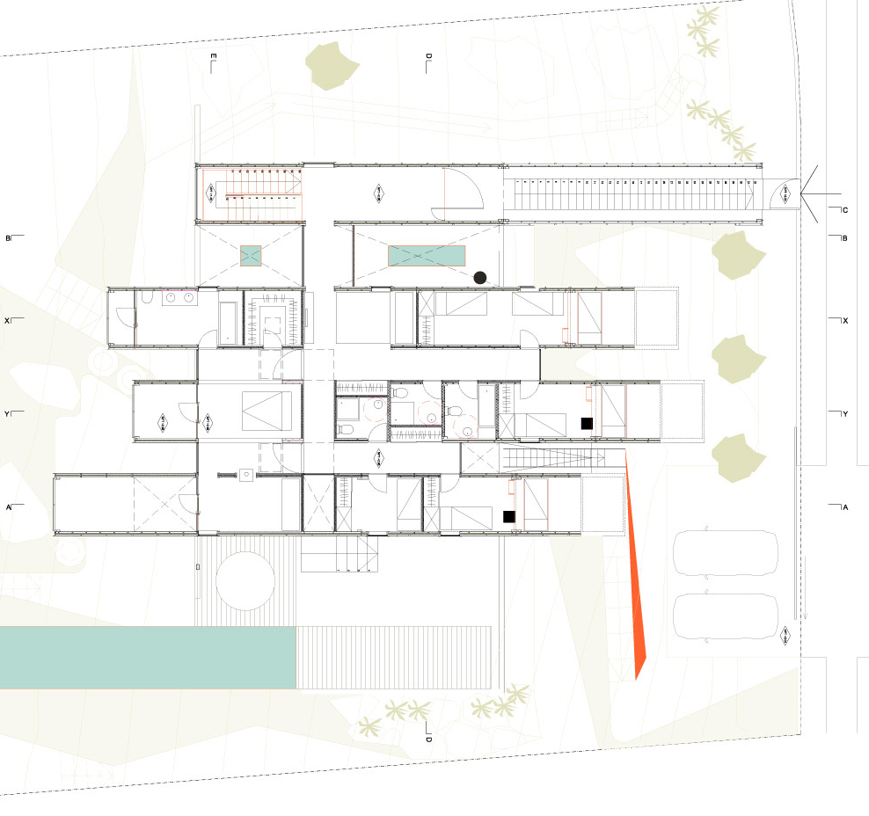
project info:
name of the project : casa oruga /caterpillar house
architect: sebastián irarrázaval delpiano associated architect: erick caro
client: ricardo bezanilla location: los trapenses , lo barnechea, santiago de chile
structural engineer: pedro bartolomé construction: sebastián irarrázaval arquitectos site supervision: ricardo carril
materials:
5 x 40“standard shiping containers,
6 x 20“standard shiping containers and
1 x 40“ open top shiping container,
steel plates , concrete retaining walls, and gypsum board , tymber wood
site area: 900 mt2
gross built area: 350 m2

Slide 33
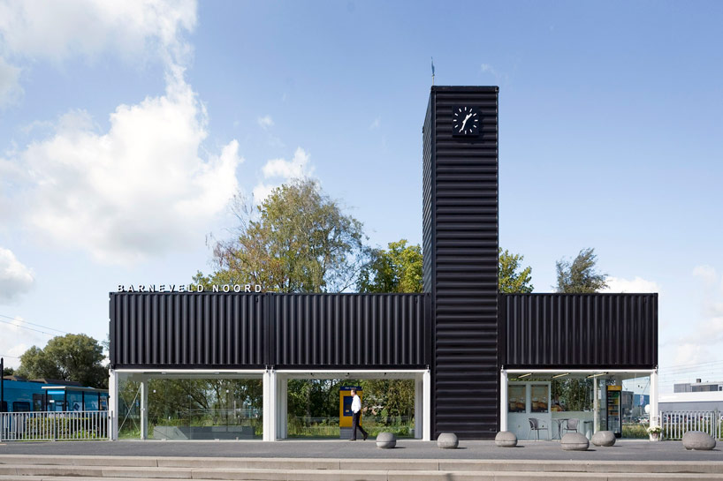
Barneveld Noord Bus Station, the Netherlands ‘designed to improve the waiting experience’, NL Architects
Source of illustration:
NL architects convert containers into barneveld noord station http://www.designboom.com/architecture/nl-architects-convert-containers-into-barneveld-noord-station-10-23-2013/ (Jan. 2014)

Slide 34
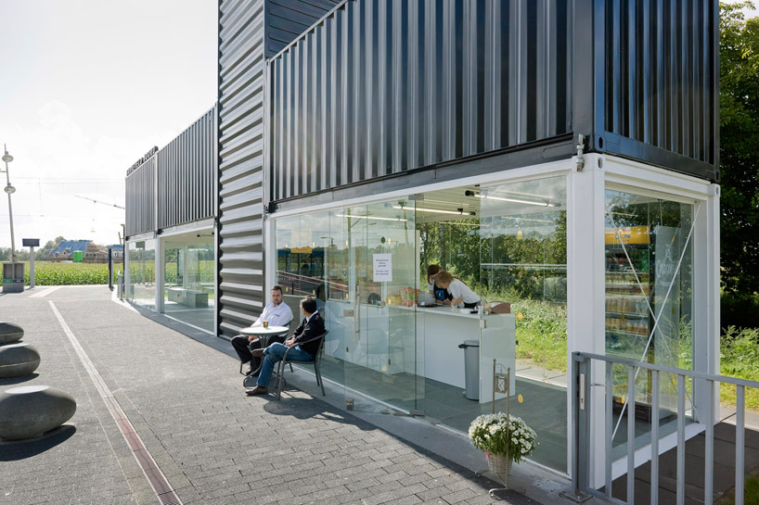
Barneveld Noord Bus Station, the Netherlands ‘designed to improve the waiting experience’, NL Architects
Source of illustration:
NL architects convert containers into barneveld noord station http://www.designboom.com/architecture/nl-architects-convert-containers-into-barneveld-noord-station-10-23-2013/ (Jan. 2014)

Slide 35
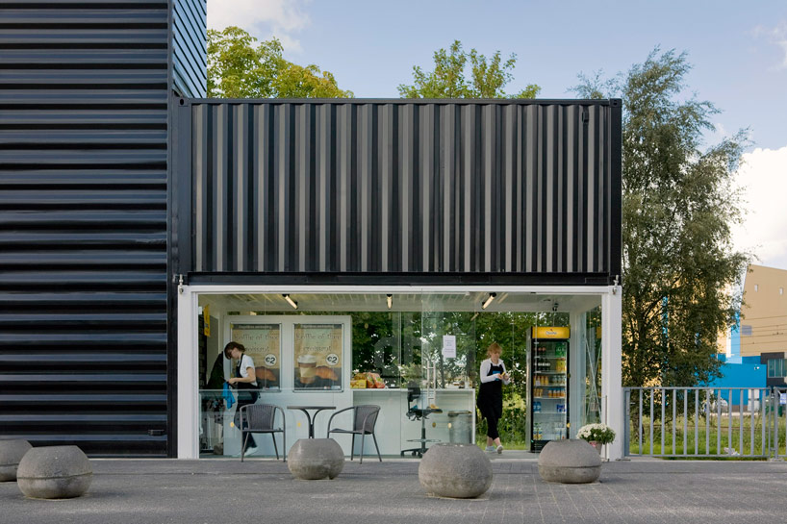
Barneveld Noord Bus Station, the Netherlands ‘designed to improve the waiting experience’, NL Architects, 2013
Source of illustration:
NL architects convert containers into barneveld noord station http://www.designboom.com/architecture/nl-architects-convert-containers-into-barneveld-noord-station-10-23-2013/ (Jan. 2014)

Slide 36
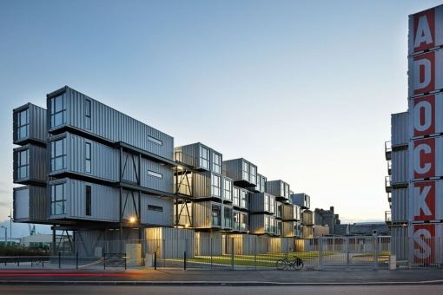
Cité A Docks Student Housing
Cattani Architects, Le Havre, France
Source of illustration:
http://openbuildings.com/buildings/cite-a-docks-student-housing-profile-5787

Slide 37
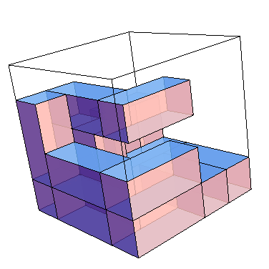
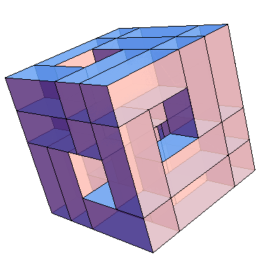
Geometry of a shipping container

Slide 38
12.00
2.90
2.60
2.45
6.00

Slide 39
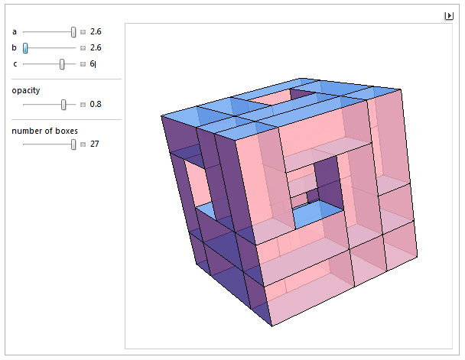
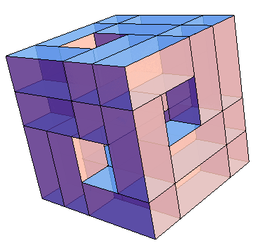
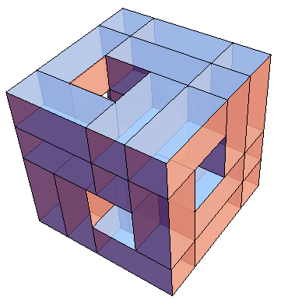
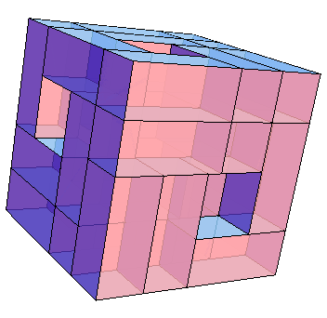

Slide 40
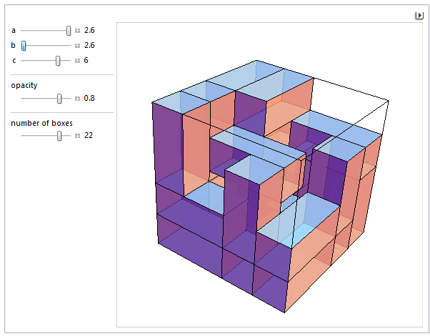
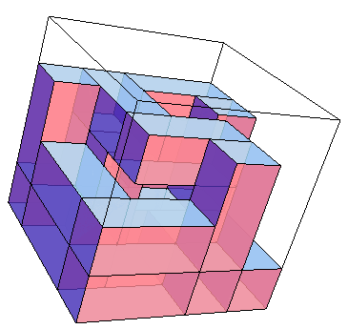
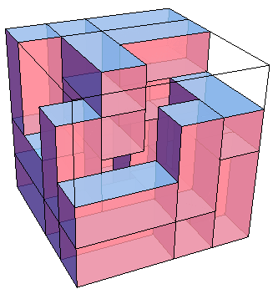
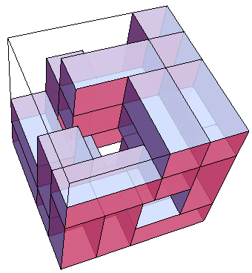

Slide 41
http://empire-logistics.org/wp-content/uploads/2012/11/Marc_Levinson_The_Box_How_the_Shipping_Container_Made_the_World_Smaller_and_the_World_Economy_Bigger__2006.pdf

Slide 42
