Slide 1
Exploring Architectonics of Affine Form GEFFA Workshop, Rijeka, Croatia, 2012

Slide 4
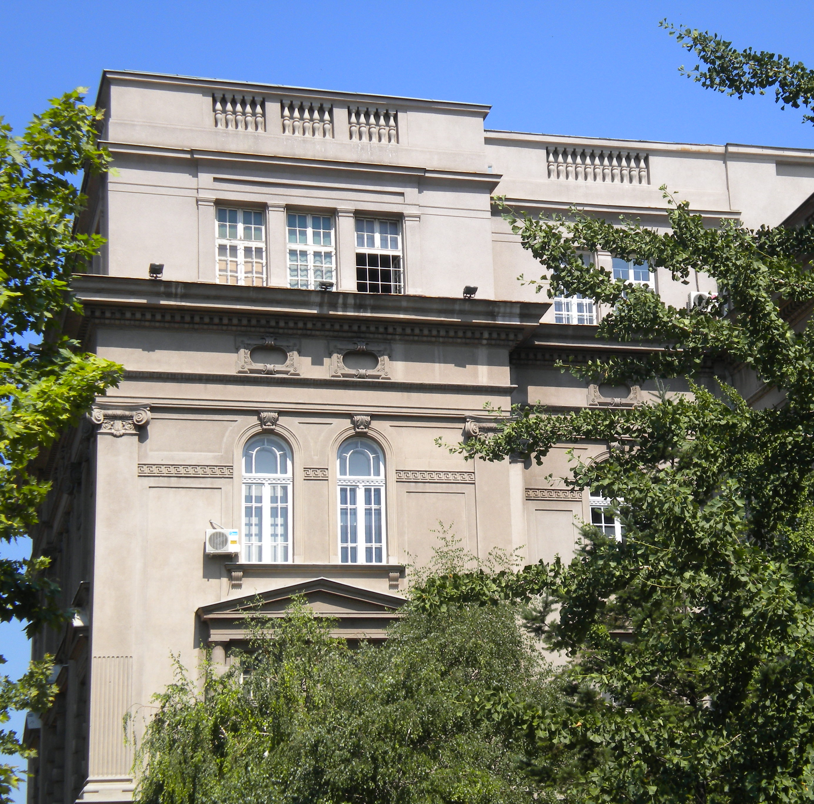

Slide 5
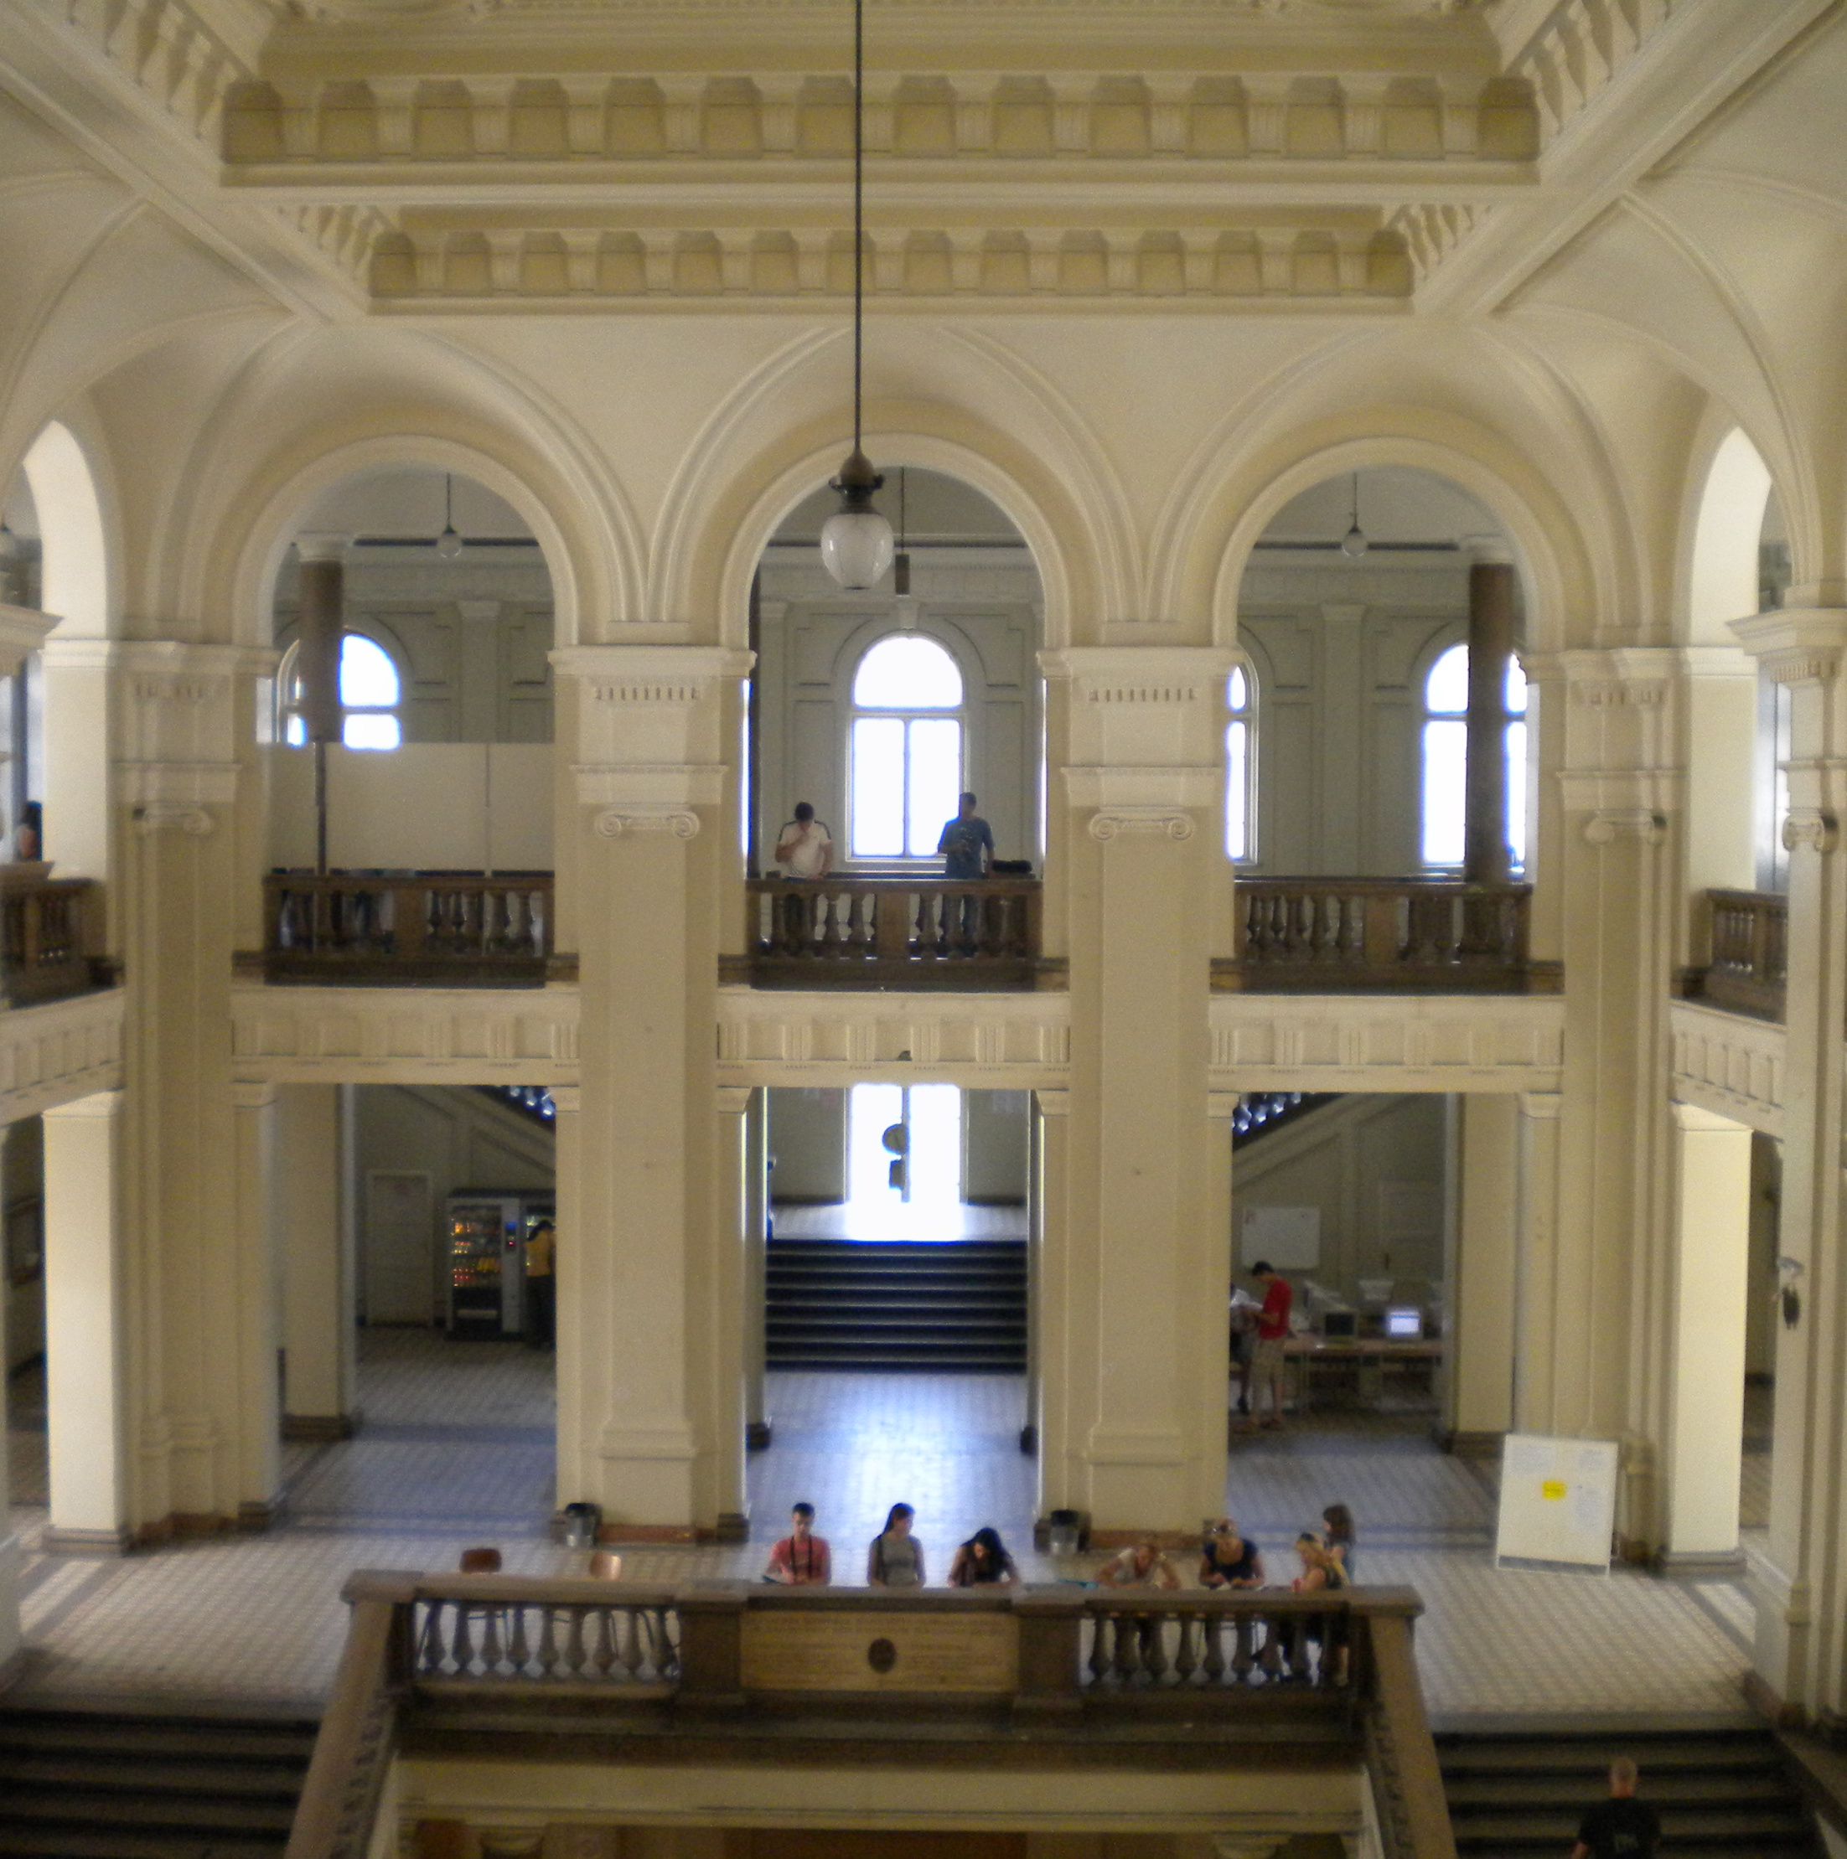

Slide 6
> Mathematics, Architectural Geometry and CAAD (Kabinet za matematiku, arhitektonsku geometriju i CAAD)
Belgrade University, Faculty of Architecture
Department of Architecture

Slide 7
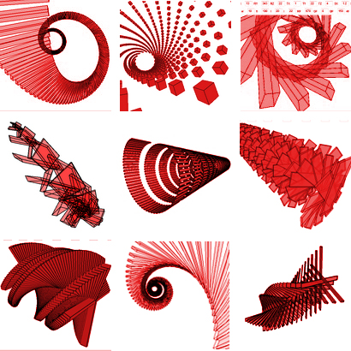
Topics: AFFINE TRANSFORMATIONS

Slide 8
An affine transformation is a composition of scaling, reflection, translation and rotation, or some of them, in any order.

Slide 9
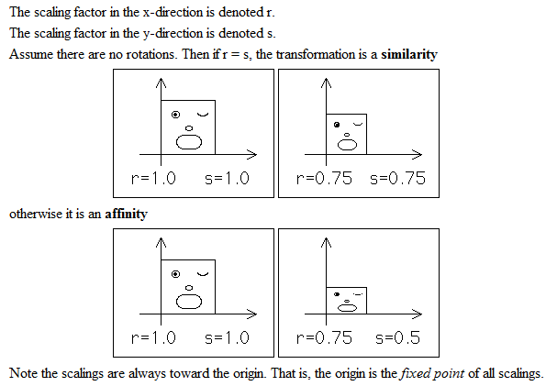
> Scaling (r, s)
http://classes.yale.edu/fractals/IntroToFrac/TransfGeom/TransfGeom.html

Slide 10
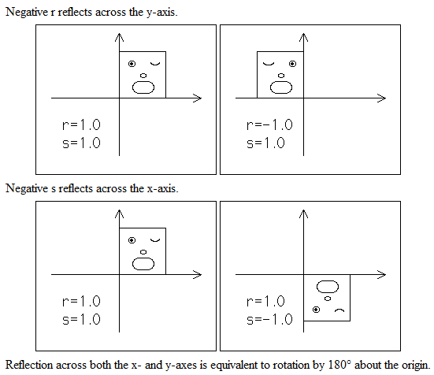
> Reflection (±r, ±s)
http://classes.yale.edu/fractals/IntroToFrac/TransfGeom/TransfGeom.html

Slide 11
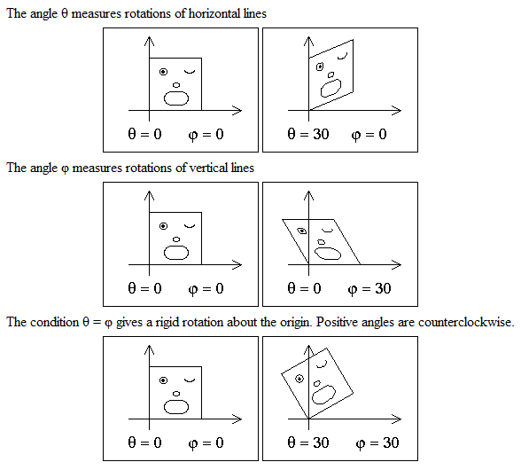
> Rotation (Ѳ,ϕ)
http://classes.yale.edu/fractals/IntroToFrac/TransfGeom/TransfGeom.html

Slide 12
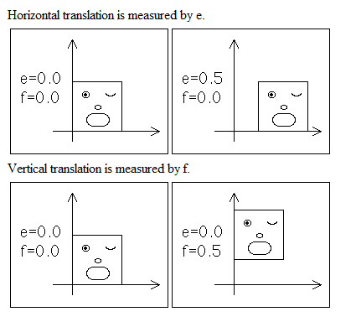
> Translation (e, f)
http://classes.yale.edu/fractals/IntroToFrac/TransfGeom/TransfGeom.html

Slide 13
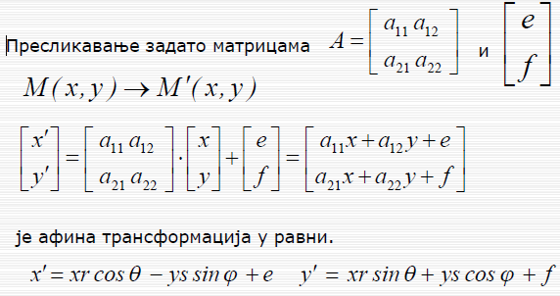

Slide 14
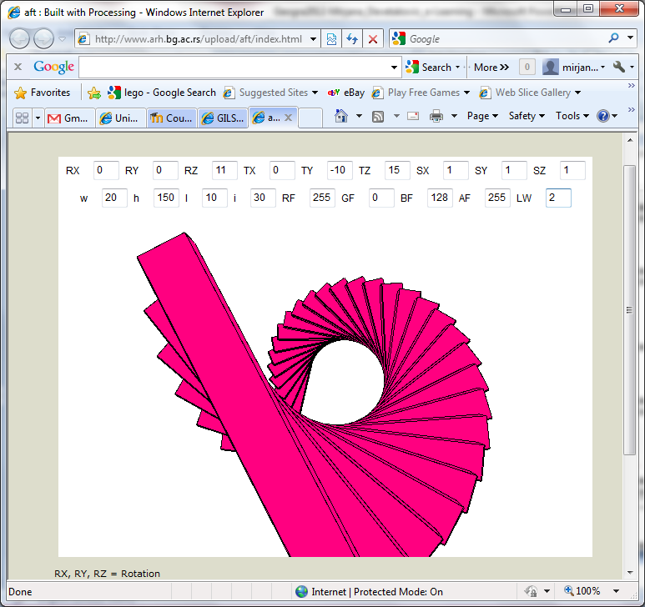
Discussion forum ~ 250 answers
> Affine Transformations
Within the core course Mathematics in Architecture 1
Affine transformations applet
Available online

Slide 15
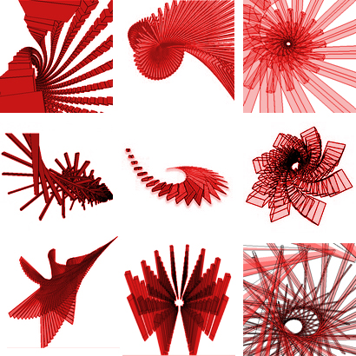

Slide 16
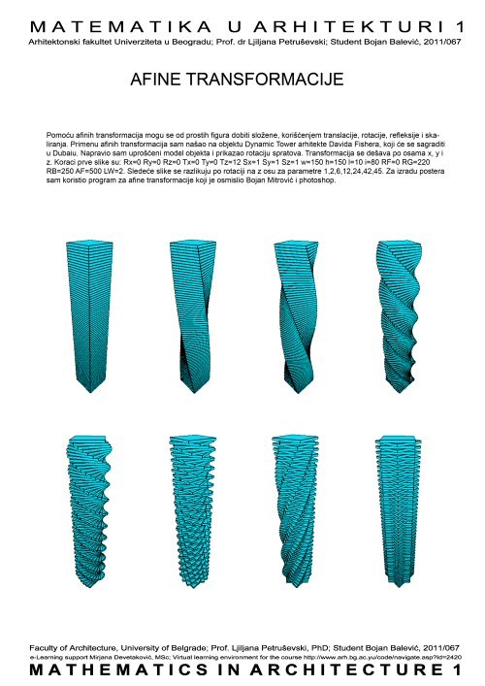
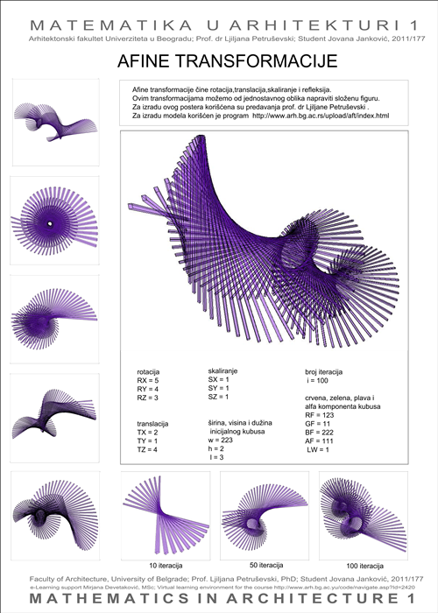
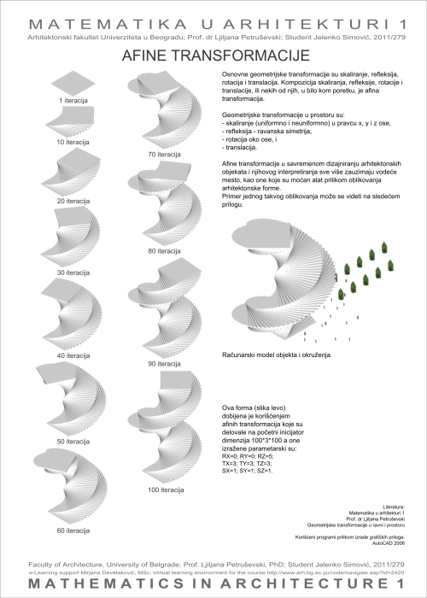
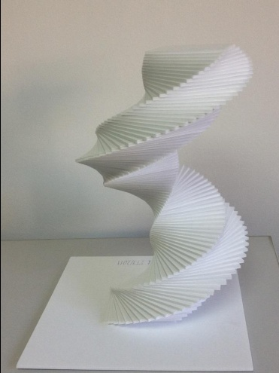
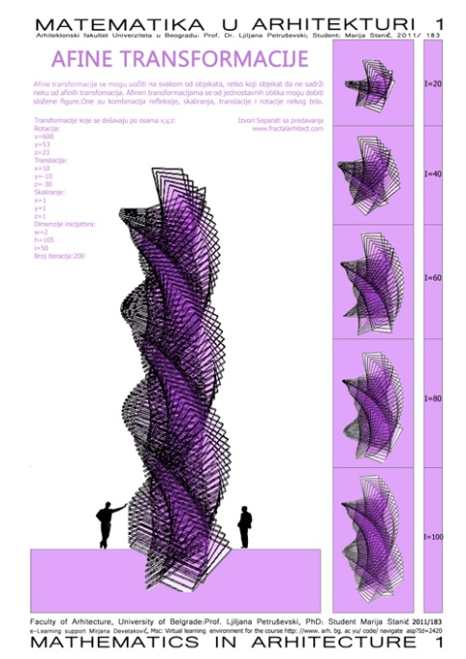
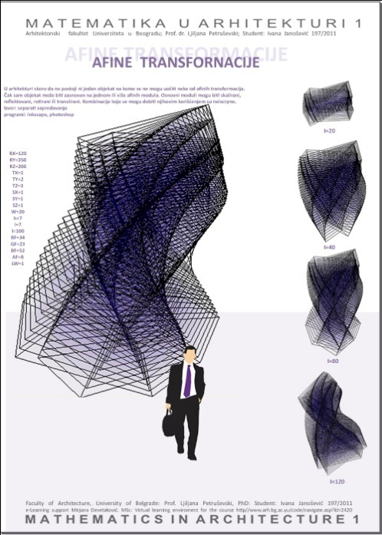
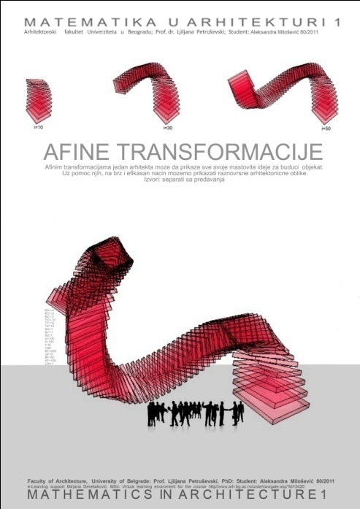

Slide 17
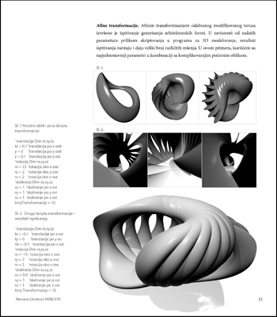
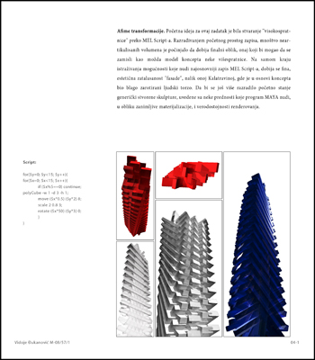
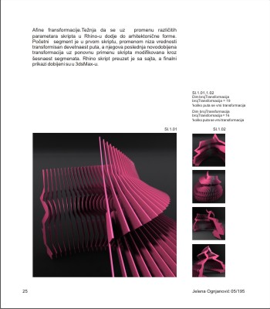
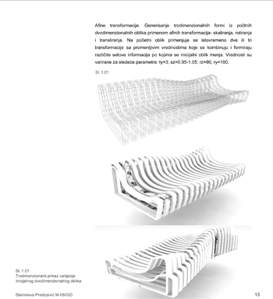
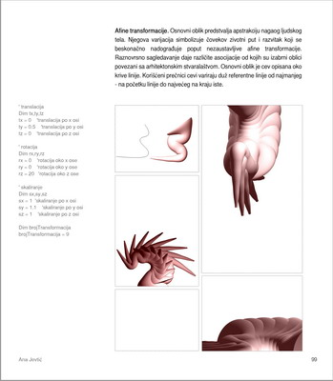
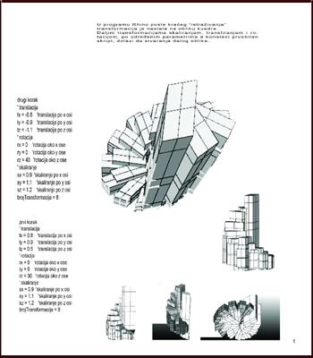
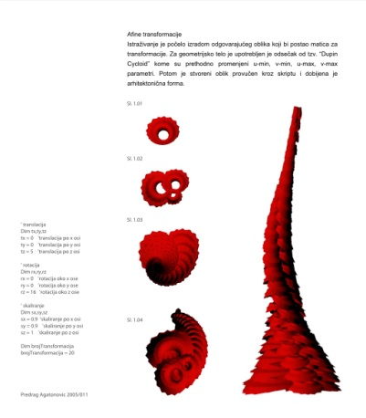
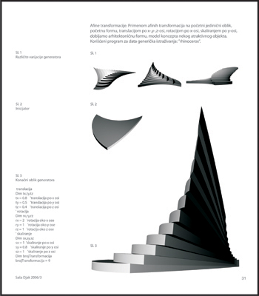
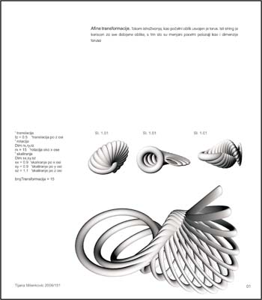
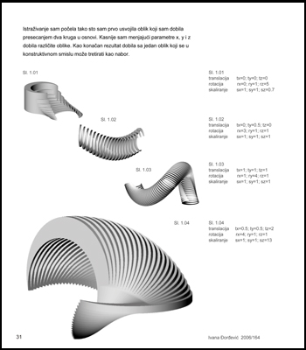
> Affine Transformations
Elective course Generic explorations

Slide 19
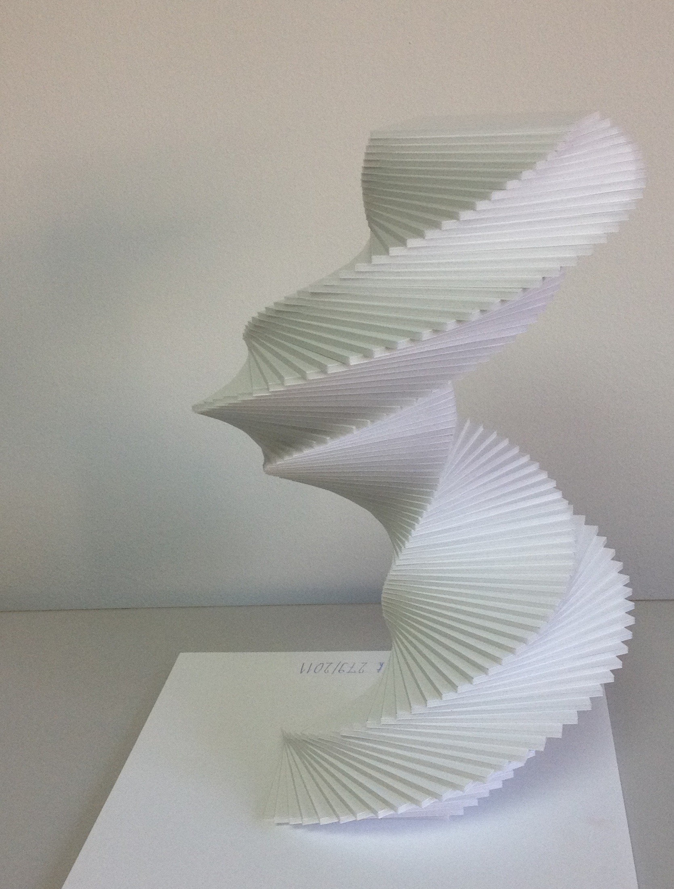

Slide 20
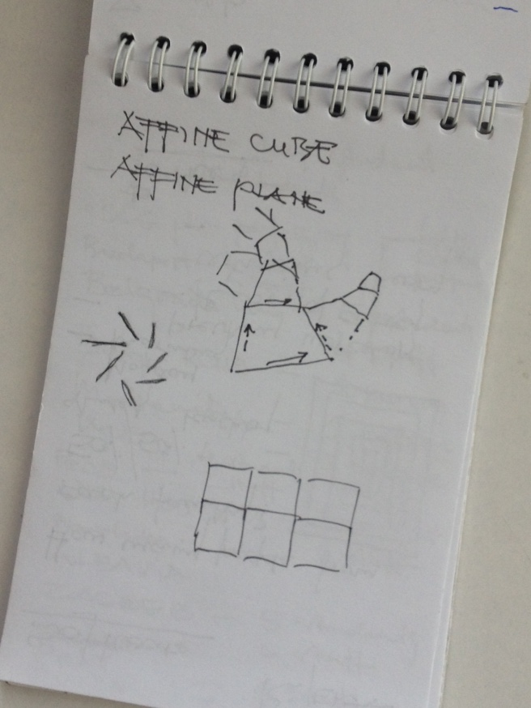

Slide 22
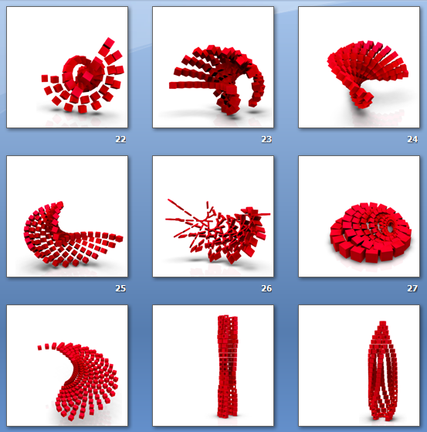
Examples

Slide 30
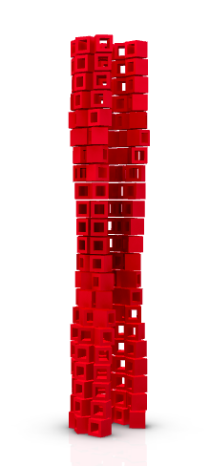

Slide 31
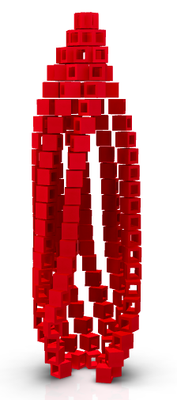

Slide 32
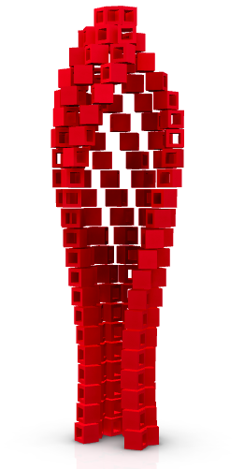

Slide 33
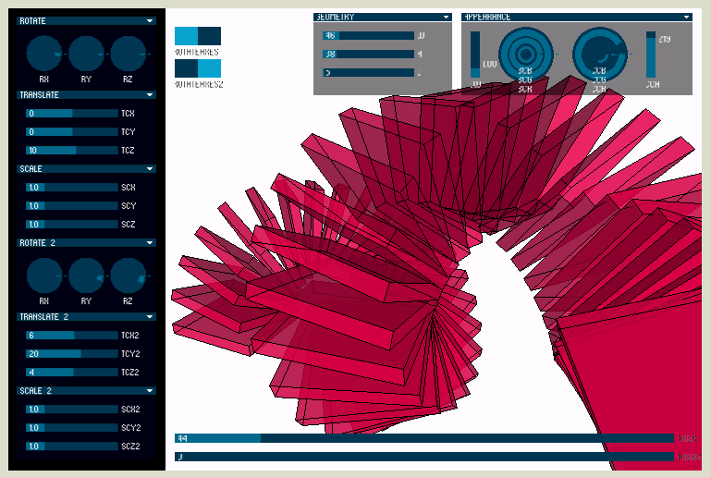
The Applet

Slide 34
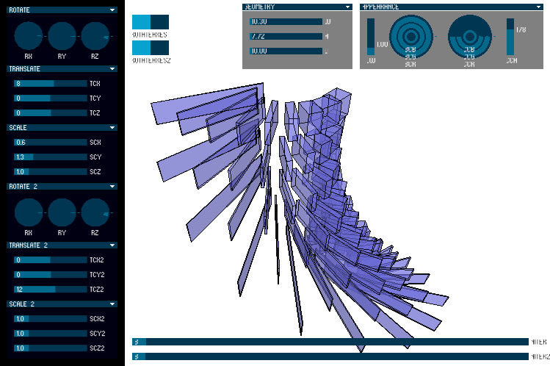
> The Applet
http://www.arh.bg.ac.rs/upload/applets/daft/index.html

Slide 35
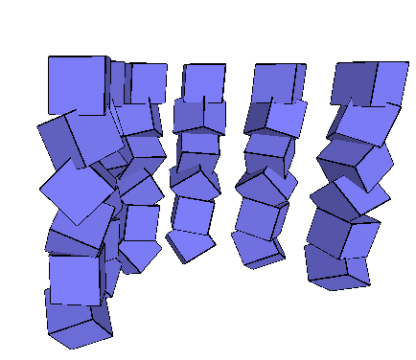
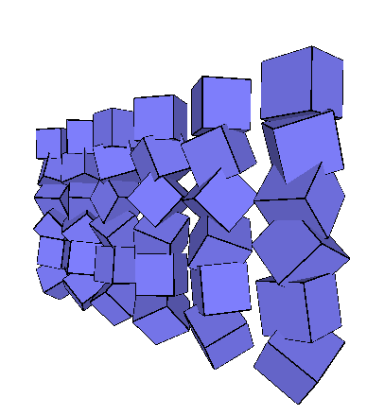

Slide 36
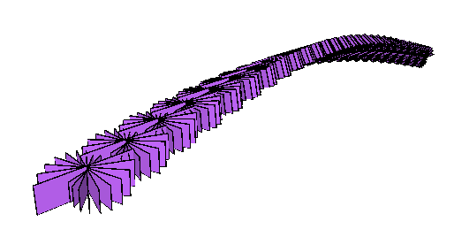
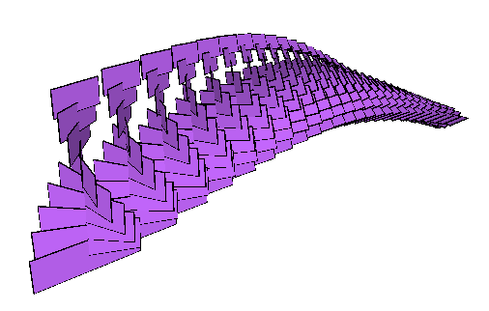
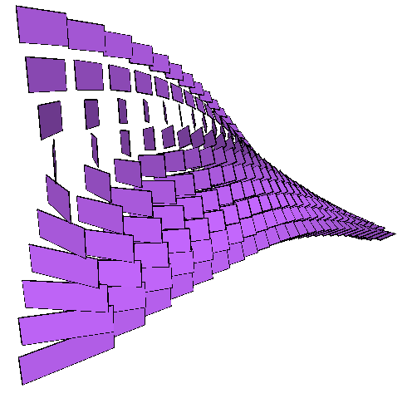

Slide 37
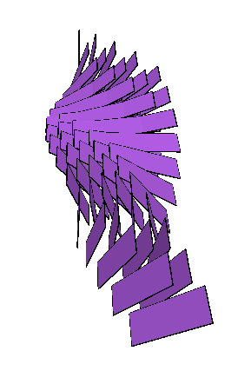
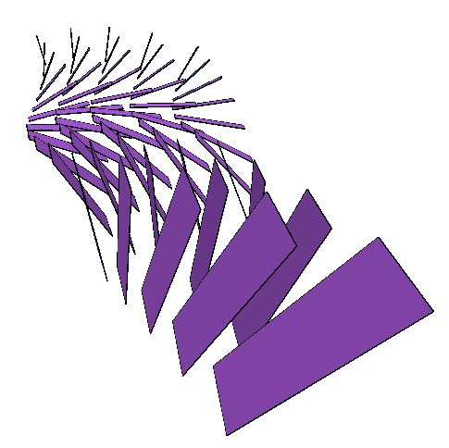
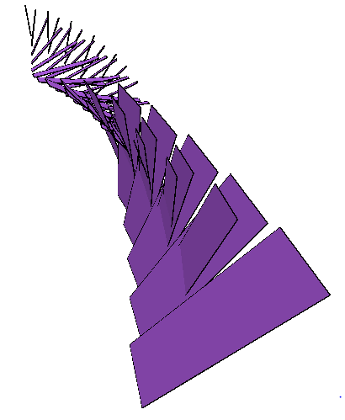

Slide 38
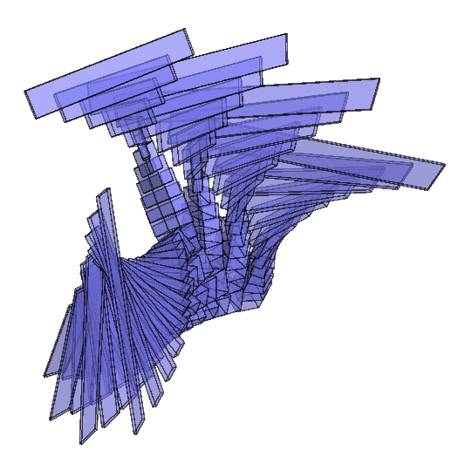
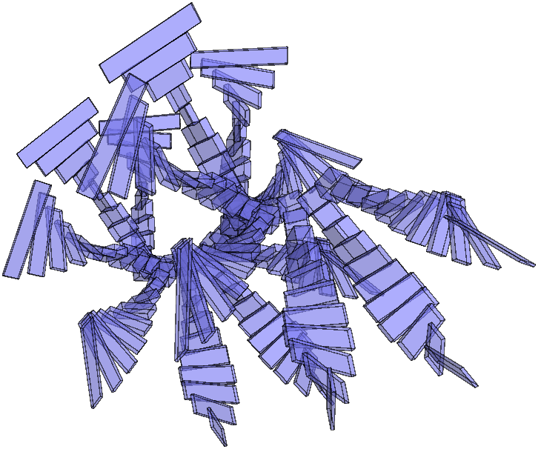
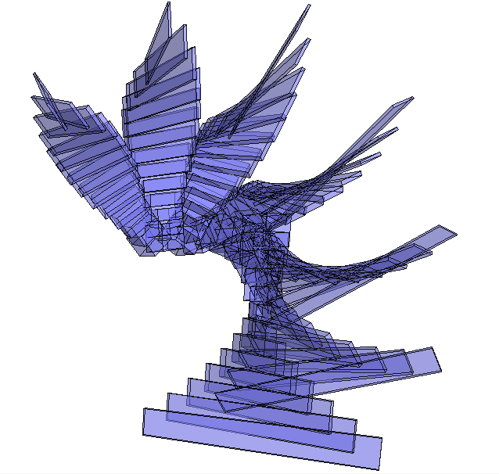
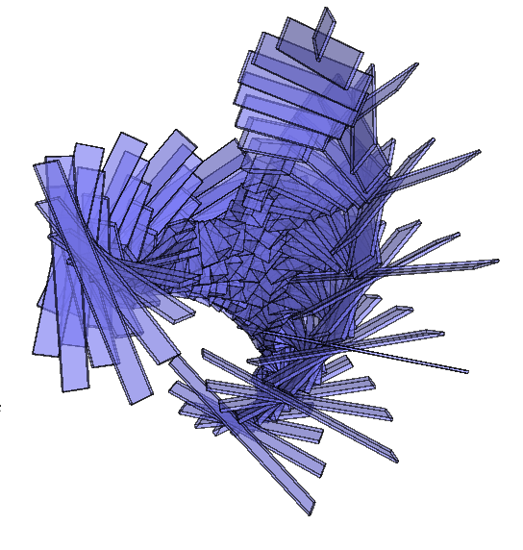

Slide 39
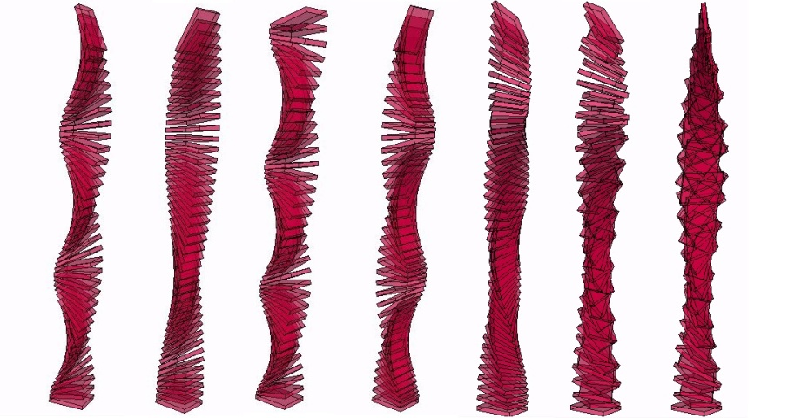
Methodology

Slide 40
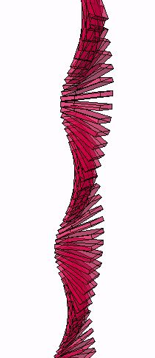
> Single Affine Transformation

Slide 41
> Sequence

Slide 42
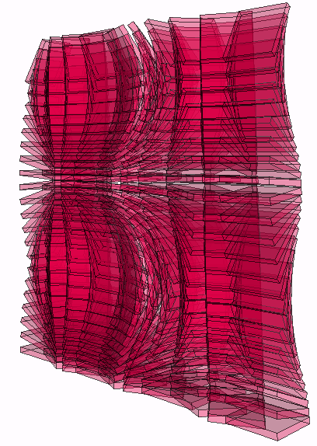
> Dual Affine Transformation

Slide 43
> Dual Affine Transformation

Slide 44
AFFINE TRANSFORMATIONS at Biennale

Slide 49
Rijeka, Croatia, September 2012

